Slide 1
How expert persuasion can decrease
willingness to pay
for sugar-containing food
Ioannis Ntoumanis
PhD student
International Laboratory of Social Neurobiology
HSE University

Slide 2
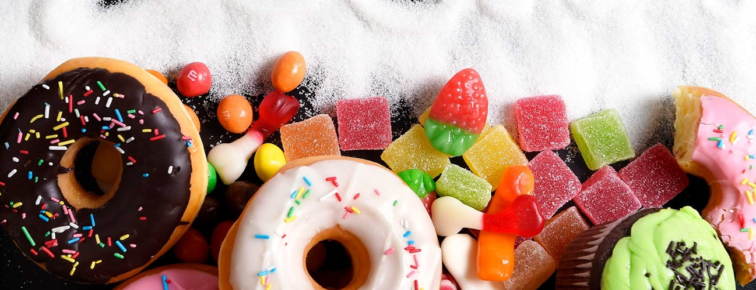
Motivation and hypotheses
Although sugar is the key cause of obesity (Yu et al., 2022), there is limited research exploring what can influence individuals to consume less sugar.

Slide 3
Motivation and hypotheses
Earlier studies have focused on sugar-related labels and the results are inconsistent (e.g., Bialkova et al., 2016).

Slide 4
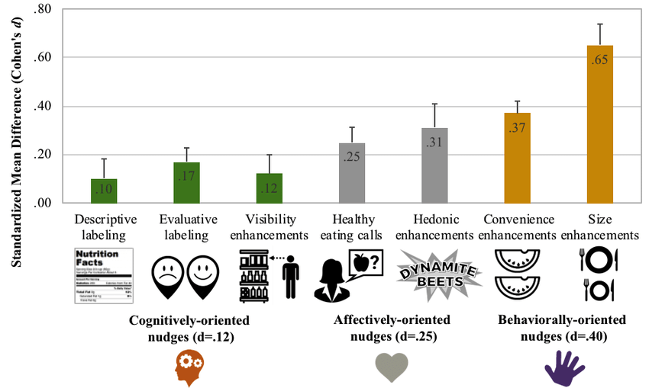
Motivation and hypotheses
However, “healthy eating calls” can, in general, more effective (Cadario and Chandon, 2019).
“Healthy eating calls” are defined as written or oral injunctions.

Slide 5
Motivation and hypotheses
In our study, we hypothesized that (H1) a healthy eating call can be effective in reducing consumers’ willingness to pay (WTP) for sugar-containing food.
In order to maximize persuasion, we designed the healthy eating call so that:
it is communicated by a health expert (Deutsch and Gerard, 1955)
it is not a single sentence, but an entire narrative (Binder et al., 2020)

Slide 6
Motivation and hypotheses
Apart from the behavioral effect, we are also interested in investigating which aspects of neural responses to the healthy eating call can predict the efficacy of expert persuasion.
The intersubject correlation (ISC) measures to what extent do all brains work alike during natural conditions (Hasson et al., 2004) and is an index of attention (Ki et al., 2016).

Slide 7
Motivation and hypotheses
ISC has been successfully used to predict population-wide music popularity (Leeuwis et al., 2021), movies’ box-office performance (Christoforou et al., 2017).
We hypothesized that (H2) high ISC during listening to the healthy eating call will result in a large decrease in the WTP for sugar-containing products.

Slide 8
Motivation and hypotheses
Finally, in order to better understand the neural mechanisms underlying expert persuasion, we also investigated how the healthy eating call affects particular event-related potentials (ERPs) elicited by viewing sugar-containing products that may prompt WTP decisions
The P300 amplitude is increased, when seeing products that fit one’s preferences (Wang and Han, 2014), products that are recommended by others (Guo et al., 2016), and products that one is willing to buy (Jones et al., 2012; Lin et al., 2017)
Thus, we hypothesized that (H3) the P300 amplitude can predict WTP

Slide 9
Experiment 1
Behavioral

Slide 10
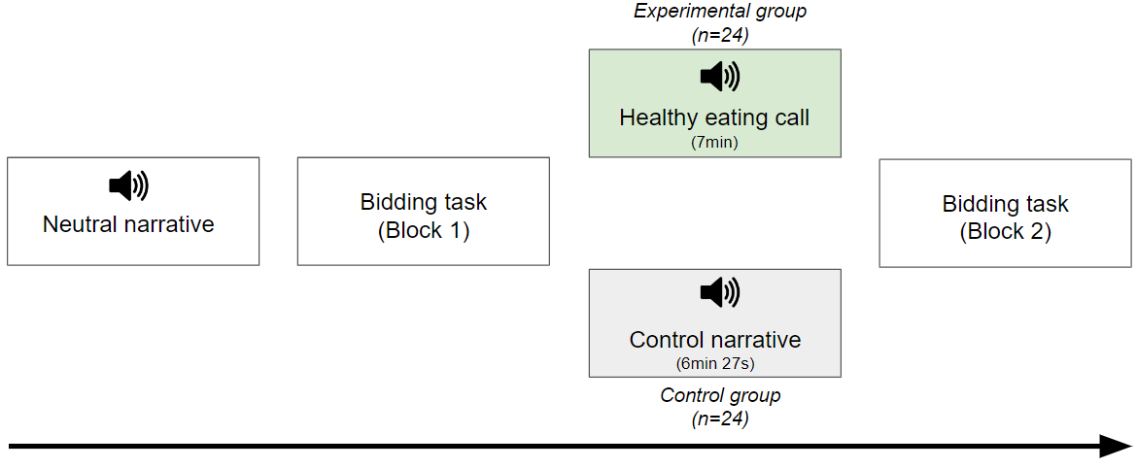
Participants and experimental design
48 participants (60% females, aged 18-44 years)
All of them mentioned that they eat sweets in general
They were asked to not eat anything for at least 3 hours before the experiment

Slide 11
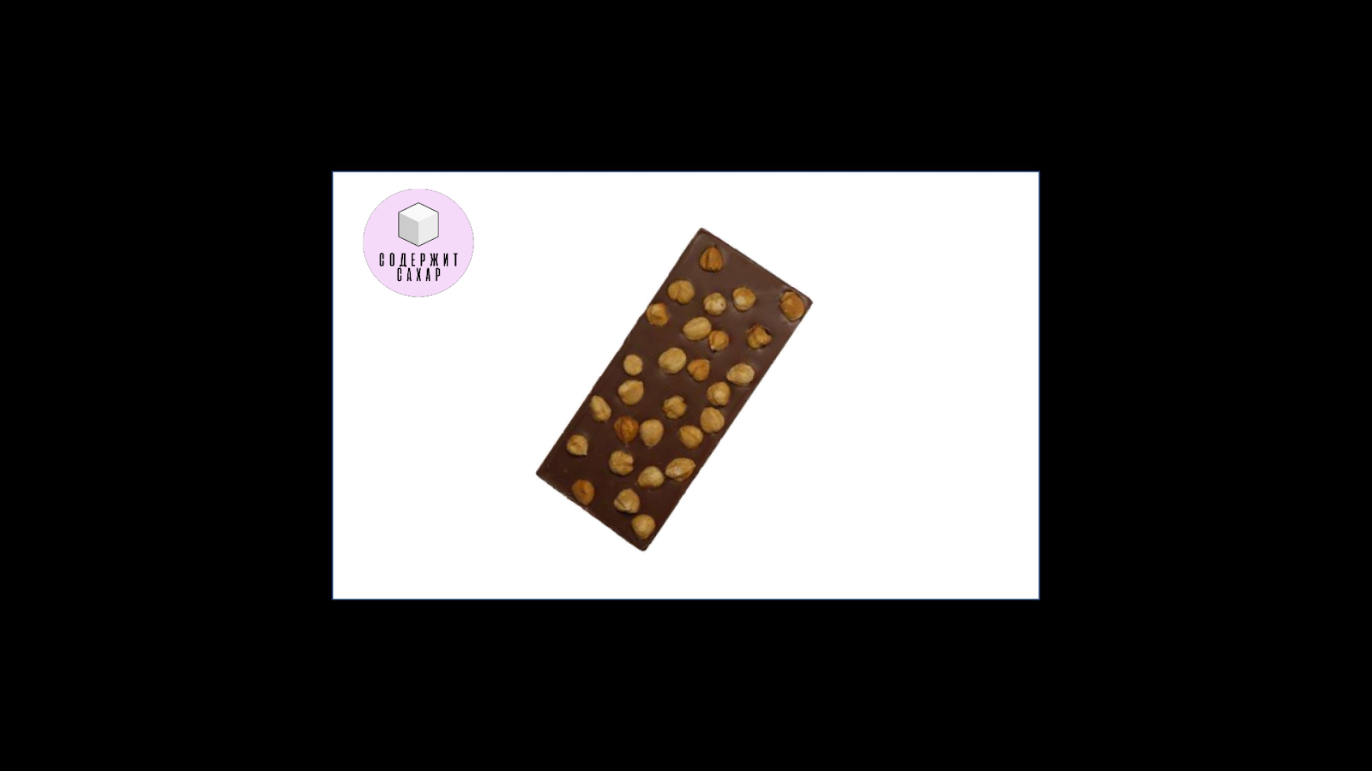
Bidding task
Each block consisted of 60 trials: 30 products labelled as “sugar-containing” and 30 as “sugar-free”
At the beginning, participants received an endowment of 150 rubles to use in the task.
The Becker-DeGroot-Marschak auction was used in order to measure individual preferences and each participant’s exact WTP for every product (Plassman et al., 2007; Becker et al., 1964).
4s 5s max 2-6s

Slide 12
Food stimuli
30 sugar-containing | 30 sugar-free
The two categories did not differ in their perceived healthfulness, sweetness, tastefulness and WTP, as assessed by an independent cohort of 12 participants.

Slide 13
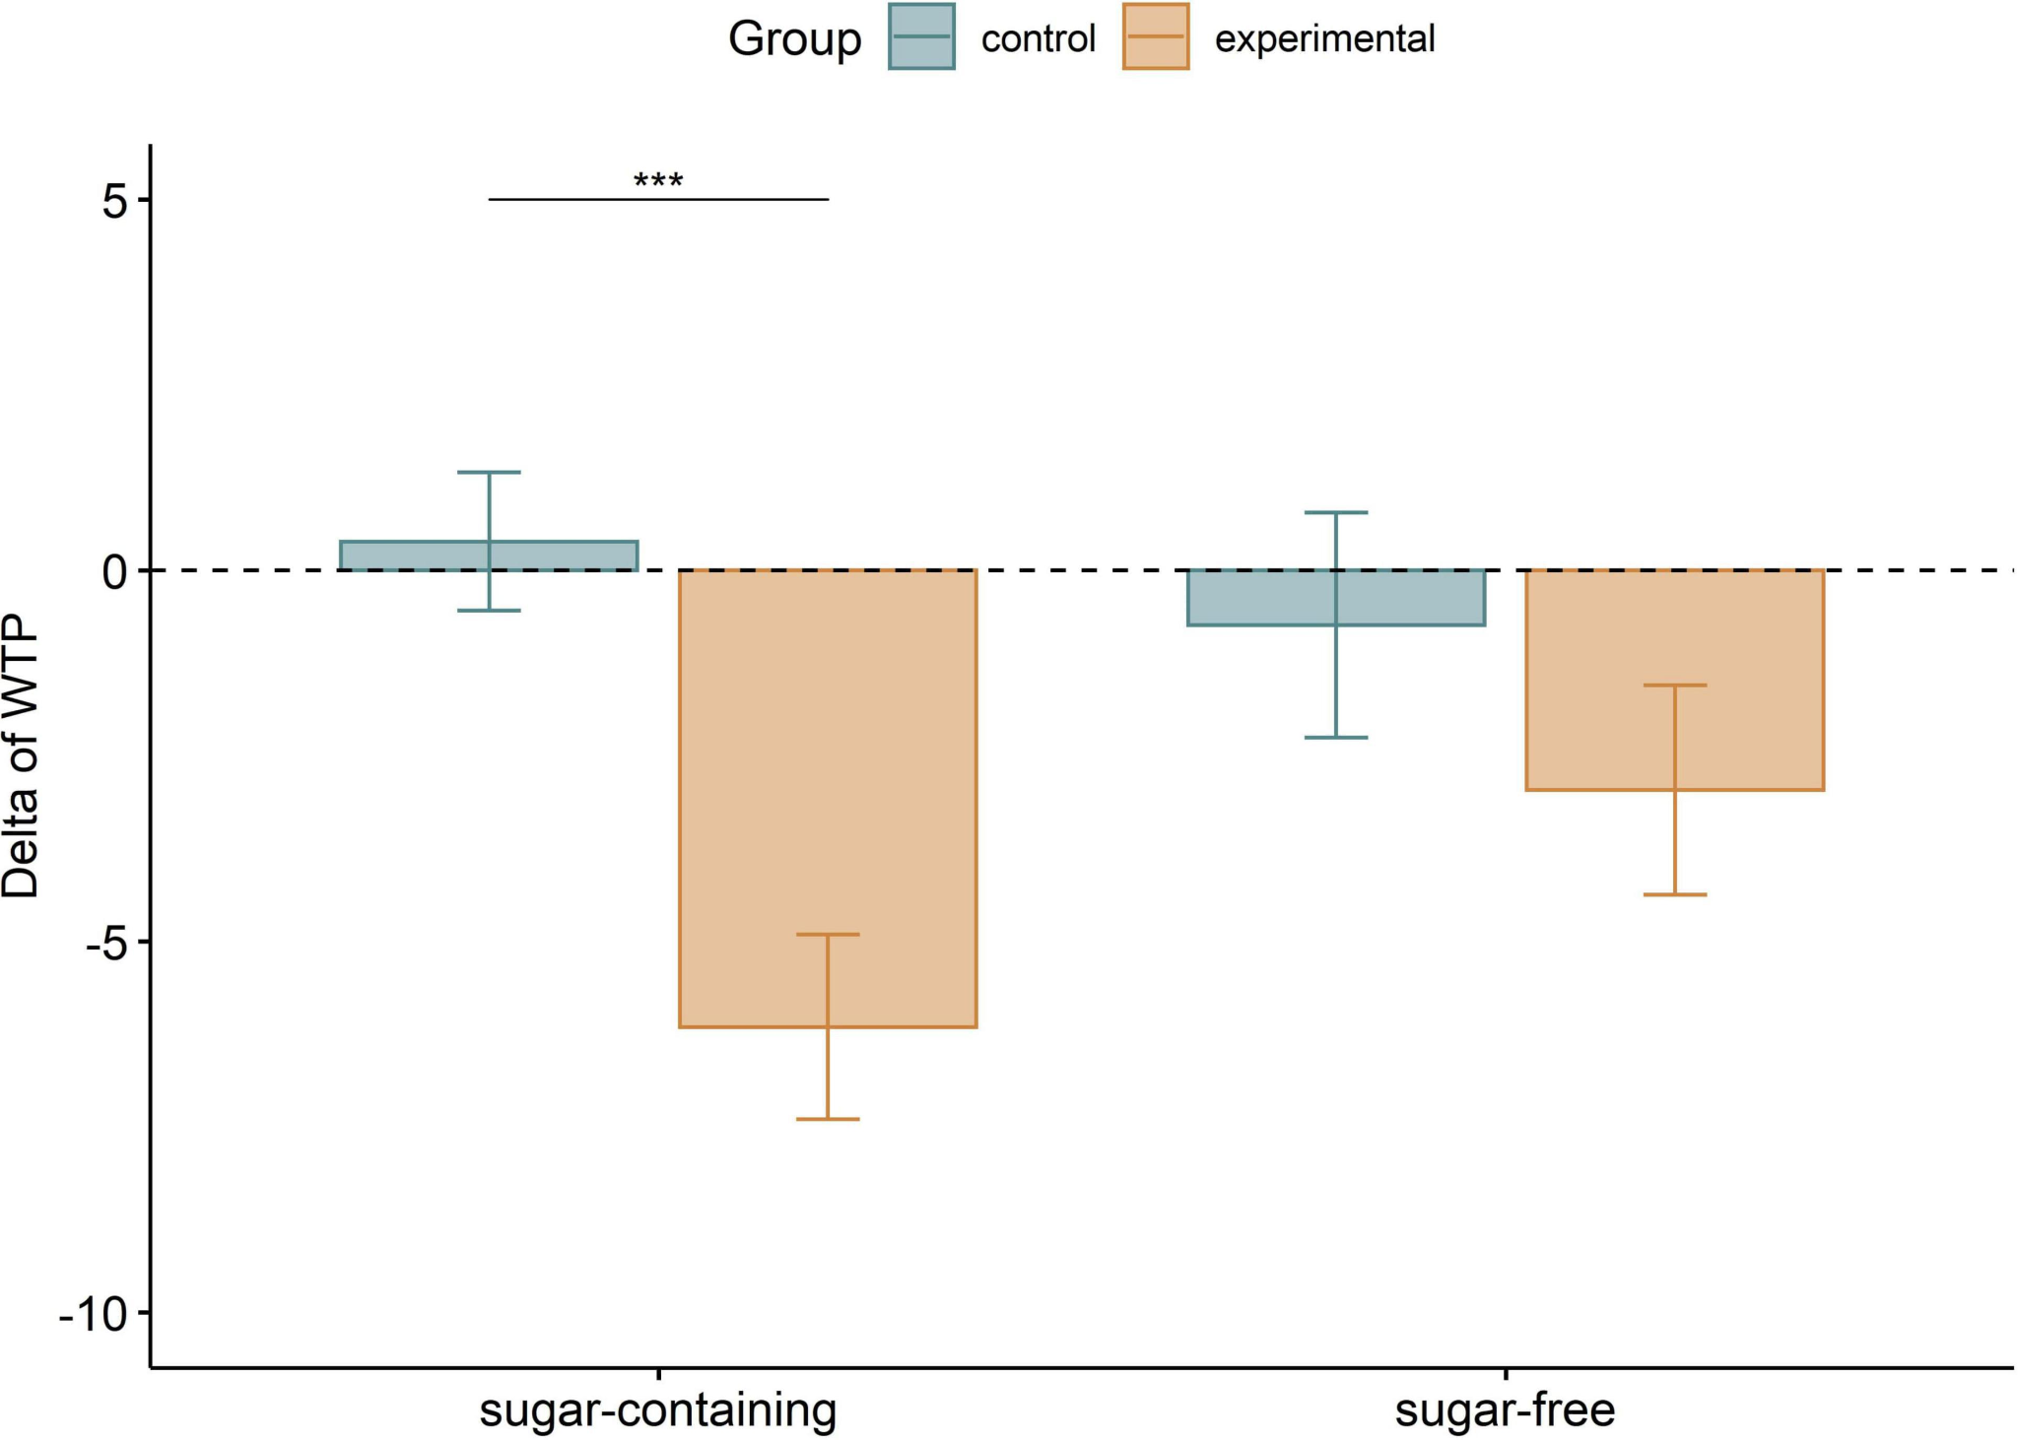
Results
Delta of WTP: the WTP for each food product in Block 2 subtracted by the WTP for the corresponding product in Block 1

Slide 14
Conclusion
Our findings support earlier studies positing that consumers may conform to healthy eating calls by rather devaluating unhealthy food products than by increasing the value of healthy ones (Cadario and Chandon, 2019)
The above is also in line with the notion of negativity bias (Baumeister et al., 2001)
Overall, our study extends previous work on nudging healthy food choices through narratives (Binder et al., 2020)

Slide 15
Experiment 2
EEG

Slide 16
Participants and experimental design
46 participants (58% females, aged 18-35 years) participated in the experiment
All of them mentioned that they eat sweets in general
They were asked to not eat anything for at least 3 hours before the experiment

Slide 17
Stimuli
30 sugar-containing | 30 sugar-free | 30 non-edible

Slide 18
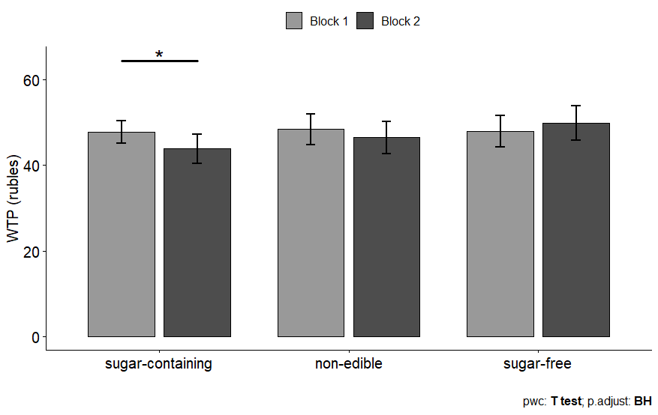
Behavioral results
There was a statistically significant interaction between Block and Condition on the WTP (p = .008).

Slide 19
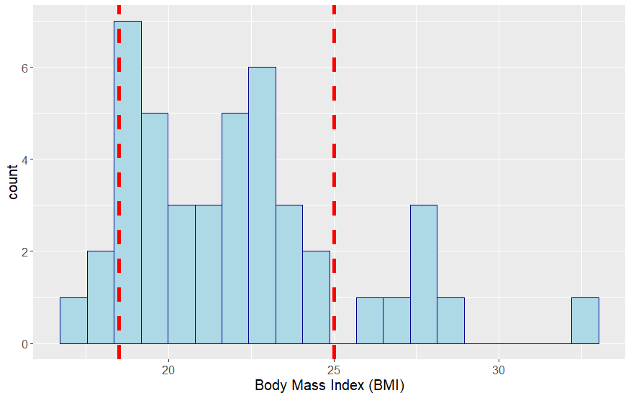
Does Body Mass Index (BMI) moderates the effect?
Participants BMI was calculated as kg/m².
Effect | p-value
BMI | .458
Condition | .713
Block | .227
Condition: BMI | .494
Block:BMI | .076
Block:Condition | .004
Condition:Block:BMI | .184
underweight normal overweight

Slide 20
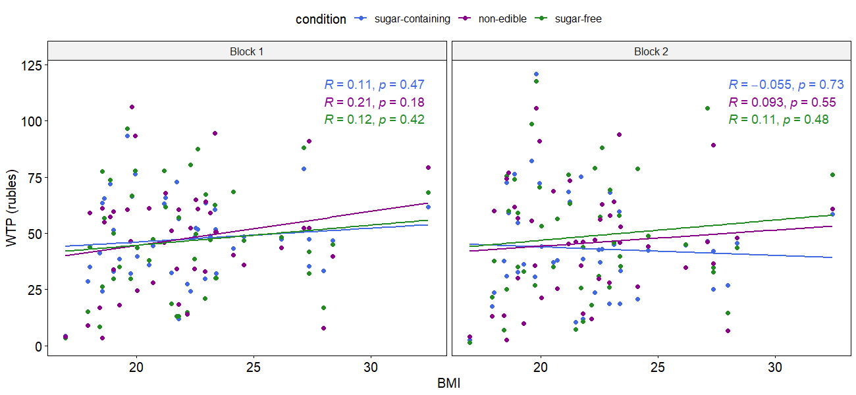
Does Body Mass Index (BMI) moderates the effect?

Slide 21
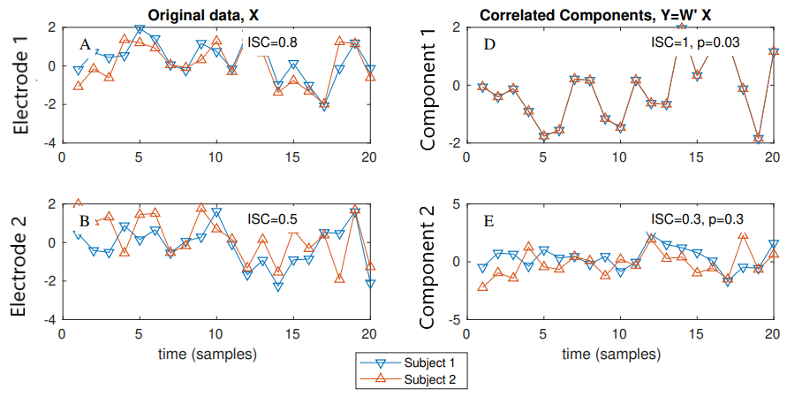
Intersubject correlation analysis
We project the data to components that capture the maximal correlation between subjects (i.e. ISC)
Projection of the data with maximal correlation (ISC=1)
The recordings of
two electrodes and
two subjects
Projection of the data with lower ISC
Parra et al., 2019

Slide 22
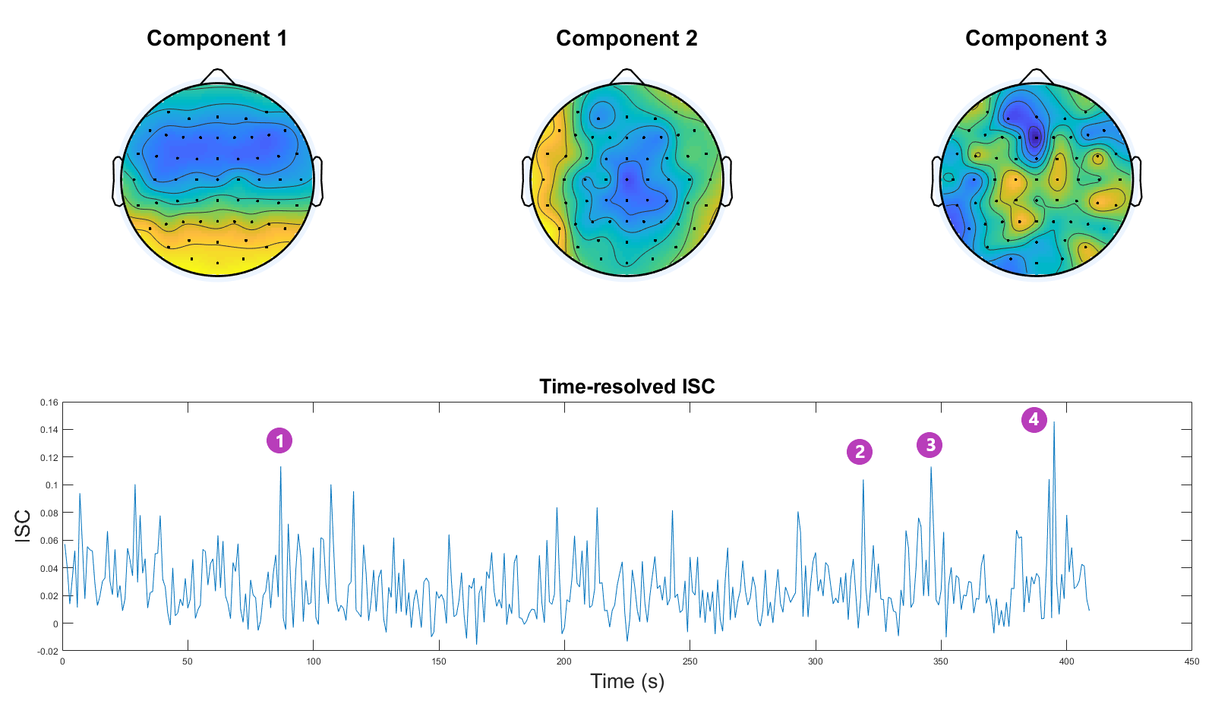
Intersubject correlation analysis
The ISC was calculated by extracting components of the data that explain the maximal correlation between participants. The sum of the 3 strongest components is reported.
«Studies show that sugar is more addictive than cocaine»
«Sugar also affects the health of your eyes»
«Hormones that regulate digestion are neglected»
«That’s all about the health benefits of giving up sugar»

Slide 23
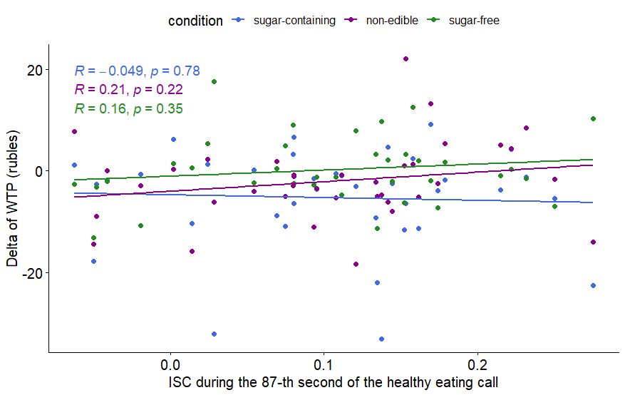
Intersubject correlation analysis
ISC was not predictive of subsequent WTP decisions.
Note: The results were insignificant in all time windows - here, data from only one time window is used for visualization.

Slide 24
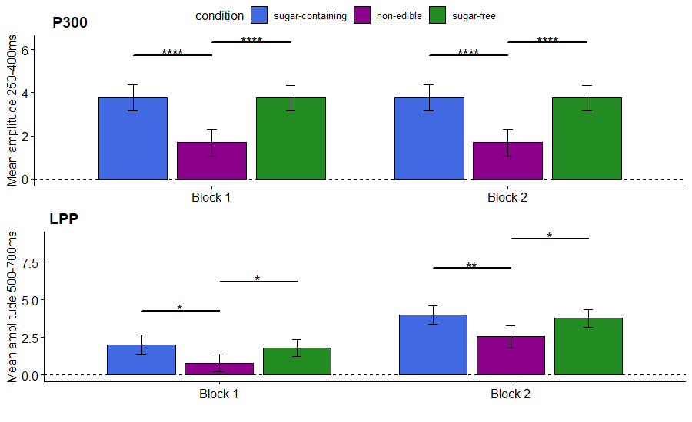
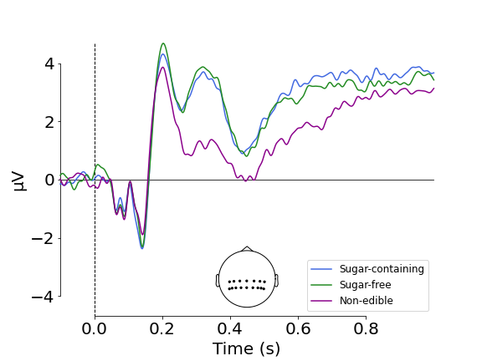
Quality control of ERP data
The amplitude of the P300 and the LPP in response to food stimuli was stronger in response to food vs. non-food stimuli, consistently with previous studies (Nijs et al., 2010; 2009; 2008).

Slide 25
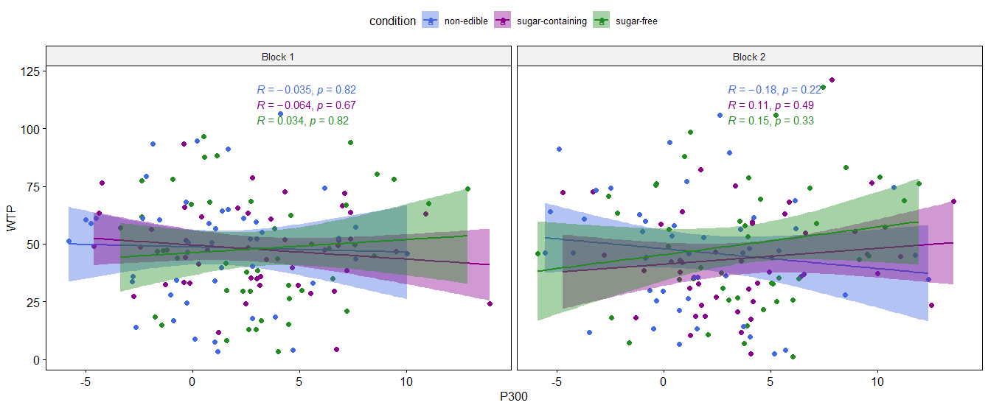
P300 and WTP
P300 amplitude was not predictive of subsequent WTP decisions.

Slide 26
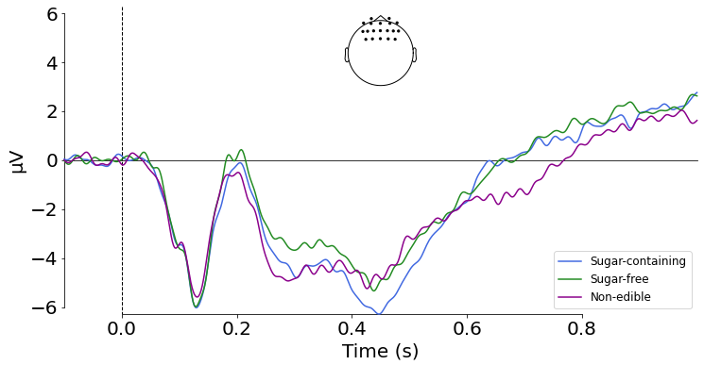
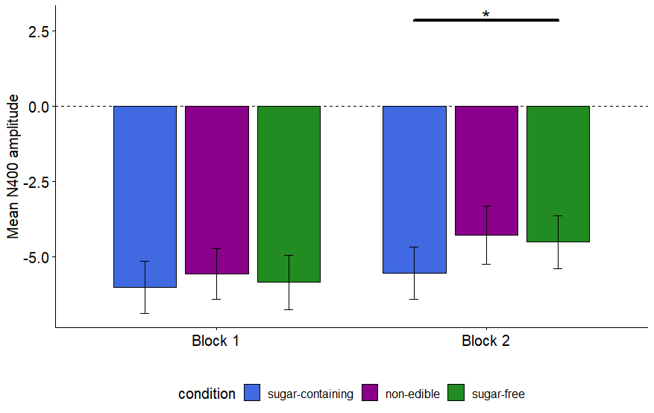
ERPs in response to sugar-containing vs. sugar-free
An exploratory analysis showed that after the healthy eating call, sugar-containing products elicit the strongest N400 amplitude.
A frontal N400 is associated with the experience of guilt (Leng et al., 2016). A centro-frontal N400 is observed in response to incongruent pictures (Kutas & Hillyard, 1980; 2011).

Slide 27
General discussion
The expert’s healthy eating call decreased the WTP for sugar-containing food
ISC during listening to the expert did not predict the efficacy of expert persuasion
We plan to examine whether spatiotemporal patterns of EEG signals during the healthy eating call are predictive of expert persuasion.
The P300 amplitude in response to a product did not predict the WTP for this product
After the healthy eating call, participants exhibited a stronger N400 in response to sugar-containing food compared to the other stimuli. Although this result has to be considered with caution due to an insignificant interaction of Block and Condition, it may reflect a mismatch between their desire to eat the product and its perceived unhealthiness.

Slide 28
Thank you
Many thanks to my colleagues who contributed in this project!
All materials used in our experiments are publicly available at https://osf.io/6ewy5/

