Slide 1
Electrogastrography as a method for studying emotional states
By Alfred Essel

Slide 2
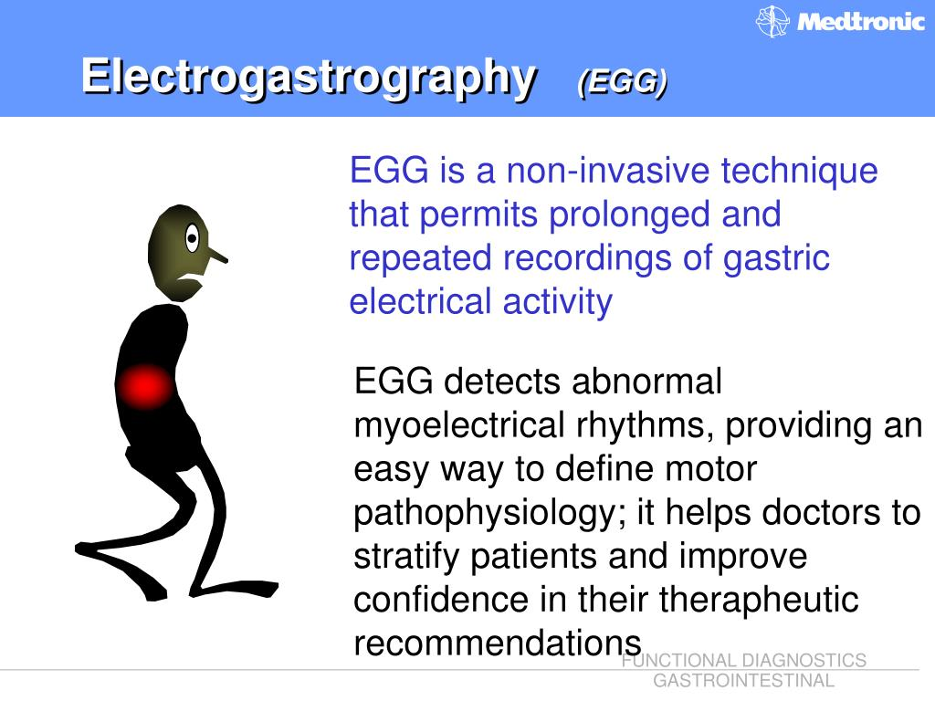
Electrogastrography
A technique using electrodes positioned on the abdominal skin to pick up stomach rhythmic Slow Waves (SW) (CHANG, 2005).

Slide 3
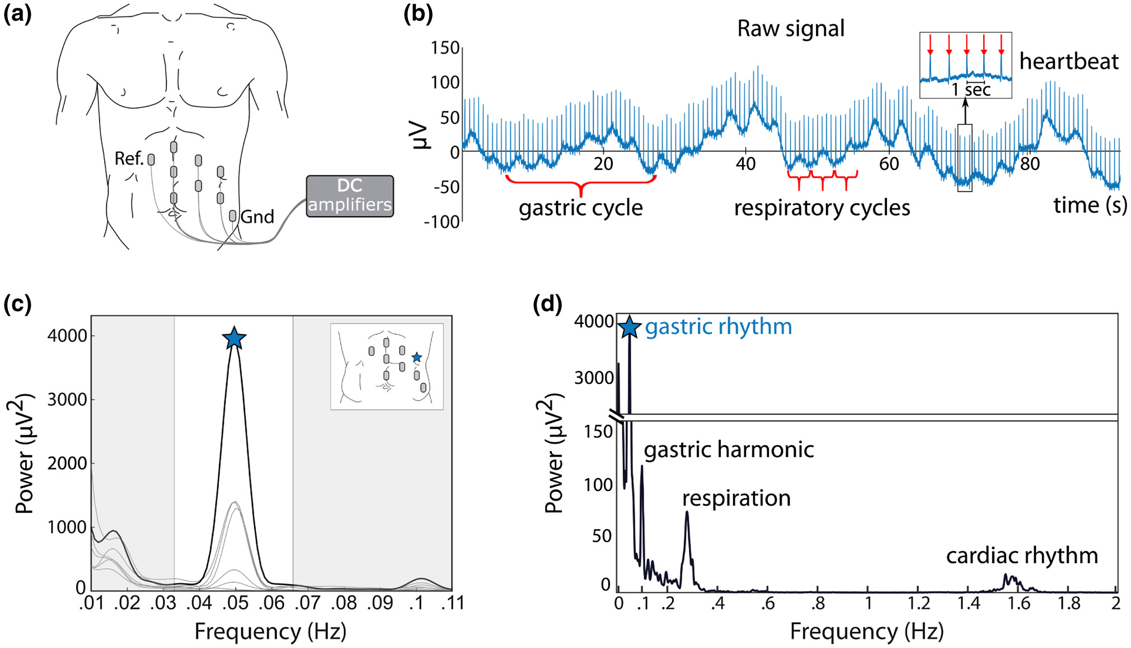
Electrogastrography and Psychophysiology
Wolpert, et al (2020). Electrogastrography for psychophysiological research: Practical considerations, analysis pipeline, and normative data in a large sample. Psychophysiology, 57(9), e13599. https://doi.org/10.1111/psyp.13599

Slide 4
Electrogastrography and Psychophysiology
The EGG has so far mostly been used for clinical purposes in gastroenterology but represents an interesting tool in psychophysiology (CHANG, 2005).
Compared to other literature (eg. electrocardiography), practical recommendations and normative data are abundant.
Literature on EGG in humans remains scarce (Wolpert, Rebollo, & Tallon‐Baudry, 2020).
However, effort was made to bring forth some of these scarce literature.

Slide 5
Going with our Guts: Potentials of Wearable Electrogastrography (EGG) for Affect Detection
Vujic, Tong, Picard & Maes, (2020)
The stomach or gastric signal is an unexplored modality that could offer new affective information.
The goal was to evaluate the relationship between EGG and affect.

Slide 6
Participants
Thirty-three (33) Participants
  ages 20 to 59,
  16 males, 17 females with normal to corrected-to-normal hearing and vision,
  no known gastrointestinal, neurological, or psychiatric disorders
  ability to sit still and stay awake during movie sequences were recruited.

Slide 7
Stimulus
Seven Movie Clips
  Three Positive
  Three Negative
  One neutral
  Emotions
    Happiness
    Love
    Amusement
    Sadness
    Fear
    Disgust

Slide 8
EEG Placement
EGG signals were recorded using disposable Ag AgCl electrodes (Skintact, F-301 gel electrode) connected to the OpenBCI amplifier sampled at 250 Hz with no filtering in hardware.
Finding
It was found that negative stimuli attenuate EGG’s indicators of parasympathetic activation, or "rest and digest" activity.

Slide 9
Effects of violent video stimuli on gastric activity: Electrogastrography-based case study. Popović, Miljković, Knežević, & Lazarević, (2020)
Aim | acquire preliminary insights into efficacy and performance of EGG
Participants | Two healthy female participants
Stimulus | Violent video
Emotion | Stress or “gut feeling”
EGG | Placement of 5 Ag/AgCl self-adhesive surface electrodes was done to provide three separate bipolar recording channels as proposed in (Popović et al., 2019).
Finding | This preliminary investigation showed promising results regarding the assessment of emotionally induced variations in gastric activity by the means of the EGG. Further work should include EGG signals recorded in a larger sample with suitable statistical analysis, to derive more robust conclusions.

Slide 10
Bradygastric activity of the stomach predicts disgust sensitivity and perceived disgust intensity. By Meissner, Muth & Herbert, (2011)
Aim | investigate gastric and non-gastric autonomic responses to disgusting pictures
Participants | Twenty-six healthy participants (12 males, 14 females, aged 20–33 years)
Stimulus | Sixty pictures were selected from the International Affective Picture System. 30 explicitly disgusting and 30 pictures with affectively neutral content.
Emotion | Arousal, disgust
EGG | Gastric myoelectrical activity was measured using two Ag/AgCl electrodes placed at standard positions on the skin above the abdomen
Finding | The results suggest that feelings of disgust may be specifically related to increased bradygastria, which may represent a prodromal sign of vomiting.

Slide 11
Does vivid emotional imagery depend on body signals?.
By Vianna, Naqvi, Bechara & Tranel(2009).
Hypothesis
  vivid emotional imagery would be accompanied by strong increases in gastrointestinal and sympathetic nervous system activity

Slide 12
Participants
  17 healthy participants (8 males, 9 females)
Stimulus
  Emotional Imagery (remembering autobiographical episode)
Emotion
  Happiness
  Fear Disgust
  Sadness
  Anger

Slide 13
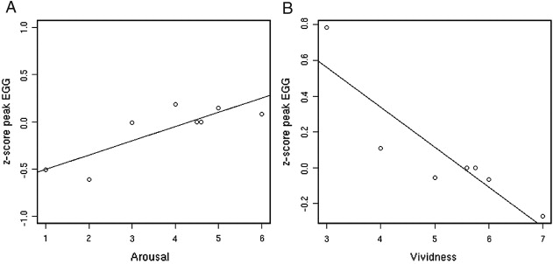
EGG was recorded using a standard 3 leads montage (Einthoven lead 2 configuration)
Finding
  contrary to prediction, there was a strong but negative correlation between the maximum spectral z-score values of the EGG and vividness ratings

Slide 14
Effects of audio stimulation on gastric myoelectrical activity and sympathovagal balance in healthy adolescents and adults.
By Chen, Xu, Zhao, Yin, Sallam, & Chen, (2008).
Alteration of gastric myoelectrical and autonomic activities with audio stimulation in healthy humans.
By Chen, Xu, Wang & Chen, (2005).

Slide 15
 | Chen et al 2008 | Chen et al 2005
Aim | investigate the effects of different audio stimulations on gastric myoelectrical activity and sympathovagal balance in adolescents compared with adults | investigate the effects of music or noise on gastric myoelectrical activity and autonomic function in healthy volunteers
Participants | 11 adults and 12 adolescents | 10 healthy volunteers
Stimulus | classical music and household noises | Classical Music and Noises
Emotion | Emotional Stress | Cold or Emotional Stress
EGG | Three silver-silver chloride EGG electrodes attached to the abdominal area. Two epigastric electrodes (one at the midline between xiphoid process and the umbilicus and the other 5cm away 45 degrees to the upper-left of the subject) were used to yield a bipolar EGG signal. The third as a reference. | Three silver-silver chloride ECG electrodes were placed on the abdominal skin. Two epigastric electrodes were connected to yield a bipolar EGG signal. The other electrode was used as a reference.
Finding | Gastric slow waves and the sympathovagal balance are more strongly affected by audio stimulation in adolescents than in adults. | audio stimulation, both music and noise, alter the rhythmicity of gastric slow waves.

Slide 16
Effects of music on gastric myoelectrical activity in healthy humans.
By Lin, Chang, Chu, Huang, Chao & Hsieh, (2007)
Aim | the effects of listening to music on gastric myoelectrical activity in healthy humans.
Participants | 17 healthy volunteers (12 men and five women)
Stimulus | music
Emotion | Enjoyment
EGG | Three disposable EGG electrodes were placed on the abdominal skin. Two epigastric electrodes were connected to yield a bipolar EGG signal. One electrode was placed at the midline of the abdomen halfway between the xiphisternum and the umbilicus. Another electrode was placed on the 45° line, 5 cm above and to the left of the first electrode. The third electrode was placed at the right flank beneath the rib cage and was used as a reference.
Finding | Listening to enjoyable music increases the amplitude of gastric myoelectrical activity in healthy humans. Music therapy may improve gastric motility and may be used to stimulate gastric emptying.

Slide 17
Inhibitory effects of stress on postprandial gastric myoelectrical activity and vagal tone in healthy subjects. Yin, Levanon & Chen, (2004).
Aim | investigate gastric myoelectrical activity and vagal activity in response to stress
Participants | Ten healthy participants (4 males, 6 females)
Stimulus | Horror movies, guided meditation tape
Emotion | Emotional stress
EGG | Two epigastric electrodes were connected to yield a bipolar EGG signal, while the last electrode was used as a reference.
Finding | stress has inhibitory effects on postprandial GMA, and these inhibitory effects may involve both vagal and sympathetic pathway.

Slide 18
Conclusion
All the researchers used healthy participants but differed in the number of participants used.
Stimulus for eliciting emotions differed from research to research but basically fell within
  Videos
  Music
  Pictures
  Imagery
  There seem to be protocol for the placement of the EGG electrodes, but some differed on the number of electrodes to be used

Slide 19
Conclusion
Findings were not consistent across the researches reviewed.
However, they all recommended that more researches be organised in this area of EGG and Emotions.
Wolpert et al (2020) suggested that electrode coverage should extend to lower abdominal locations than the current clinical guidelines.

Slide 20
References
Chang, F. Y. (2005). Electrogastrography: basic knowledge, recording, processing and its clinical applications. Journal of Gastroenterology and Hepatology, 20(4), 502-516. https://doi.org/10.1111/j.1440-1746.2004.03751.x
Chen, D. D., Xu, X., Wang, Z., & Chen, J. D. (2005). Alteration of gastric myoelectrical and autonomic activities with audio stimulation in healthy humans. Scandinavian Journal of Gastroenterology, 40(7), 814-821. https://doi.org/10.1080/00365520510015656
Chen, D. D., Xu, X., Zhao, Q., Yin, J., Sallam, H., & Chen, J. D. (2008). Effects of audio stimulation on gastric myoelectrical activity and sympathovagal balance in healthy adolescents and adults. Journal of Gastroenterology and Hepatology, 23(1), 141-149. https://doi.org/10.1111/j.1440-1746.2007.05123.x

Slide 21
Lin, H. H., Chang, W. K., Chu, H. C., Huang, T. Y., Chao, Y. C., & Hsieh, T. Y. (2007). Effects of music on gastric myoelectrical activity in healthy humans. International Journal of Clinical Practice, 61(7), 1126-1130. https://doi.org/10.1111/j.1742-1241.2006.01090.x
Meissner, K., Muth, E. R., & Herbert, B. M. (2011). Bradygastric activity of the stomach predicts disgust sensitivity and perceived disgust intensity. Biological Psychology, 86(1), 9-16. https://doi.org/10.1016/j.biopsycho.2010.09.014
Popović, N. B., Miljković, N., Knežević, G., & Lazarević, L. B. (2020). Effects of violent video stimuli on gastric activity: Electrogastrography-based case study. Empirical Studies in Psychology, 33. 32-36

Slide 22
Vianna, E. P. M., Naqvi, N., Bechara, A., & Tranel, D. (2009). Does vivid emotional imagery depend on body signals?. International Journal of Psychophysiology, 72(1), 46-50. https://doi.org/10.1016/j.ijpsycho.2008.01.013
Vujic, A., Tong, S., Picard, R., & Maes, P. (2020). Going with our guts: potentials of wearable electrogastrography (EGG) for affect detection. In Proceedings of the 2020 International Conference on Multimodal Interaction (pp. 260-268).
Wolpert, N., Rebollo, I., & Tallon‐Baudry, C. (2020). Electrogastrography for psychophysiological research: Practical considerations, analysis pipeline, and normative data in a large sample. Psychophysiology, 57(9), e13599. https://doi.org/10.1111/psyp.13599

Slide 23
Yin, J., Levanon, D., & Chen, J. D. Z. (2004). Inhibitory effects of stress on postprandial gastric myoelectrical activity and vagal tone in healthy subjects. Neurogastroenterology & Motility, 16(6), 737-744. https://doi.org/10.1111/j.1365-2982.2004.00544.x

