Slide 1







Psychophysiological Study of Video Sharing
Student: Danila Shelepenkov
Supervisor: Vladimir Kosonogov
Behavioral study
EEG study
Stimulus collection
Data
Collection
Analysis
Data
Collection
Analysis
April
2023
May
2023
September
2022
December
2022
February
2023
March
2023
Moscow 2023

Slide 2


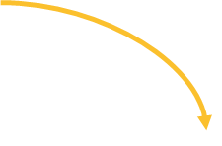



BACKGROUND
This study
Marketing
Sharing study
(neuroscience)
Berger, J. (2011). Arousal increases social transmission of information
Berger, J., & Milkman, K. L. (2012). What makes online content viral?. Journal of marketing research
Fischer et al. (2018). Frontal Alpha Asymmetry and Theta Oscillations Associated With Information Sharing Intention
Background
Introduction

Slide 3
BACKGROUND
This study
Take information from Tik-Tok
Likes
Comments
Views
Reposts
Record Psychophysiology
EEG
EDA
Heartbeat
EMG
Try to predict Tik-Tok scores
Correlations/Regression
Random Forest Classification
Background
Introduction

Slide 4
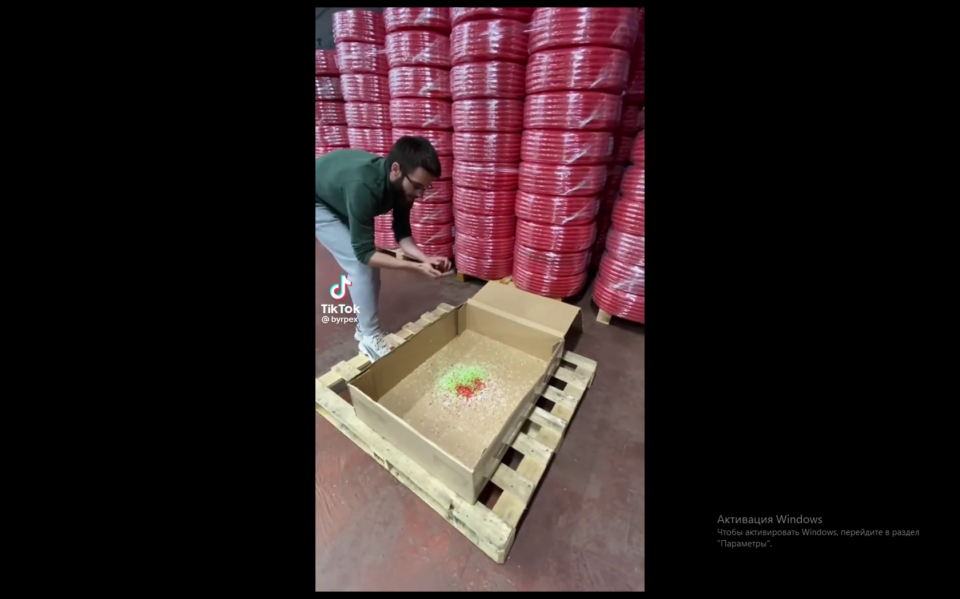
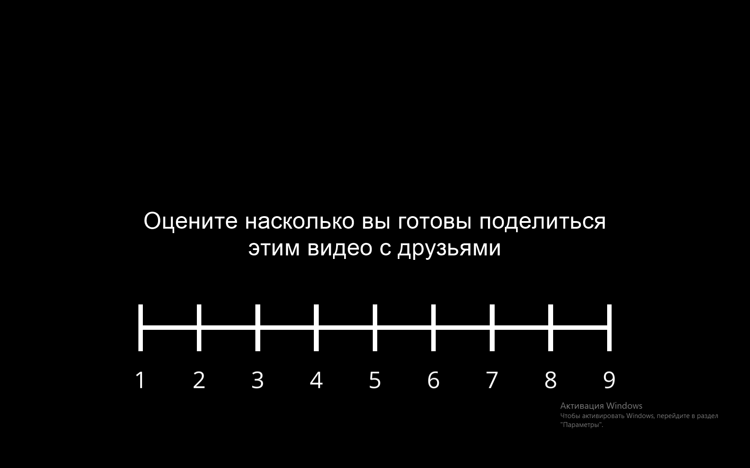

Methods
Task Stimuli
Tik-Tok
1 | 2 | 3 | 4 | 5 | 6 | 7 | 8 | 9
7.69% | 7.69% | 7.69% | 12.82% | 12.82% | 12.82% | 12.82% | 12.82% | 12.82%
Group 1: 13.8 seconds (SD = 2.34) mean corresponds to 96.97% SV
Group 2: 14.6 seconds (SD = 2.25) mean corresponding to 88.03% SV
Group 3: 12.2 seconds (SD = 3.02) mean corresponding to 77.53% SV
Group 4: 13.3 seconds (SD = 2.67) mean corresponding to 65.12% SV
Group 5: 11.9 seconds (SD = 2.66) mean corresponding to 50.27% SV
Group 6: 12.6 seconds (SD = 2.65) mean corresponding to 39.16% SV
Group 7: 12.0 seconds (SD = 2.16) mean corresponding to 25.62% SV
Group 8: 12.6 seconds (SD = 2.03) mean corresponding to 12.15% SV
Group 9: 11.8 seconds (SD = 3.0) mean corresponding to 3.03% SV
Средняя оценка группы: 2
Methods
Methods

Slide 5
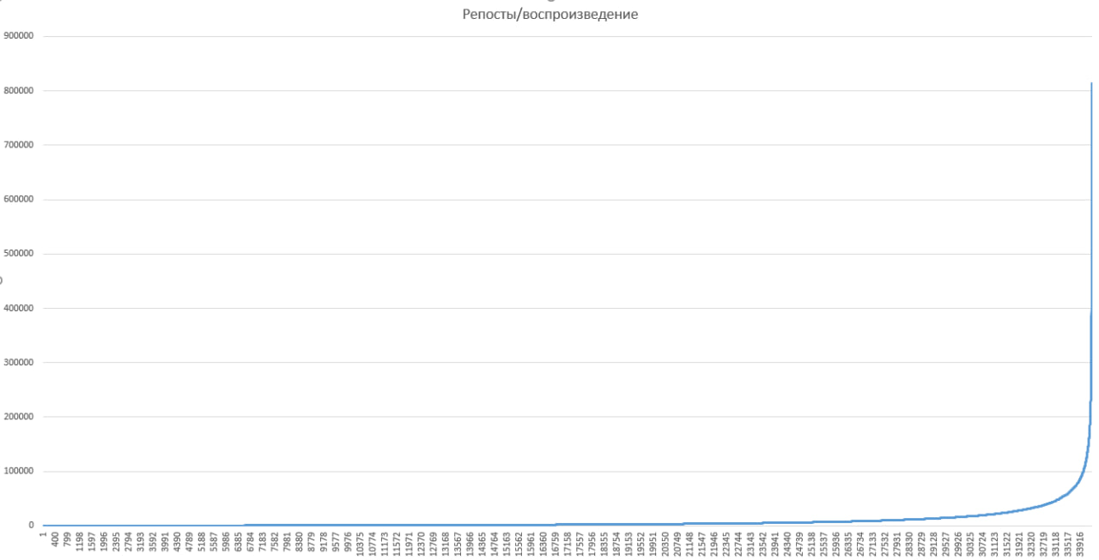
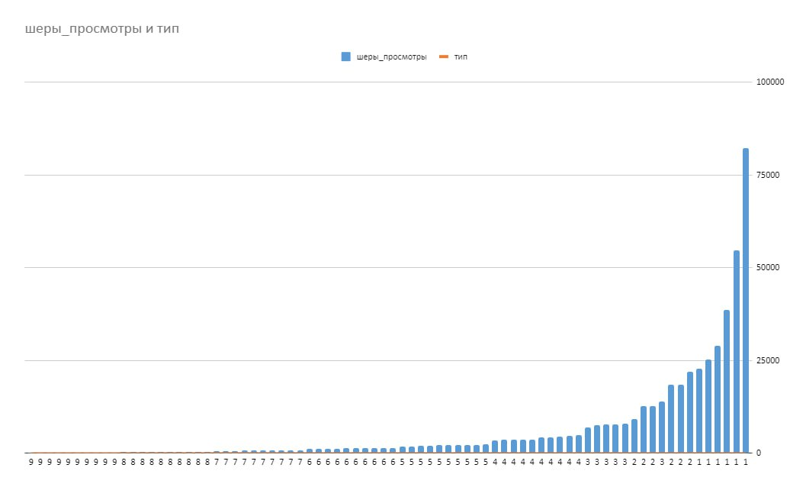
Methods
For 34 thousand videos For 78 videos
Средняя оценка группы: 2
Methods
Methods

Slide 6
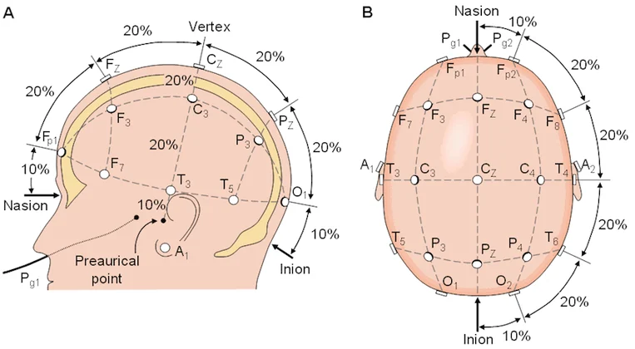
Methods
Electromyographic activity of zygomaticus major
Electromyographic activity of corrugator supercilii
Skin conductance from two fingers
Heartbeat was recorded with a photoplethysmograph
Средняя оценка группы: 2
Methods
Methods

Slide 7
Sample
Participants
Main age Tik-Tok in Russia 18-24 (54.6%)
 | N | Age |  | Tik-Tok
Female | 15 (13) | 21.46 | 46% | 52.2%
Male | 15 | 22.73 | 53% | 47.8%
All | 30 (28) | 21.37
Средняя оценка группы: 2
Methods
Methods

Slide 8



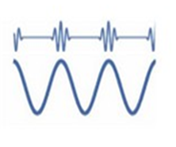
Goals
Goals:
Find virality correlates for short videos
Test the hypothesis about the contribution of emotional arousal to video virality
FAA = alpha F4 - alpha F3
Arousal + valence
(alphaF4 / betaF4) - (alphaF3 / betaF3)
(betaF3 + betaF4) / (alphaF3 + alphaF4)
Hypothesis
Hypothesis

Slide 9
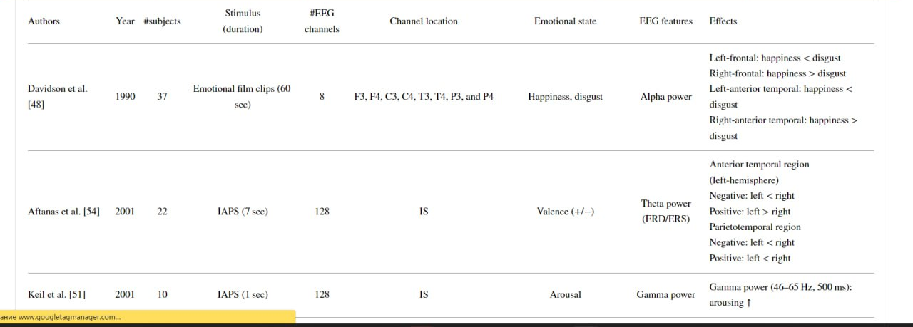
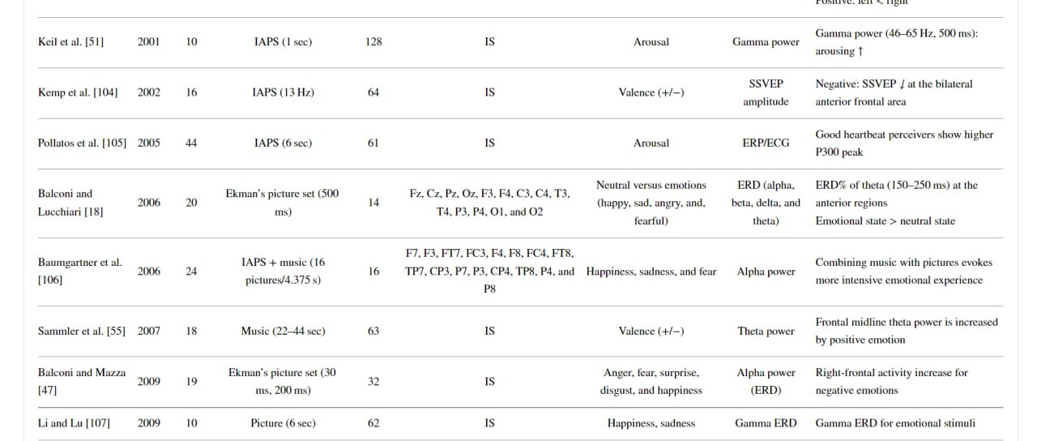
Goals
Hypothesis
Hypothesis

Slide 10
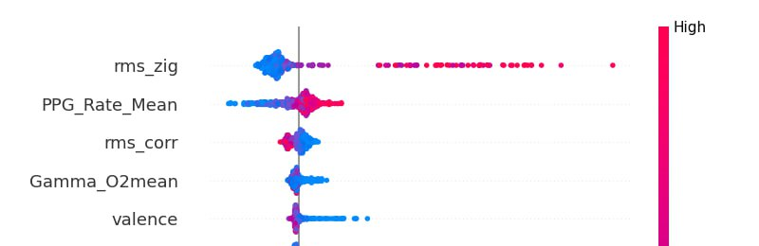
Results
 | Heart Rate | Skin conductance | RMS Zygomaticus | RMS Corrugator | Arousal index | Valence index | FAA
Answer | 0.37 (p-value = 0.001) | 0.41 (p-value = 0.0009) | 0.31 (p-value = 0.0048) | -0.33 (p-value = 0.004) | 0.287 (p-value = 0.0009) | -0.255 (p-value = 0.004) | (p-value > 0.05)
expected
expected
expected
unexpected
expected
expected
expected
Regression
Feature value
 | Accuracy | MAE | RMSE
Random Forest regression | 0.23 | 1.86 | 5.05
No
0
3
Results
5

Slide 11
Results
Valence - EMG Zigg (Smile) no significant correlations
Valence - EMG Corr (eyebrow) significant correlations 0.2
Valence - FAA significant correlations 0.3
Arousal - EDA significant correlations 0.44
Arousal - Heart rate significant correlations 0.34
Arousal - Engagement Index significant correlations 0.7 Beta / Alpha
Arousal - Engagement Index by Kislov significant correlations 0.5 (Beta (Cz + Pz + P3 + P4)) / (Alpha (Cz + Pz + P3 + P4)
Arousal - Visual engagement significant correlations 0.51 Beta+Gamma / Alpha in Occipital
Arousal - ISC no significant correlations
No
Results
5

Slide 12
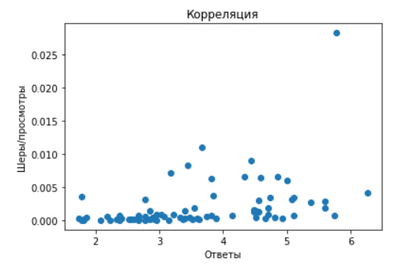
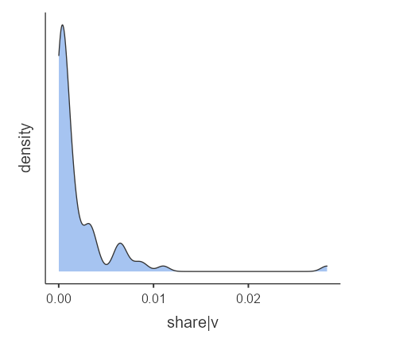
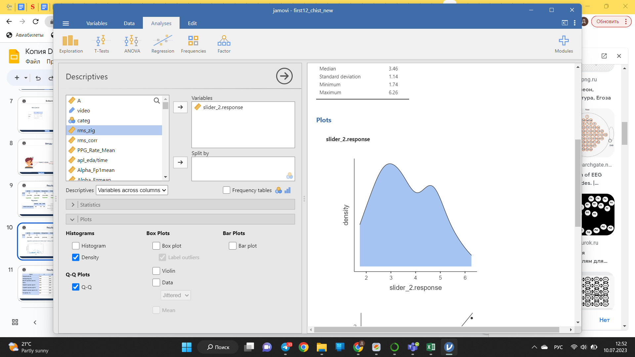
Results
 | Heart Rate | Skin conductance | RMS Zygomaticus | RMS Corrugator | Arousal index | Valence index | FAA
Tik-Tok Share | 0.39 (p-value = 0.001) | 0.5 (p-value = 0.01) | (p-value > 0.05) | -0.26 (p-value = 0.01) | 0.33 (p-value = 0.003) | (p-value > 0.05) | (p-value > 0.05)
Spearman's correlation Answers with TikTok values = 0.615 p < 0.001, Pearson's correlation = 0.394 p < 0.001
No
Results
5

Slide 13
Results
Features | R | R^2 | Adj. R^2 | F | p-value
Participants score (PS) | 0.389 | 0.151 | 0.144 | 13.6 | < 0.001
Psychophysiology (Psy) | 0.558 | 0.312 | 0.274 | 8.26 | < 0.001
Beta (Pz) + Alpha (C4) + Alpha (F8) | 0.391 | 0.153 | 0.119 | 4.46 | 0.006
PS+Phy | 0.576 | 0.332 | 0.285 | 7.34 | < 0.001
PS+BetaPz + Alpha C4 + Alpha F8 | 0.458 | 0.210 | 0.166 | 4.84 | 0.002
Phy+BetaPz + Alpha C4 + Alpha F8 | 0.585 | 0.342 | 0.277 | 5.21 | < 0.001
PS+BetaPz + Alpha C4 + Alpha F8 + Phy | 0.597 | 0.356 | 0.281 | 4.77 | < 0.001
PS + Alpha C4 + Phy | 0.59 | 0.348 | 0.293 | 6.32 | < 0.001
 | 0.5 | 0.253 | 0.243 | 25.7 | < 0.001
EDA
No
Results
5

Slide 14
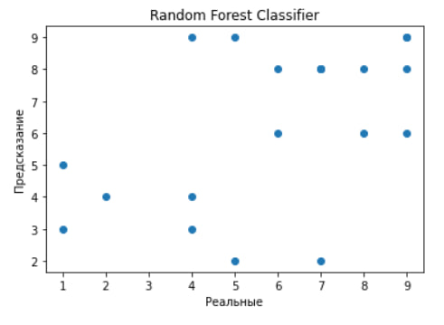
Results
Random = 0.13
Our accuracy for 9 cat. = 0.25
No
Results
5

Slide 15
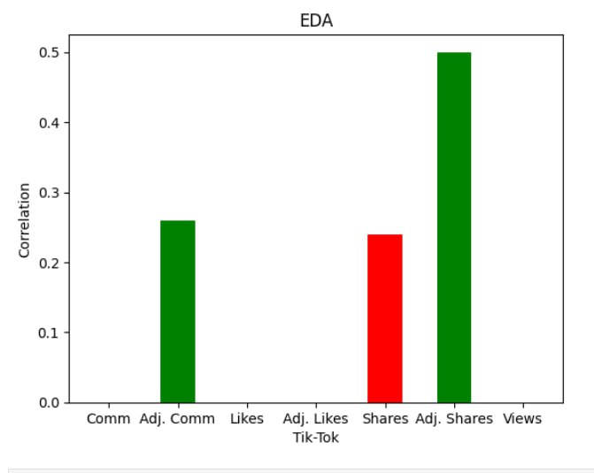
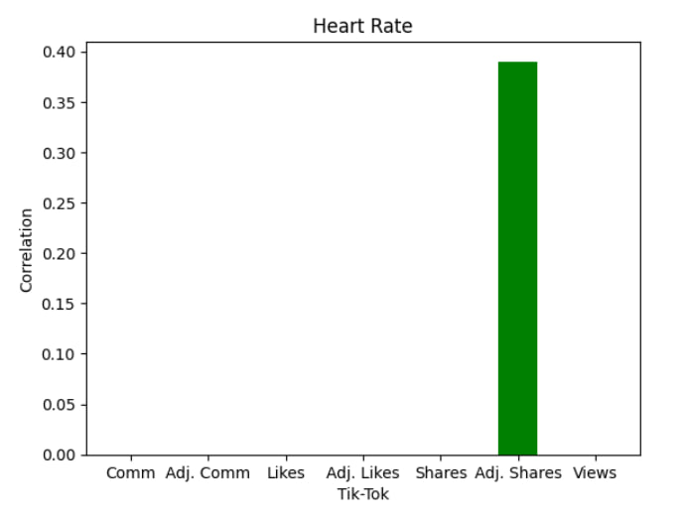
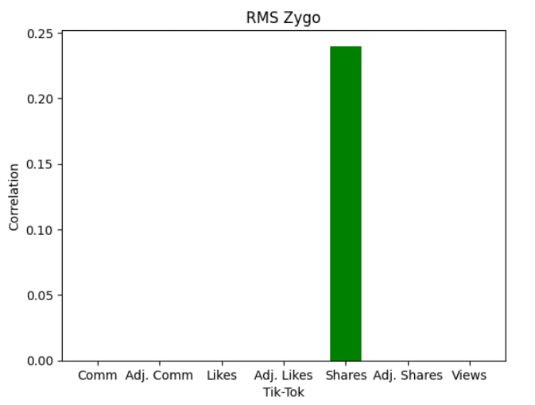
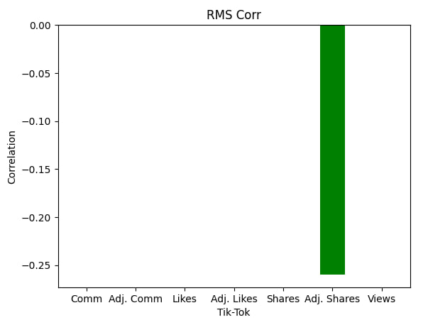
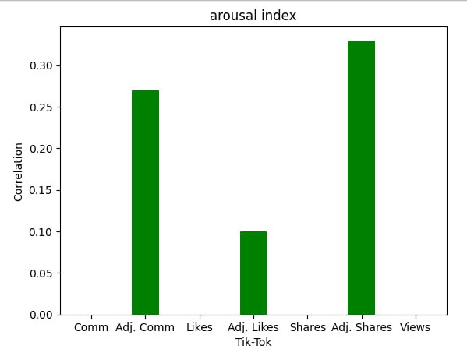
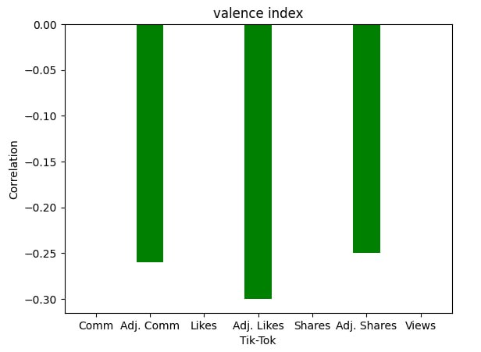
Results
No
Results
5

Slide 16
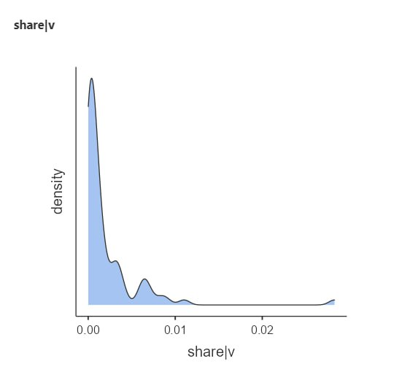
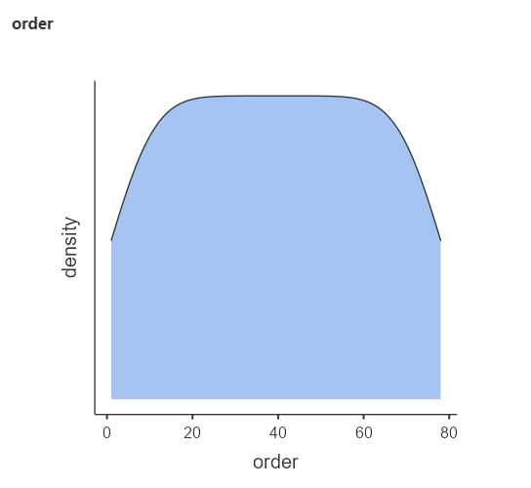
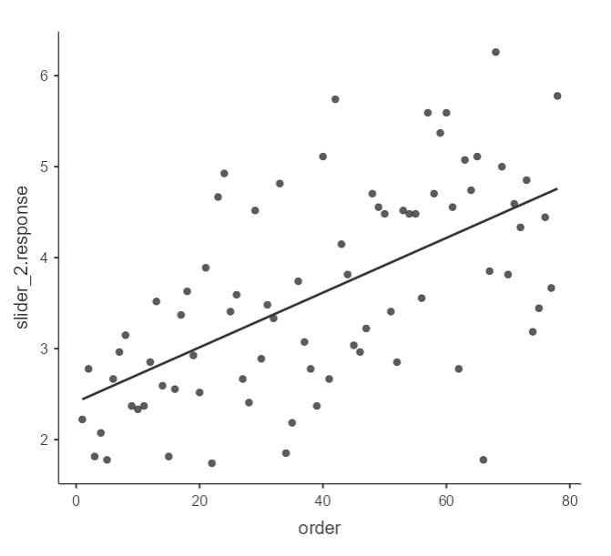
Results
 | Heart Rate | Skin conductance | RMS Zygomaticus | RMS Corrugator | Arousal index | Valence index | FAA
Tik-Tok | 0.3 (p-value = 0.001) | 0.28 (p-value = 0.01) | (p-value > 0.05) | -0.36 (p-value = 0.01) | 0.34 (p-value = 0.003) | -0.39 (p-value > 0.05) | (p-value > 0.05)
Spearman's correlation with TikTok values = 0.603 p < 0.001, Pearson's correlation = 0.598 p < 0.001
No
Results
5

Slide 17
Results
Features | R | R^2 | Adj. R^2 | F | p-value
Participants score (PS) | 0.598 | 0.357 | 0.349 | 42.3 | < 0.001
Psychophysiology (Psy) | 0.45 | 0.2 | 0.158 | 4.62 | 0.002
Beta (Pz) + Alpha (C4) + Alpha (F8) | 0.513 | 0.26 | 0.233 | 8.82 | < 0.001
PS+Phy | 0.63 | 0.397 | 0.355 | 9.47 | < 0.001
PS+BetaPz + Alpha C4 + Alpha F8 | 0.662 | 0.438 | 0.407 | 14.2 | < 0.001
Phy+BetaPz + Alpha C4 + Alpha F8 | 0.583 | 0.34 | 0.274 | 5.14 | < 0.001
PS+BetaPz + Alpha C4 + Alpha F8 + Phy | 0.687 | 0.472 | 0.410 | 7.70 | < 0.001
PS + Alpha C4 + Phy | 0.635 | 0.403 | 0.353 | 7.99 | < 0.001
arousal + valence | 0.4 | 0.16 | 0.139 | 7.21 | 0.001
arousal + valence +Ps | 0.63 | 0.4 | 0.38 | 16.7 | < 0.001
arousal + valence +Ps+rm_corr | 0.6 | 0.4 | 0.39 | 13.4 | < 0.001
arousal + valence +Ps+rm_corr+visual eng | 0.67 | 0.44 | 0.41 | 11.7 | < 0.001
No
Results
5

Slide 18
REFERENCES
Jääskeläinen, I. P., Sams, M., Glerean, E., & Ahveninen, J. (2021). Movies and narratives as naturalistic stimuli in neuroimaging. NeuroImage, 224, 117445.
Shestyuk, A. Y., Kasinathan, K., Karapoondinott, V., Knight, R. T., & Gurumoorthy, R. (2019). Individual EEG measures of attention, memory, and motivation predict population level TV viewership and Twitter engagement. PloS one, 14(3), e0214507.
Doré, B. P., Scholz, C., Baek, E. C., Garcia, J. O., O’Donnell, M. B., Bassett, D. S., ... & Falk, E. B. (2019). Brain activity tracks population information sharing by capturing consensus judgments of value. Cerebral Cortex, 29(7), 3102-3110.
Scholz, C., Baek, E. C., O’Donnell, M. B., Kim, H. S., Cappella, J. N., & Falk, E. B. (2017). A neural model of valuation and information virality. Proceedings of the National Academy of Sciences, 114(11), 2881-2886.
Schnuerch, R., & Pfattheicher, S. (2018). Motivated malleability: Frontal cortical asymmetry predicts the susceptibility to social influence. Social Neuroscience, 13(4), 480-494.
Smith, E. E., Reznik, S. J., Stewart, J. L., & Allen, J. J. (2017). Assessing and conceptualizing frontal EEG asymmetry: An updated primer on recording, processing, analyzing, and interpreting frontal alpha asymmetry. International Journal of Psychophysiology, 111, 98-114.
Liu, Y. (2006). Word of mouth for movies: Its dynamics and impact on box office revenue. Journal of marketing, 70(3), 74-89.
Yang, C., Hsu, Y. C., & Tan, S. (2010). Predicting the determinants of users' intentions for using YouTube to share video: moderating gender effects. Cyberpsychology, Behavior, and Social Networking, 13(2), 141-152.
Klucharev, V., Hytönen, K., Rijpkema, M., Smidts, A., & Fernández, G. (2009). Reinforcement learning signal predicts social conformity. Neuron, 61(1), 140-151.
Shestakova, A., Rieskamp, J., Tugin, S., Ossadtchi, A., Krutitskaya, J., & Klucharev, V. (2013). Electrophysiological precursors of social conformity. Social cognitive and affective neuroscience, 8(7), 756-763.
Berns, G. S., Capra, C. M., Moore, S., & Noussair, C. (2010). Neural mechanisms of the influence of popularity on adolescent ratings of music. Neuroimage, 49(3), 2687-2696.
8

