Slide 1
Vegetative measures of the valence of emotional states
Institute for Cognitive Neuroscience
International Laboratory of Social Neurobiology
Moscow
2023
Student: Feruza Komilova
Academic Supervisor: Vladimir Kosonogov, Senior Research Fellow, Institute for Cognitive Neuroscience, National Research University “Higher School of Economics”

Slide 2
Definitions and abbreviations
Institute for Cognitive Neuroscience
International Laboratory of Social Neurobiology
Vegetative measures of the valence of emotional states
Emotional valence – the feature of the emotional response, that represents approach or avoidance motivation.
ANS – autonomic nervous system. A component of the peripheral nervous system that regulates involuntary physiologic processes including heart rate, blood pressure, respiration, digestion, and sexual arousal (Waxenbaum et al., 2019)

Slide 3
Background
Institute for Cognitive Neuroscience
International Laboratory of Social Neurobiology
Vegetative measures of the valence of emotional states
ANS measures “predicting” valence
Infrared Thermal Imaging
Heart Rate Variability
Pupil Dilation
Startle Reflex
Head Motion
Postural Balance
decreased facial temperature is a sign of negative emotions, decreased nose temperature – disgust, fear and… happiness
decreased under the negative emotion increased under the positive emotions
difference between negative and positive emotions in terms of pupil sustainability, duration and dilation diameter
is enhanced during a fear state and is diminished in a pleasant emotional context
unpleasant pictures provoke more sway unpleasant stimuli provoke either avoiding (more sway) or freezing responses

Slide 4
Background
Institute for Cognitive Neuroscience
International Laboratory of Social Neurobiology
Vegetative measures of the valence of emotional states
No consistent measures
Meta-analysis
Caccioppo, 2000
Siegel, 2018
Behnke, 2022
Conclusion
Only 4 significantly predicting measures (Diastolic blood pressure, Blood volume, Nonoscillary duration of the skin blood flow response, Electrodermal response duration)
ANS can predict only arousal level, not valence
positive emotions are characterized by strong approach tendencies, such as joy and excitement, were accompanied by a higher sympathetic reactivity than low-approach positive emotions like amusement

Slide 5
Research question
Institute for Cognitive Neuroscience
International Laboratory of Social Neurobiology
Vegetative measures of the valence of emotional states
Problem
Lack of knowledge about the link between the emotional valence and the ANS activity.
Could the subjective state/sensations during specific emotions correspond to the specific pattern of ANS activation?

Slide 6
Research Goal
Institute for Cognitive Neuroscience
International Laboratory of Social Neurobiology
Vegetative measures of the valence of emotional states
To identify the somatovegetative markers of emotional states based on the self-reports about the bodily sensations.
Research Hypothesis
There are some specific manifestations of emotional valence in the self-reported patterns of somatovegetative activation (bodily sensations).

Slide 7
Methods exploratory qualitative research
Institute for Cognitive Neuroscience
International Laboratory of Social Neurobiology
Vegetative measures of the valence of emotional states
Object | Method
Data collection | Structured interview
Data analysis | Content analysis, frequency analysis

Slide 8
Methods
Institute for Cognitive Neuroscience
International Laboratory of Social Neurobiology
Vegetative measures of the valence of emotional states
I collecting material for the 1st draft of the interview protocol | II analyzing data, choosing the emotions& sensations for the interview protcol | III collecting the data from 3 subjects using the interview protocol draft | IV analyzing structured interview validity, making corrections | V collecting data
preliminary data on which emotions usually are associated with the prominent autonomous expression and what sensations in the body they cause | chose 10 the most frequently mentioned emotions and all mentioned parts of the body and constructed questions for the structured interview | in these pilot sessions more attention will be paid not to the contents of the interview but to the validity of the questionnaire parts | number of emotions should be adequate as well as not too tiring for the subject. The validity of the structured interview: questions that are hard to understand would be paraphrased or excluded | 24 participants to interview

Slide 9
Methods
Institute for Cognitive Neuroscience
International Laboratory of Social Neurobiology
Vegetative measures of the valence of emotional states
Examples of interview questions
10 emotions
радость-joy,
умиление-tenderness,
удивление-surprise,
печаль-sadness,
гнев/злость-anger,
презрение-contempt,
отвращение-disgust,
страх-fear,
стыд-shame,
вина-guilt
10 body parts
затылок-nape,
глаза-eyes,
челюсть-jaw,
лицо-face,
уши-ears,
шея/горло-neck/throat,
плечи-shoulders,
грудь-chest,
живот-stomach,
конечности-limbs
Example of digitized protocol
Emotion | Body part | Description
радость | грудь | мышечное сжатие неболезненное
радость | все тело | легкость
умиление | верхняя грудь | легкое напряжение
удивление | грудь | ощущение спазма
удивление | живот | ёканье
печаль | верхняя спина | напряжение
печаль | горло | зажим/ком
печаль | грудь | давление

Slide 10
Participants
Institute for Cognitive Neuroscience
International Laboratory of Social Neurobiology
Vegetative measures of the valence of emotional states
20 participants (13 females, median age is 21, M=23.15)
age 18+
no psychiatric or neurological diseases
do not take psychotropic drugs

Slide 11
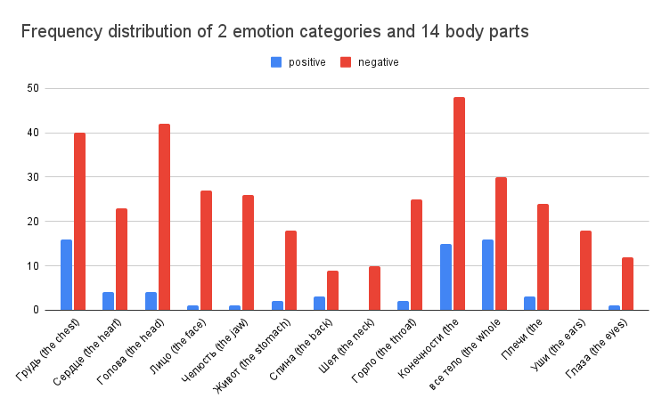
Results & Discussion
Institute for Cognitive Neuroscience
International Laboratory of Social Neurobiology
Vegetative measures of the valence of emotional states
negative emotions are reported to be accompanied by sensations in the chest significantly more often than positive emotions;
the same for the whole body variable
Frequency distribution of 2 emotion categories in 14 body parts

Slide 12
Limitations
Institute for Cognitive Neuroscience
International Laboratory of Social Neurobiology
Vegetative measures of the valence of emotional states
The number of emotion categories in two groups was not equal
The self-report measures of emotions cannot be considered as fully reliable, especially when it comes to reflecting the experience, that was gained long time ago.

Slide 13
Perspectives & Appliance
Institute for Cognitive Neuroscience
International Laboratory of Social Neurobiology
Vegetative measures of the valence of emotional states
Set hypothesis for the future psychophysiological experiments
Input for the system of emotion-inducing texts

Slide 14
References
Institute for Cognitive Neuroscience
International Laboratory of Social Neurobiology
Vegetative signs of emotion valence
Wu, W., & Lee, J. (2009, November). Improvement of HRV methodology for positive/negative emotion assessment. In 2009 5th International Conference on Collaborative Computing: Networking, Applications and Worksharing (pp. 1-6). IEEE.
Kreibig, S. D. (2010). Autonomic nervous system activity in emotion: A review. Biological psychology, 84(3), 394-421.
Goulart, C., Valadão, C., Delisle-Rodriguez, D., Caldeira, E., & Bastos, T. (2019). Emotion analysis in children through facial emissivity of infrared thermal imaging. PloS one, 14(3), e0212928.
Babiker, A., Faye, I., & Malik, A. (2013, October). Pupillary behavior in positive and negative emotions. In 2013 IEEE International Conference on Signal and Image Processing Applications (pp. 379-383). IEEE.
Lang, P. J., Bradley, M. M., & Cuthbert, B. N. (1990). Emotion, attention, and the startle reflex. Psychological review, 97(3), 377.
Kosonogov, V., Martínez-Selva, J. M., Torrente, G., Carrillo-Verdejo, E., Arenas, A., & Sánchez-Navarro, J. P. (2019). Head motion elicited by viewing affective pictures as measured by a new LED-based technique. Multisensory research, 32(7), 575-588.
Siegel, E. H., Sands, M. K., Van den Noortgate, W., Condon, P., Chang, Y., Dy, J., ... & Barrett, L. F. (2018). Emotion fingerprints or emotion populations? A meta-analytic investigation of autonomic features of emotion categories. Psychological bulletin, 144(4), 343.
Behnke, M., Kreibig, S. D., Kaczmarek, L. D., Assink, M., & Gross, J. J. (2022). Autonomic nervous system activity during positive emotions: A meta-analytic review. Emotion Review, 14(2), 132-160.
Waxenbaum, J. A., Reddy, V., & Varacallo, M. (2019). Anatomy, autonomic nervous system.

Slide 15
Thank you for your attention!
Institute for Cognitive Neuroscience
International Laboratory of Social Neurobiology
Vegetative measures of the valence of emotional states

Slide 16
Comparisons of Negative and Positive Emotions by Physiological measure
Institute for Cognitive Neuroscience
International Laboratory of Social Neurobiology
Vegetative signs of emotion valence
The psychophysiology of emotion (Cacioppo et al, 2000)
Measure | More in N than P* | p | Number of comparisons
Diastolic blood pressure | 0,54 | 0,01 | 7
Blood volume | 0,5 | 0,01 | 2
Nonoscillary duration of the skin blood flow response | -0,25 | 0,02 | 5
Electrodermal response duration | -0,29 | 0,01 | 5
 | *greater activation by negative emotion compared to positive

Slide 17
Emotion Fingerprints or Emotion Populations? A Meta-Analytic Investigation of Autonomic Features of Emotion Categories
Institute for Cognitive Neuroscience
International Laboratory of Social Neurobiology
Vegetative signs of emotion valence
(Siegel et al, 2018)
The psychophysiology of emotion (Cacciopo et al, 2000)
For anger: HR, CO, DBP, SBP, RR, and SCR +
For fear: HR, SBP, RR, and SCR +
For disgust: SCL and SCR +
For happiness: HR, DBP, RR, SCL, and SCR +
For sadness HR, DBP, SBP, and RR +

Slide 18
Autonomic Nervous System Activity During Positive Emotions: A Meta-Analytic Review
Institute for Cognitive Neuroscience
International Laboratory of Social Neurobiology
Vegetative signs of emotion valence
(Behnke et al, 2022)
Findings in approach motivation dimension:
positive emotions are characterized by strong approach tendencies, such as joy and excitement, were accompanied by a higher sympathetic reactivity (e.g., DBP, MAP) than low-approach positive emotions like amusement.
Mean effects (Cohen’s d) for each of the 11 discrete positive emotions with symbols representing the mean effect sizes and horizontal lines representing 95% confidence intervals

