Slide 1
Non-Euclidean space as a potential stimulus for psychophysiological studies
Department of psychology
Institute for Cognitive Neuroscience
Moscow
2023
Diana Salikova*, Vladimir Kosonogov**
*Student group МНК221 Master’s program “Cognitive Sciences and Technology: From Neuron to Cognition”,
**Laboratory Head, Institute for Cognitive Neuroscience, International Laboratory of Social Neurobiology, National Research University “Higher School of Economics”, Moscow, Russia.

Slide 2
The base:
a combination of
Math,
Awe,
VR.
Source: Midjourney Bot

Slide 3
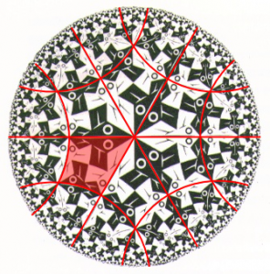
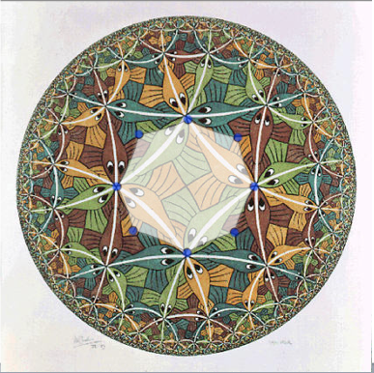
Hyperbolic geometry
Source: https://web.colby.edu/

Slide 4
Fractal geometry
fractal is a geometric pattern that is repeated at every scale and so cannot be represented by classical Euclidean geometry. Each small part of the pattern replicates the structure of the whole, possessing symmetry across scale
Dr. S. Bhattacharyya, 2016
Source: http://www.juliasets.dk/Fractals.htm

Slide 5
Awe
“…vastness refers to anything that is experienced as being much larger than the self or the self’s ordinary level of experience or frame of reference. Vastness is often a matter of simple physical size, but it can also involve social size such as fame, authority, or prestige”.
“…awe involves a need for accommodation, which may or may not be satisfied. The success of one’s attempts at accommodation may partially explain why awe can be both terrifying (when one fails to understand) and enlightening (when one succeeds)”.
Keltner and Haidt, 2003
Source: Midjourney Bot

Slide 6
VR
Virtual reality can be utilized as a tool for investigating the perception of hyperbolic/fractal space during «psychedelic» experiences, which can provide insights into the neural mechanisms underlying spatial perception.
Source: Midjourney Bot

Slide 7
Decomposition of psychedelic experience
Induction of awe by means of non-Euclidean geometry through virtual reality may induce transcendental experience.
This raises questions of brain functional correlates of “switching” between types of geometries as well as possibility to simulate a transcendental visual space.
Source: Midjourney Bot

Slide 8
Goal and tasks:
To compare brain electrical activity in different geometric spaces using virtual reality (VR) as an imitation of the psychedelic experience, the following objectives are proposed:
obtain data on brain activity while perceiving hyperbolic space compared to Euclidean space;
obtain data on brain activity while perceiving fractal geometry vs. kaleidoscopic movement
conduct behavioral tests before and after the experiment;
assess the influence of novelty in a new sensory experience through control experiments;
develop a methodologically sound comparison between the experimental data obtained and existing literature data.

Slide 9
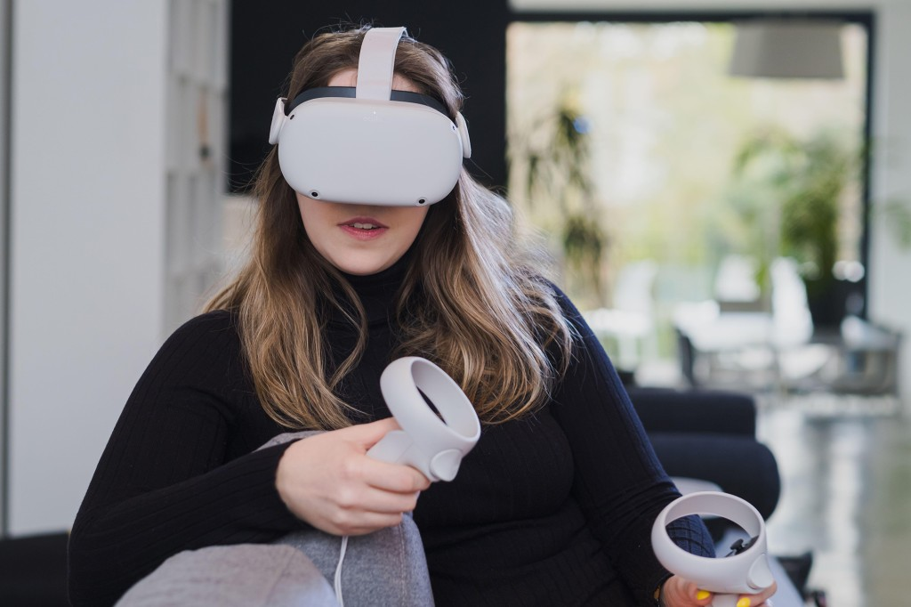
Materials
The study will use
VR headset (Oculus Quest 2);
Unity 3D software for creating the virtual environment;
EEG.

Slide 10
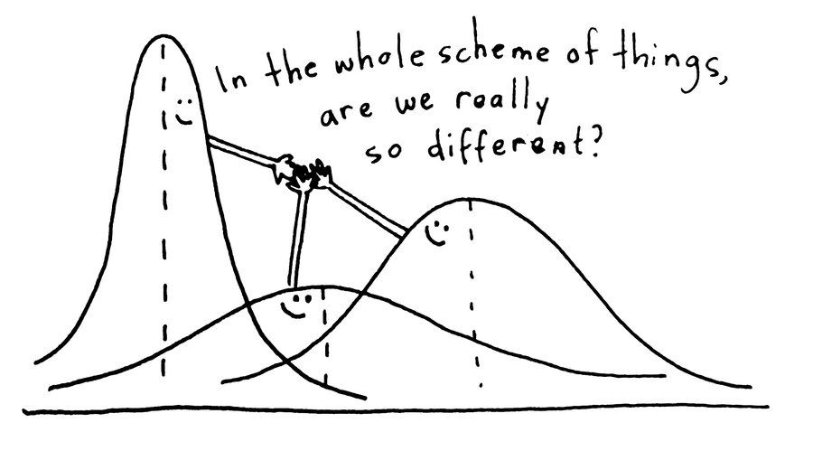
Data
The EEG data will be analyzed using spectral analysis to assess changes in power and coherence of different frequency bands (delta, theta, alpha, beta, and gamma) in response to non-Euclidean and Euclidean environments. Statistical analyses (paired t-tests, ANOVA) will be used to compare the EEG activity between the different conditions.

Slide 11
Examples of VR environment
Uniform honeycombs in hyperbolic space

Slide 12
Examples of VR environment (сontrol)

Slide 13
Examples of VR environment
Fractal’s environment

Slide 14
Examples of VR environment

Slide 15
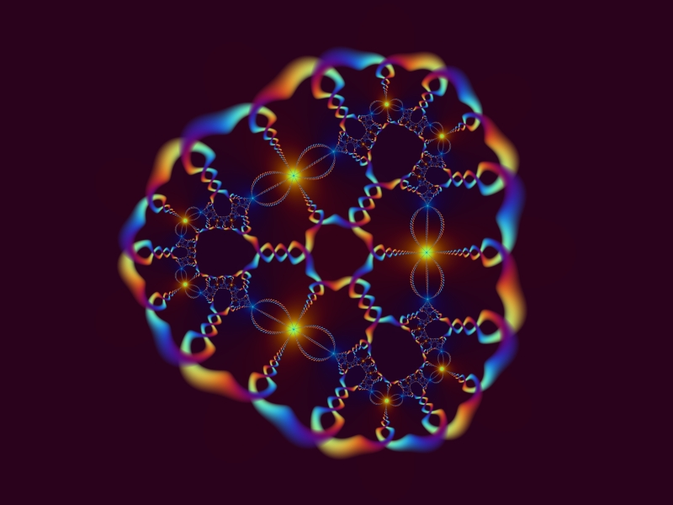
Сonclusions
The study aims to explore the neuronal mechanisms underlying non-Euclidean space perception using VR technology and EEG. Is there really differences?
By analyzing changes in brain activity in response to different VR environment, we could possibly understand how exactly these perception is different and potentially use in treating people.
Source: http://www.juliasets.dk/Fractals.htm

Slide 16
Reference
1. Bhattacharya, S. (2016, June). Fractals: Nature’s Versatile Code. http://www.vigyanprasar.gov.in/.
2. Keltner, D., & Haidt, J. (2003). Approaching awe, a moral, spiritual, and aesthetic emotion. Cognition & Emotion, 17(2), 297–314. https://doi.org/10.1080/02699930302297

