Slide 1
The role of VLPFC in emotion regulation: a tDCS study
Institute of Cognitive Neuroscience
MSc. Cognitive Sciences and Technologies 2022/2024
Vishmi Hasini Ranatunga
Candidate: Vishmi Ranatunga
Scientific Supervisor: Vladimir Kosonogov, Leading Research Fellow, Senior Research Fellow: Institute for Cognitive Neuroscience / International Laboratory of Social Neurobiology
Consultant: Nikita Otstavnov, Junior Research Fellow: Institute for Cognitive Neuroscience / International Laboratory of Social Neurobiology

Slide 2
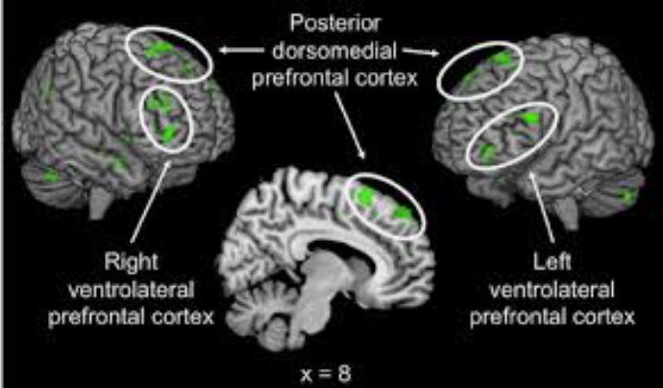
What is emotion regulation?
Institute of Cognitive Neuroscience
The role of VLPFC in emotion regulation: a tDCS study
Vishmi Ranatunga
Emotion regulation (ER) is the process through which individuals adjust their emotional reactions to effectively navigate social interactions, playing a crucial role in promoting overall well-being and mental health. (Qiu et al, 2023)
Notes:
The ventrolateral prefrontal cortex, especially its right portion (rVLPFC), is considered as an important brain region for down-regulating negative emotions when participants experienced social pain (Eisenberger et al., 2003; Masten et al., 2009; Onoda et al., 2010; Vijayakumar et al., 2017)

Slide 3
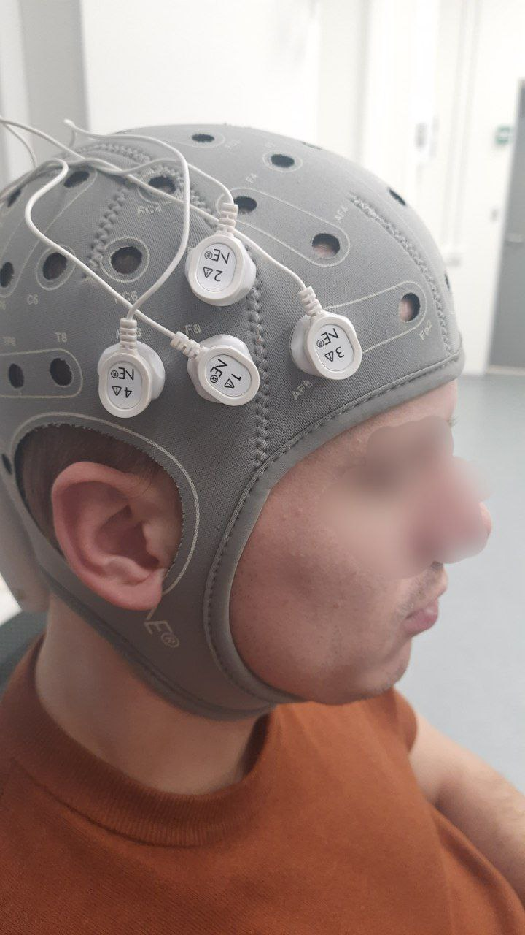
HD – tDCS (tES)
Institute of Cognitive Neuroscience
The role of VLPFC in emotion regulation: a tDCS study
Vishmi Ranatunga
tES applies various current waveforms, including transcranial direct current stimulation (tDCS), transcranial alternating current stimulation (tACS), and transcranial random noise stimulation (tRNS), to the scalp, modulating neuronal states.
Notes:
The ventrolateral prefrontal cortex, especially its right portion (rVLPFC), is considered as an important brain region for down-regulating negative emotions when participants experienced social pain (Eisenberger et al., 2003; Masten et al., 2009; Onoda et al., 2010; Vijayakumar et al., 2017)

Slide 4
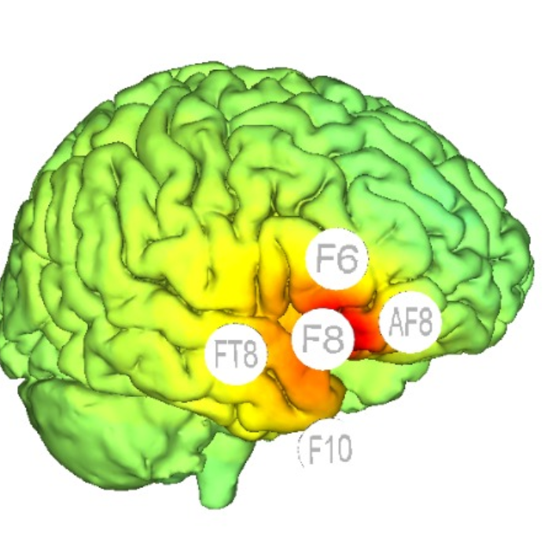
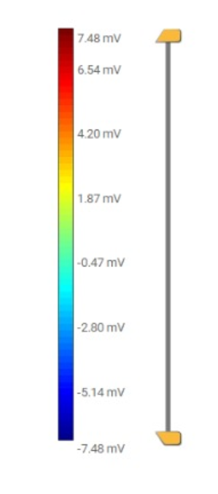
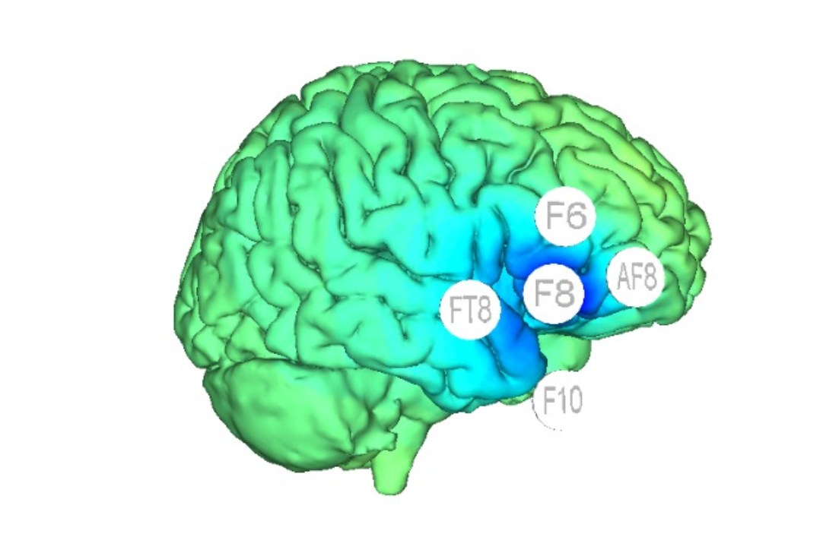
The role of the Ventrolateral Prefrontal Cortex in emotion regulation
Institute of Cognitive Neuroscience
The role of VLPFC in emotion regulation: a tDCS study
Vishmi Ranatunga
The rVLPFC plays a significant role in regulating emotions related to social pain, but there is insufficient evidence to definitively establish a causal link between this brain region and voluntary emotion regulation, as both inhibitory and excitatory findings are lacking. (Yu et al, 2023)
Notes:
The ventrolateral prefrontal cortex, especially its right portion (rVLPFC), is considered as an important brain region for down-regulating negative emotions when participants experienced social pain (Eisenberger et al., 2003; Masten et al., 2009; Onoda et al., 2010; Vijayakumar et al., 2017)

Slide 5
Objective of study
Institute of Cognitive Neuroscience
The role of VLPFC in emotion regulation: a tDCS study
Vishmi Ranatunga
Using HD – tDCS – preliminary hypotheses
Excitatory stimulation will assist in higher emotion regulation.
Inhibitory stimulation will not assist in emotion regulation.
Control condition - Sham
Notes:
The ventrolateral prefrontal cortex, especially its right portion (rVLPFC), is considered as an important brain region for down-regulating negative emotions when participants experienced social pain (Eisenberger et al., 2003; Masten et al., 2009; Onoda et al., 2010; Vijayakumar et al., 2017)

Slide 6
Research methodology – Experiment design
Institute of Cognitive Neuroscience
The role of VLPFC in emotion regulation: a tDCS study
2nd step Behavioural Experiment - 4 conditions
Participants have to watch 1- 2 minute long video clips, most of which are unpleasant.
After watching, they have to give a rating of 1 (Not unpleasant) to 9 (Highly unpleasant).
Neutral – JUST WATCH
Negative – JUST WATCH
Negative – SUPPRESS EMOTIONS
Negative – REAPPRAISE EMOTIONS
1st step tDCS Stimulation (20 minutes)
tDCS Stimulation variants
Excitatory
Inhibitory
Sham

Slide 7

Institute of Cognitive Neuroscience
The role of VLPFC in emotion regulation: a tDCS study
2nd step Behavioural Experiment - 4 conditions
Participants have to watch 1- 2 minute long video clips, most of which are unpleasant.
After watching, they have to give a rating of 1 (Not unpleasant) to 9 (Highly unpleasant).
Neutral – JUST WATCH
Negative – JUST WATCH
Negative – SUPPRESS EMOTIONS
Negative – REAPPRAISE EMOTIONS

Slide 8
Research methodology - procedure
Institute of Cognitive Neuroscience
The role of VLPFC in emotion regulation: a tDCS study
Behavioural Experiment - 4 conditions
Participants have to watch 1- 2 minute long video clips, most of which are unpleasant.
After watching, they have to give a rating of 1 (Not unpleasant) to 9 (Highly unpleasant).
Neutral – JUST WATCH
Negative – JUST WATCH
Negative – SUPPRESS EMOTIONS
Negative – REAPPRAISE EMOTIONS
Emotion regulation strategies
Suppressing emotions – if participant feels a certain emotion at the time of viewing the video, we ask them “not to feel” it – to suppress their emotion.
Reappraise emotions – we ask the participant to watch the video in a “third person perspective” or more “objectively”.

Slide 9
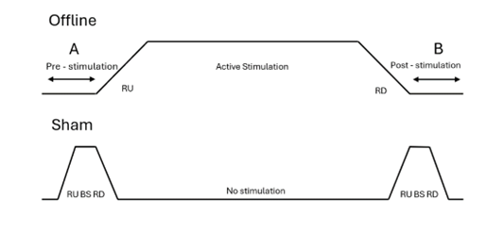
Research methodology – tDCS stimulation procedure
Institute of Cognitive Neuroscience
The role of VLPFC in emotion regulation: a tDCS study
The offline stimulation involves a period of stimulation (A) and then followed by a post-stimulation task (B). Sham stimulation involves the ramping up (RU) of current, followed by a brief, weak stimulation (BS), and ramping down of current (RD) followed by no stimulation, where before the end of the 20 minute session, another session of RU-BS-RD is conducted for 20 seconds.
Diagram illustrating experimental protocols.

Slide 10
Research methodology - procedure
Institute of Cognitive Neuroscience
The role of VLPFC in emotion regulation: a tDCS study
Prep scalp for electrode placing
Cortical stimulation - excitatory, inhibitory, sham. (20 minutes)
Pre-task set up to record physiological measures
Emotion Reaction Task (Rating of video clips) (45 – 55 minutes)
Order and timing of experimental procedures. Participants go through 20 minutes of active/sham stimulation. Participants then complete the emotion regulation task (rating videos).

Slide 11
Research methodology
Institute of Cognitive Neuroscience
The role of VLPFC in emotion regulation: a tDCS study
Vishmi Ranatunga
Study Design
Repeated measures, within subjects design.
Pairwise comparison
Participants – 45 (ages 18 – 30)
Required sample population
63 ( data collection is still ongoing).

Slide 12
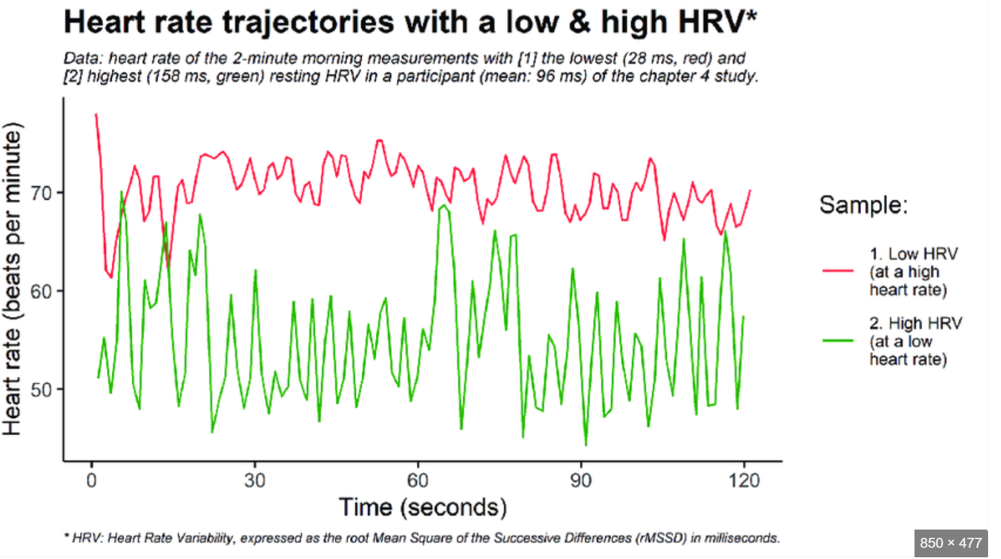
Research methodology
Institute of Cognitive Neuroscience
The role of VLPFC in emotion regulation: a tDCS study
Vishmi Ranatunga
Physiological Measures recorded
Heart Rate Variability

Slide 13
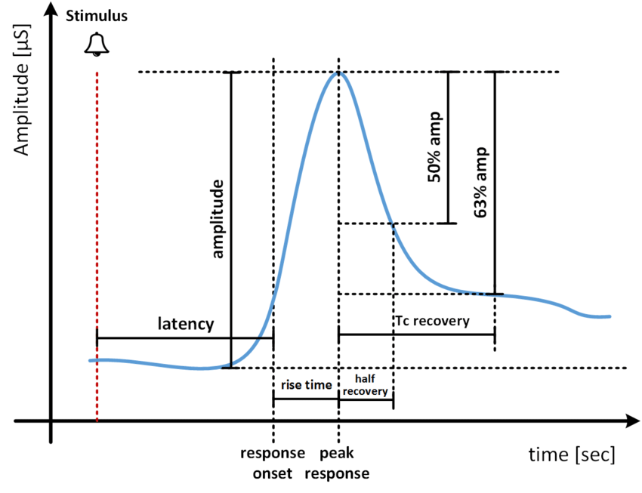
Research methodology
Institute of Cognitive Neuroscience
The role of VLPFC in emotion regulation: a tDCS study
Vishmi Ranatunga
Physiological Measures recorded
Skin Conductance Response
Typical skin conductance response variation

Slide 14
Institute of Cognitive Neuroscience
The role of VLPFC in emotion regulation: a tDCS study
Vishmi Ranatunga
Preliminary results – Sham group
The chi square analysis showed significant differences across the “just watch – neutral” condition with all the 3 conditions (just watch – negative, suppress and reappraise), χ2 (3, N=15) = 26.99, P=<00.1.

Slide 15
Institute of Cognitive Neuroscience
The role of VLPFC in emotion regulation: a tDCS study
Vishmi Ranatunga
Preliminary results – Excitatory group
Repeated measures ANOVA (non-parametric) results of the excitatory stimulation condition

Slide 16
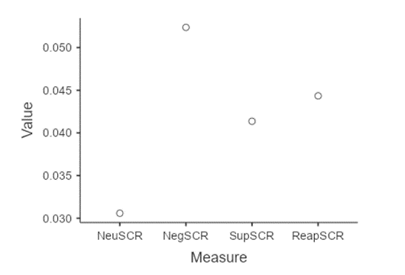
Institute of Cognitive Neuroscience
The role of VLPFC in emotion regulation: a tDCS study
Vishmi Ranatunga
Preliminary results – Excitatory group –SCR
Graph . Descriptive plot of SCR values of the excitatory group.
Pairwise ANOVA comparison of skin conductance rates among conditions, (just watch neutral – neutral, just watch negative – negative, suppress, reappraise) for excitatory stimulation

Slide 17
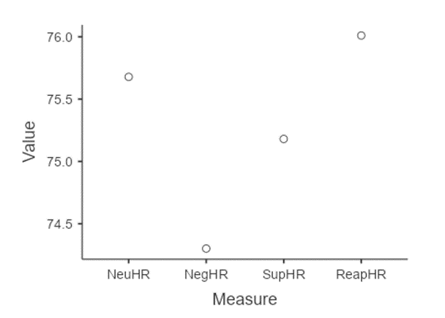
Institute of Cognitive Neuroscience
The role of VLPFC in emotion regulation: a tDCS study
Vishmi Ranatunga
Preliminary results – Excitatory group – HRV
Pairwise ANOVA comparison of heart rate variability among conditions, (just watch neutral – neutral, just watch negative – negative, suppress, reappraise)
Descriptive Plot of HRV values of the excitatory group

Slide 18
Institute of Cognitive Neuroscience
The role of VLPFC in emotion regulation: a tDCS study
Vishmi Ranatunga
Preliminary results – inhibitory group
Repeated measures ANOVA (non-parametric) results of the inhibitory stimulation group.
The ANOVA comparisons were significant for just watch (neutral) – just watch (negative) (P<0.001), just watch (neutral) – suppress (P<0.001), and just watch (neutral) – reappraise (P<0.001), χ2 (3, N=15) = 28.2, P<.001.

Slide 19
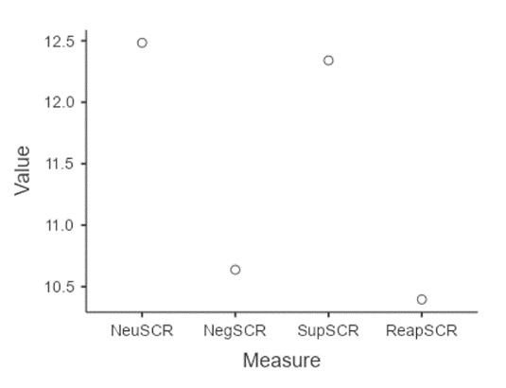
Institute of Cognitive Neuroscience
The role of VLPFC in emotion regulation: a tDCS study
Vishmi Ranatunga
Preliminary results – inhibitory group – SCR
Pairwise ANOVA comparison of skin conductance rates among conditions, (just watch neutral – neutral, just watch negative – negative, suppress, reappraise) for inhibitory stimulation
Descriptive plot of SCR values in inhibitory group.

Slide 20
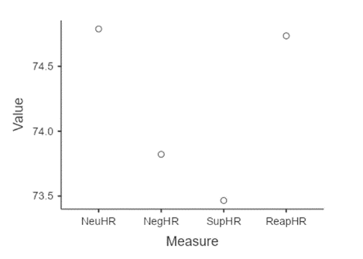
Institute of Cognitive Neuroscience
The role of VLPFC in emotion regulation: a tDCS study
Vishmi Ranatunga
Preliminary results – inhibitory group – HRV
Pairwise ANOVA comparison of heart rate variability among conditions, (just watch neutral – neutral, just watch negative – negative, suppress, reappraise) for inhibitory stimulation
Descriptive plot of HRV values in inhibitory group.

Slide 21
vInstitute of Cognitive Neuroscience
The role of VLPFC in emotion regulation: a tDCS study
Vishmi Ranatunga
Limitations of study
Psychophysiological measures
Previous studies have shown conflicting results with data analysis of physiological responses.
While aggregating all psychophysiological measures into a composite score can offer insights into the overall efficacy of an emotion regulation strategy, as demonstrated in the meta-analysis conducted by Webb et al. in 2012, this approach does not provide specific information about which individual psychophysiological responses are altered or remain unchanged when employing an emotion regulation technique.
Mode of instruction to participant by data collector.
Larger sample is needed to expect a solid effect size. – as shown by the preliminary results

Slide 22
vInstitute of Cognitive Neuroscience
The role of VLPFC in emotion regulation: a tDCS study
Vishmi Ranatunga
Limitations of study
At the end of the study conducted by Clarke et al (2020), participants were asked to indicate which neurostimulation condition they thought they had been assigned to. They could choose between "active" or "nonactive" stimulation. This was carried out as a tDCS “manipulation check”, to make sure that the participants’ perception of being allocated to a certain condition will not affect the results of the experiment. Including a pre-stimulation, and post-stimulation check for the participants, would have enhanced the content and concurrent validity of this study.
Despite obtaining significant results on the SCR and HRV values in the excitatory group, it is worth noting that when examining specific psychophysiological indicators, the results are inconclusive regarding how emotion regulation impacts autonomic physiology. Reappraisal instructions aimed at reducing negative emotions, compared to a control condition, have yielded mixed results on autonomic physiological indicators, whilst some studies found no significant effect on skin conductance (Gross, 1998a; Kalisch et al., 2005; Goldin et al., 2019), while others reported an increase (Sheppes et al., 2009; Lohani and Isaacowitz, 2014) or a decrease (Urry et al., 2009.

Slide 23
Institute of Cognitive Neuroscience
The role of VLPFC in emotion regulation: a tDCS study
Vishmi Ranatunga
Conclusions
There are significant differences between group conditions.
There is an effect from Excitatory, inhibitory and sham stimulations on Emotion regulation.
More data needs to be collected from participants to make a clear understanding of the preliminary results of the data.

Slide 24
Institute of Cognitive Neuroscience
The role of VLPFC in emotion regulation: a tDCS study
Vishmi Ranatunga
Conclusions
This study was successful in demonstrating that anodal and cathodal tDCS stimulation influences emotion regulation to a great extent.
This technology has proven to be a valuable tool in exploring the connections between brain activity and different cognitive, motor, social, and emotional functions (Filmer et al., 2014). Studies have shown that in healthy individuals, it can temporarily alter behaviour, enhance learning, and improve performance on tasks (Coffman et al., 2014; Parasuraman and McKinley, 2014).
Future improvements following this study would be to utilize a standardized protocol which implements pre-stimulation and post-stimulation manipulation checks on the participants to increase the content and concurrent validity of the study.

Slide 25
Institute of Cognitive Neuroscience
The role of VLPFC in emotion regulation: a tDCS study
Vishmi Ranatunga
REFERENCES
Aldao, A., Nolen-Hoeksema, S., and Schweizer, S. (2010). Emotion-regulation strategies across psychopathology: a meta-analytic review. Clin. Psychol. Rev. 30, 217–237. doi: 10.1016/j.cpr.2009.11.004
Alpers, G. W., Adolph, D., and Pauli, P. (2011). Emotional scenes and facial expressions elicit different psychophysiological responses. Int. J. Psychophysiol. 80, 173–181. doi: 10.1016/j.ijpsycho.2011.01.010
Qiu et al. Behavioral and Brain Functions (2023) 19:15 https://doi.org/10.1186/s12993-023-00217-8
Yu W, Li Y, Cao X, Mo L, Chen Y, Zhang D. The role of ventrolateral prefrontal cortex on voluntary emotion regulation of social pain. Hum Brain Mapp. 2023 Sep;44(13):4710-4721. doi: 10.1002/hbm.26411. Epub 2023 Jun 27. PMID: 37376719; PMCID: PMC10400789.
Zaehringer, J., Jennen-Steinmetz, C., Schmahl, C., Ende, G., & Paret, C. (2020). Psychophysiological effects of downregulating negative emotions: Insights from a meta-analysis of Healthy Adults. Frontiers in Psychology, 11. https://doi.org/10.3389/fpsyg.2020.00470

