Slide 1
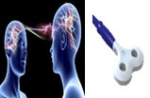
Institute of Cognitive Neuroscience
Transcranial Magnetic Stimulation (TMS) to investigate brain Emotion Regulation (ER) Processing
Transcranial Magnetic Stimulation (TMS) to investigate brain Emotion Regulation (ER) Processing
Alfred Essel

Slide 2
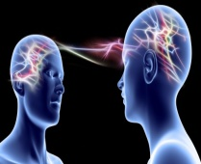
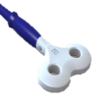
Introduction
Institute of cognitive Neuroscience
Emotion Regulation as an attempt to influence emotions in ourselves and others (McRae & Gross, 2020).
Emotion regulation helps mitigate the distressing feelings elicited by arousal of some emotions (He et al., 2020; Nasso et al., 2020; Zhao et al., 2021).

Slide 3
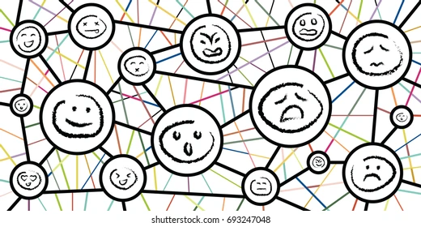
Introduction Cont’d
Institute of cognitive Neuroscience
The study of emotion regulation through varied perspectives (Jääskeläinen & Kosonogov, 2022) stimuli such as
movies,
images,
imaginations
Stimuli plus advanced neuroimaging techniques have enriched the study of emotion regulation.

Slide 4
Introduction Cont’d
Institute of cognitive Neuroscience
Though these advanced technologies have been very crucial in the holistic understanding of emotion regulation, results and findings seem scanty, inconsistent and inconclusive especially with regards to TMS and brain areas involved in emotion regulation.
Based on these inconsistencies, Li, et al (2022) among others recommended that more studies be done help unravel and explore more in the area of emotion regulation.

Slide 5
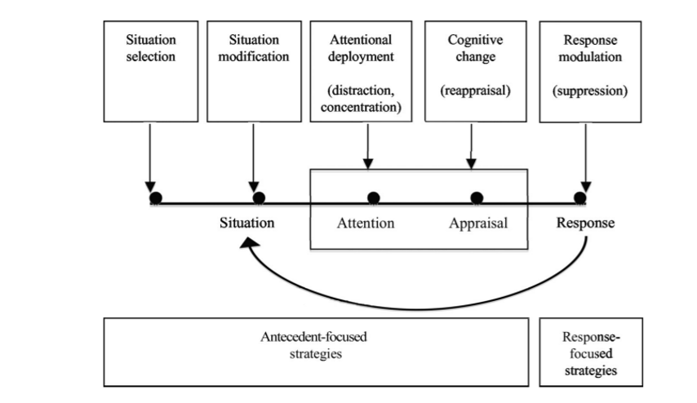
Literature Review
Institute of cognitive Neuroscience
Emotion Regulation and Strategies: Process Model of ER (Gross, 1998)

Slide 6
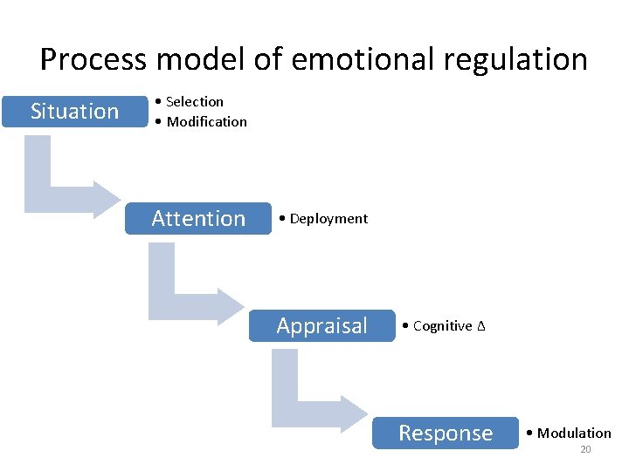
Literature Review Cont’d
Institute of cognitive Neuroscience
Manipulation of strategies especially reappraisal and suppression
Benefits of effective emotion control to include lowering stress, elevating happy emotions, etc. (McRae, 2013) .
Ineffective emotion control can result in undesirable consequences like
anxiety,
depression
trouble interacting with others

Slide 7
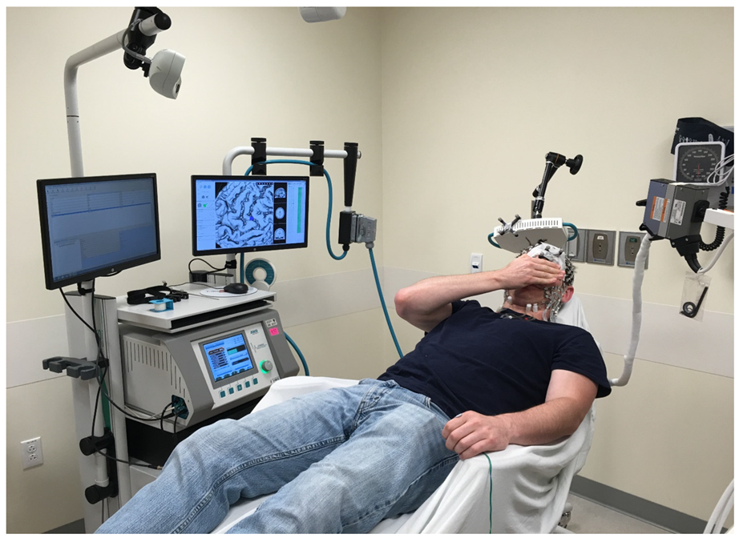
Institute of cognitive Neuroscience
Transcranial Magnetic Stimulation and ER
A well-established noninvasive technique for studying the human central nervous systems (Jean-Pascal, 2019).
Used mostly in the medical Field
Popularly recognized for stimulating the brain, to investigate its behavioral consequences.
Inconsistencies with exact brain area and emotion regulation

Slide 8
Literature Review Cont’d
Institute of cognitive Neuroscience
TMS Inhibition and Excitation of the Prefrontal Cortex
TMS has been used to study emotion regulation through the excitation and inhibition of various brain areas.
Dorsolateral Prefrontal Cortex (dlPFC), Ventralateral Prefrontal Cortex (vlPFC), orbitofrontal cortex and the cerebellum - areas popularly identified as brain areas involved in emotions through TMS inhibition or excitation.
Inhibition and excitation of these brain areas from literature seem to give varied results.

Slide 9
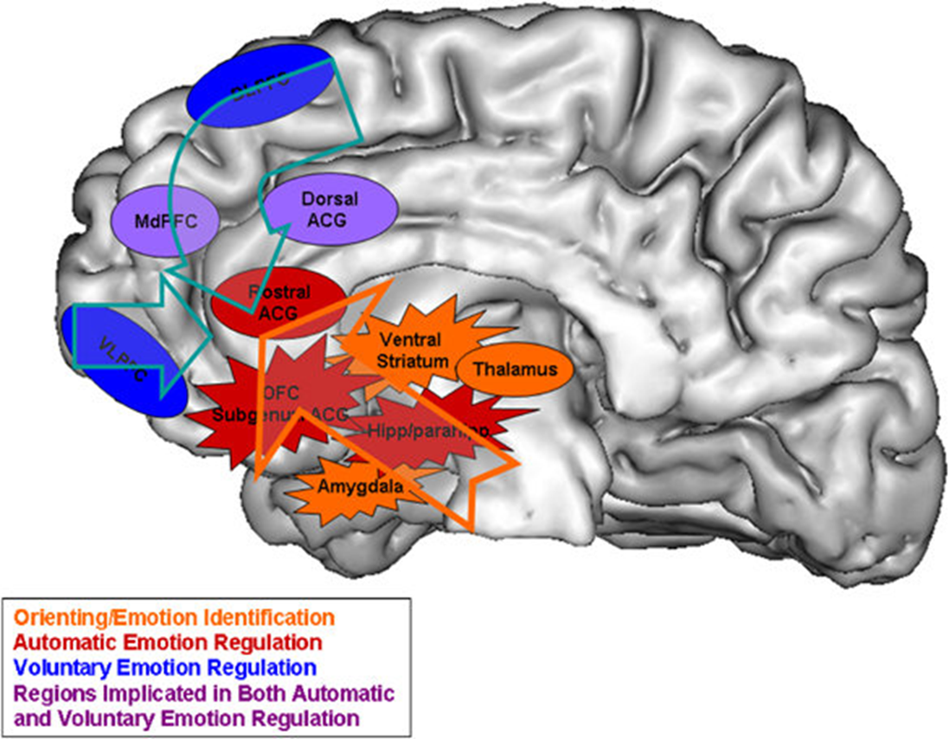
Institute of cognitive Neuroscience

Slide 10
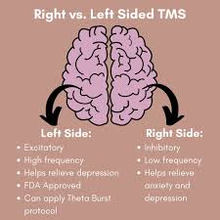
Literature Review Cont’d
Institute of cognitive Neuroscience
TMS Inhibition and Excitation of the Prefrontal Cortex (Left or Right)
Aside which general area of the brain to stimulate, there is also the argument of which hemisphere (left or right) to stimulate (Diefenbach et al., 2016; De Wit et al., 2015; Watts et al, 2012; Bystritsky et al., 2008; Mantovani et al., 2007).
Finally, previous literature seem to focus on clinical participants ; therefore there are recommendations for more studies with healthy participants.

Slide 11
Hypotheses
Institute of cognitive Neuroscience
In light of these limited findings, this study aims to investigate the use of inhibitory TMS and how subject would regulate their emotions in response to negative videos.
It is hypothesized that :
Emotion regulation mitigates the effects of negative emotions
after inhibitory TMS on DLPFC, participants will have a diminished ability to regulate their negative emotions worse in response to the negative videos.

Slide 12
Methods
Institute of cognitive Neuroscience
Participants
A priori sample size estimate of 36 subjects was acquired via G*Power .
However, Forty-one (41) healthy participants both males and females (31 (75.6%) females) were employed.
Average age= 23 years (M = 23.0, SD = 6.14)
All ethical considerations were observed
Participants were asked to have a sufficient night sleep and abstain from alcohol and any drugs the day before experiment and between the sessions.

Slide 13
Methods Cont’d
Institute of cognitive Neuroscience
Stimuli
Thirty-six (36) one-minute video clips from the affective video database were selected.
Nine (9) neutral videos, 27 negative videos.
Valence (from 1 for “less unpleasant” to 9 for “very unpleasant”)

Slide 14
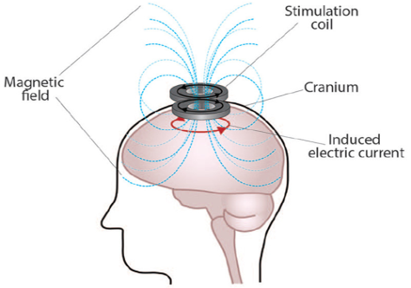
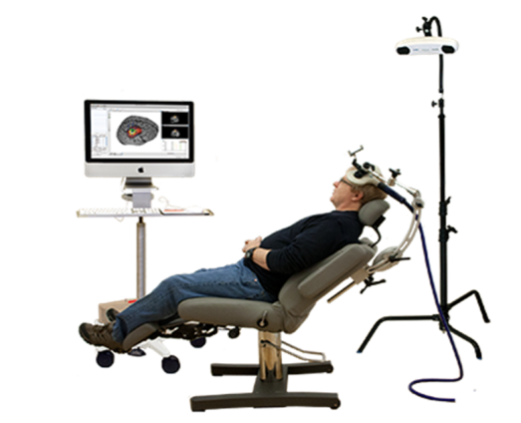
Methods Cont’d
Institute of cognitive Neuroscience
TMS Protocol
Participants were split into two equal groups:
one group received active TMS delivered on the right DLPFC
the second group received stimulation on the vertex.
A T1 weighted MRI of participants was obtained and normalized (fmri coordinates 50, 38, 15) (Goldin et al., 2008)
Neuronavigated biphasic TMS pulses was delivered over the right M1 using a MagPro X100 (MagVenture, Farum, Denmark) .
continuous Theta Burst Stimulation (cTBS) lasted for 40 seconds and 300 total pulses

Slide 15
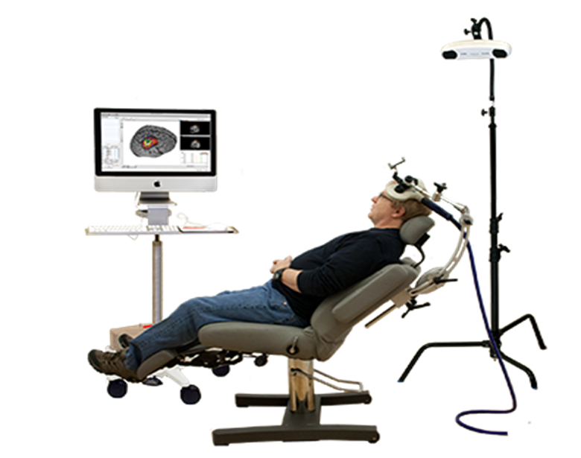
Methods Cont’d
Institute of cognitive Neuroscience
Procedure
Sitting 70cm in front of a 24 inch-monitor
ER task adapted from Richards and Gross (2000) to assess cognitive reappraisal and suppression
Neutral and Negative videos were presented on the computer screen for 60 seconds followed by a 12–18 seconds rest period with an instruction to “watch,” “reappraise,” or “suppress.”
Rating scale after each video, and participants to respond how they feel during the presentation (from 1 to 9 ).

Slide 16
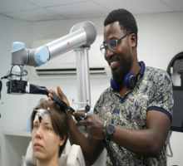
Institute of cognitive Neuroscience
Psychopy automatically generated outputs in Excel files.
The responses were averaged and grouped according to the conditions “watch neutral”, “watch negative”, “suppress” and “reappraise” for each participant.
Data Processing & Statistical Analysis
Repeated Measures ANOVA between groups (prefrontal and Vertex) and a between factor emotion (4 conditions: watch Neutral”, watch Negative”, “suppress”, “reappraise).
Posthoc tests (Tukey's HSD)
The significance level for all tests at p < .05.

Slide 17
Results
Institute of cognitive Neuroscience
Self-Reported Ratings
Table 1- The descriptive results of participant’s ratings of the conditions
 |  | N |  | Mean |  | Median |  | SD |  | Minimum |  | Maximum
Watch Neutral |  | 41 |  | 1.55 |  | 1.44 |  | 0.614 |  | 1.00 |  | 4.22
Watch Negative |  | 41 |  | 4.41 |  | 4.22 |  | 1.687 |  | 1.00 |  | 7.33
Suppress |  | 41 |  | 4.01 |  | 4.22 |  | 1.551 |  | 1.33 |  | 7.22
Reappraise |  | 41 |  | 3.87 |  | 3.67 |  | 1.662 |  | 1.00 |  | 7.44

Slide 18
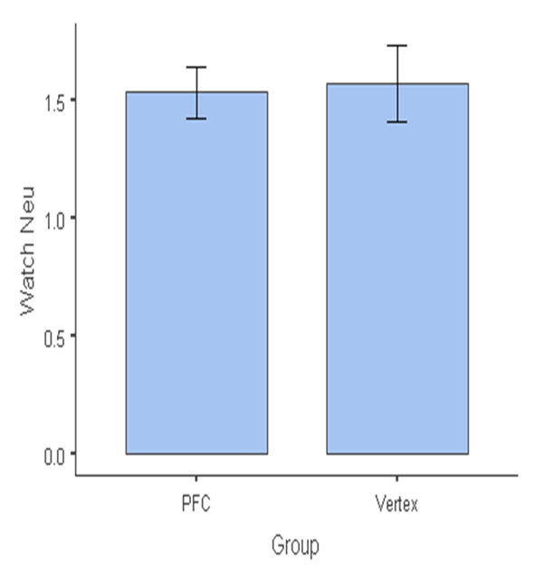
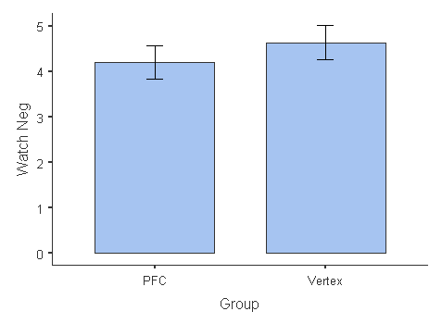
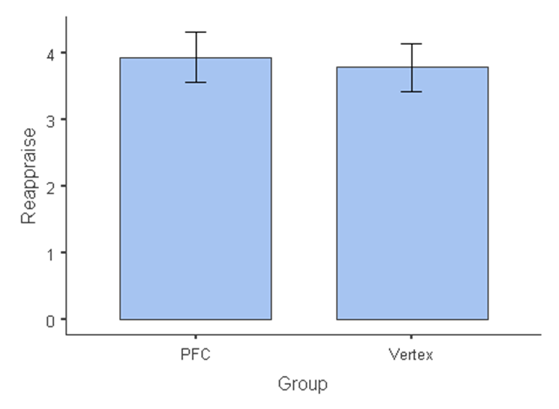
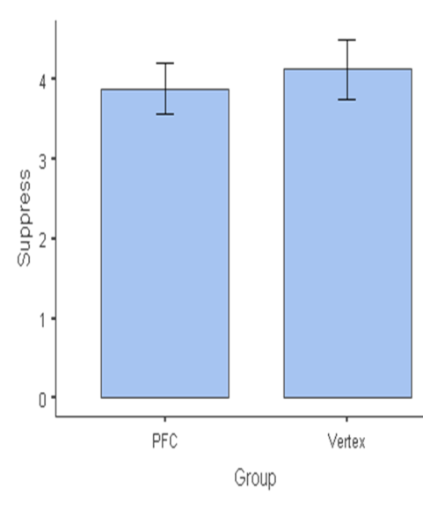
Results
Institute of cognitive Neuroscience
Group Statistics
Bar plots of group ratings conditions (Neutral, Negative, Suppress and Reappraise)

Slide 19
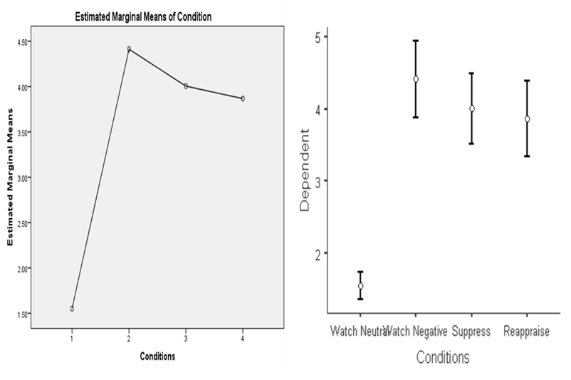
Results
Institute of cognitive Neuroscience
Hypothesis 1 : Emotion regulation mitigates the effects of negative emotions
The analysis showed a significant differences for conditions, F (3,120)= 84.9, p,<.001, η² = 0.38

Slide 20
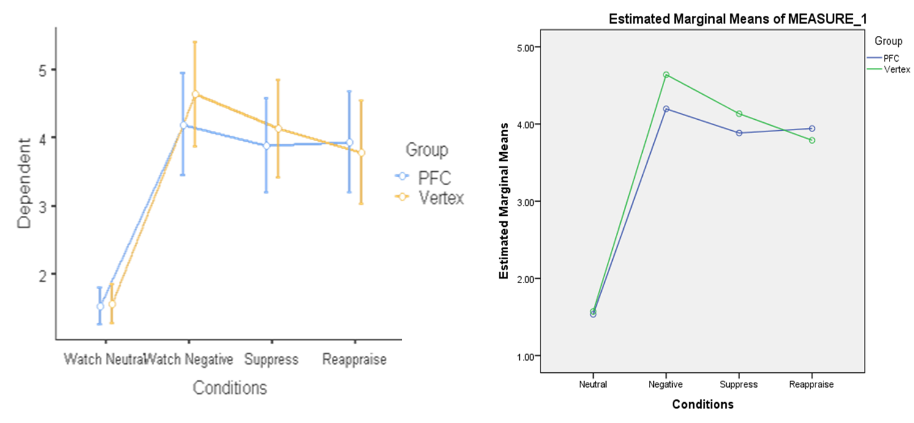
Results
Institute of cognitive Neuroscience
Hypothesis 2 : After inhibitory TMS on DLPFC, participants will have a diminished ability to regulate their negative emotions worse in response to the negative videos.
there was no significant interaction between the conditions and the groups F(3,117)= 0.84, p=.47, η² = 0.004

Slide 21
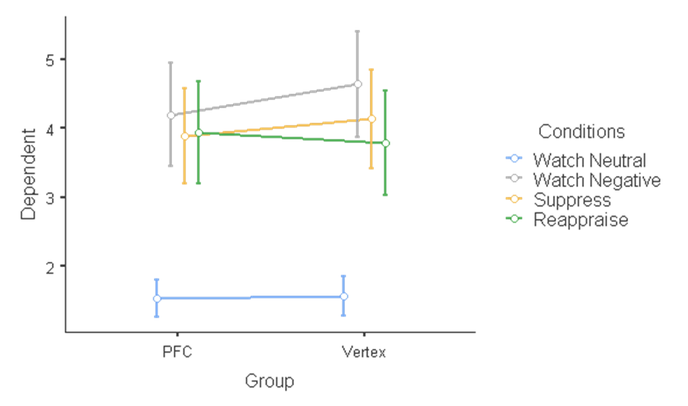
Results
Institute of cognitive Neuroscience
Group ✻Conditions
Statistically no significant effect but a difference in reappraisal is visible

Slide 22
Conclusions
Institute of cognitive Neuroscience
Negative or unpleasant videos elicited negative emotions in both active and sham healthy participants
emotion regulation strategies have the ability to affect how an individual react to negative and unpleasant situations.
Reappraisal emotion regulation strategy may be more effective than suppression
In spite of the inconsistencies in findings, stimulating some brain regions could be effective in the up and down regulation of emotions

Slide 23
Limitations
Institute of cognitive Neuroscience
self-rated valence might give room for participants to exaggerate (self-serving biases)
sampling biases due to the convenience nature of sampling the participants
Small sample size
Demographic biases

Slide 24
References
Institute of cognitive Neuroscience
Diefenbach, G. J., Assaf, M., Goethe, J. W., Gueorguieva, R., & Tolin, D. F. (2016). Improvements in emotion regulation following repetitive transcranial magnetic stimulation for generalized anxiety disorder. Journal of anxiety disorders, 43, 1-7. DOI: https://doi.org/10.1016/j.janxdis.2016.07.002
McRae, K. (2013). Emotion regulation frequency and success: Separating constructs from methods and time scale. Social and Personality Psychology Compass, 7, 289–302. DOI: https://doi.org/10.1111/spc3.12027
McRae, K., & Gross, J. J. (2020). Emotion regulation. Emotion, 20(1), 1–9. https://doi.org/10.1037/emo0000703
Mohammed, A. R., Kosonogov, V., & Lyusin, D. (2022). Is emotion regulation impacted by executive functions? An experimental study. Scandinavian Journal of Psychology, 63, 182–190. https://doi.org/10.1111/sjop.12804

Slide 25
Thank You
And questions are welcome

