Slide 1
Изучение мистического опыта посредством VR
Department of psychology
Institute for Cognitive Neuroscience
Moscow
2024
Diana Salikova*, Larisa Poznyak*
*Master’s program “Cognitive Sciences and Technology: From Neuron to Cognition”

Slide 2
Комбинация
математики,
VR.

Slide 3
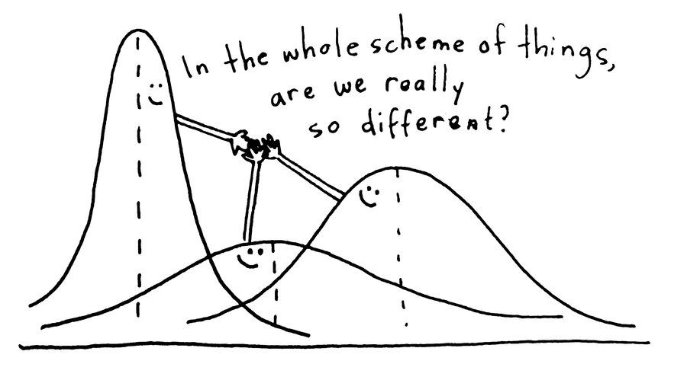
Цель:
сравнить электрическую активность мозга в различных геометрических пространствах,
-> какая осцилляторная активность подвержена влиянию геометрии?

Slide 4
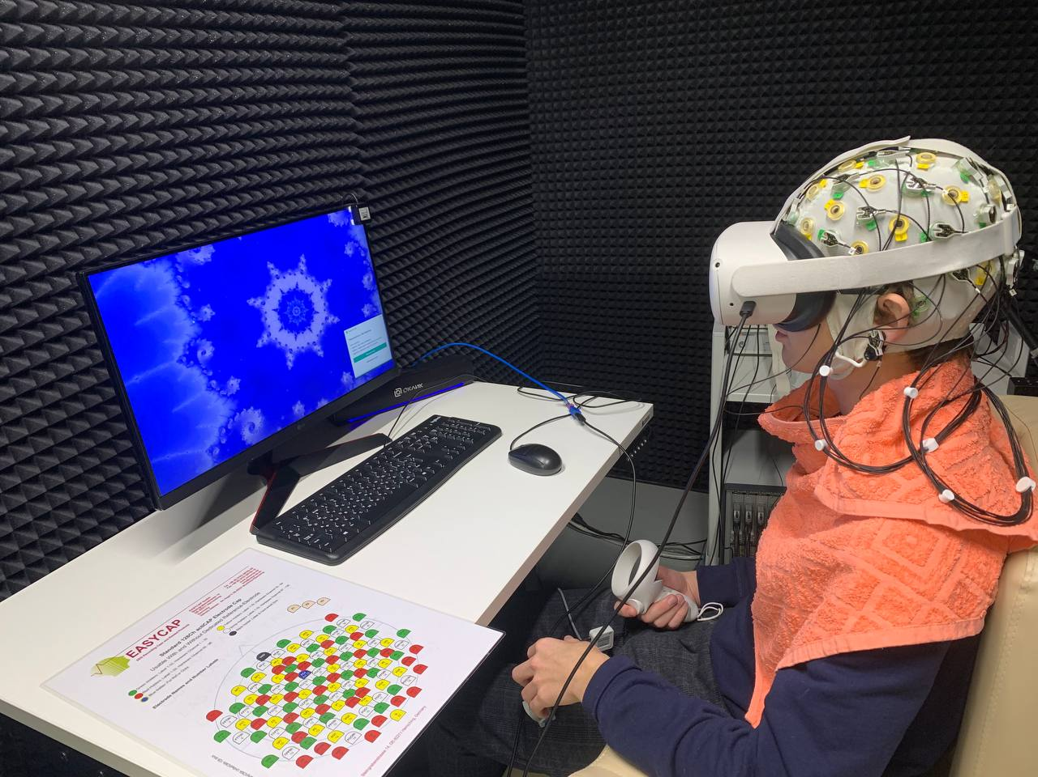
Участники
Материалы&Методы
31 участник,
средний возраст – 21 год.
VR (Oculus Quest),
EEG (28+4),
PSD (power spectral density).

Slide 5
Виртуальные среды
фрактал

Slide 6
Виртуальные среды
фрактал

Slide 7
Виртуальные среды
гиперболическая геометрия

Slide 8
Виртуальные среды
Евклидова геометрия

Slide 9
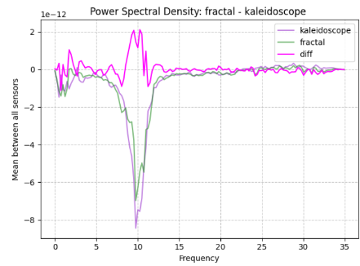
Предварительные результаты

Slide 10
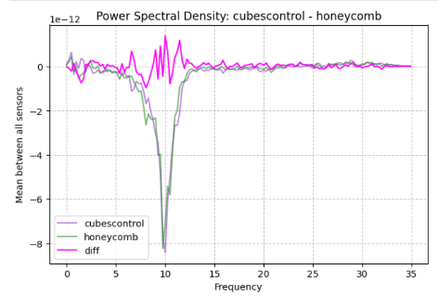

Slide 11
Альфа-ритм сильнее подавляется в паре стимулов гиперболическая/неевклидова геометрия

Slide 13
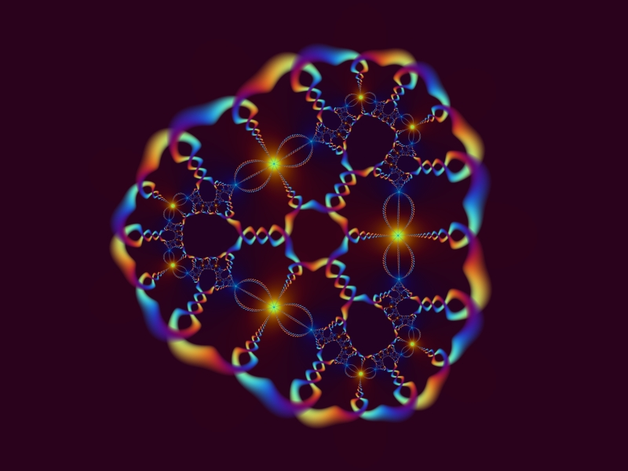
Сonclusions
The study aims to explore the psychophysiological mechanisms underlying non-Euclidean space perception using VR technology and EEG. Is there really differences?
By analyzing changes in brain activity in response to different VR environment, we could possibly understand how exactly these perception is different and potentially use in treating people.

Slide 14
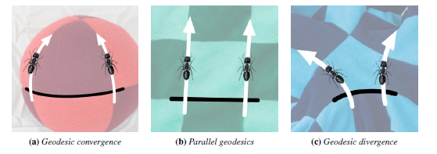
Hyperbolic geometry

Slide 15
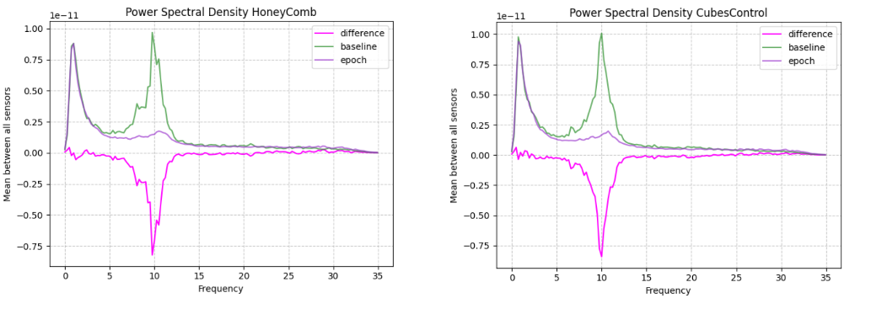
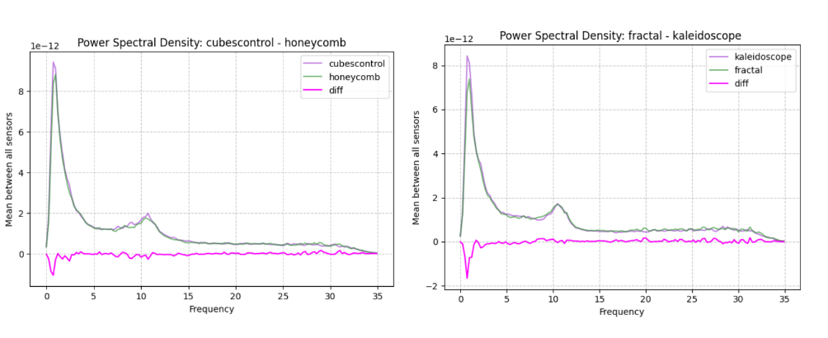

Slide 16
нормализация по частотам

Slide 17
Thesis Statement
Is hyperbolic geometry close to psychedelic experience?
Possible, yes.
Virtual reality can be utilized as a tool for investigating the perception of hyperbolic space during «psychedelic» experiences, which can provide insights into the neural mechanisms underlying spatial perception.

Slide 18
Thesis Statement
Studies suggest that inducing awe, a key element of the psychedelic experience, through virtual reality may have therapeutic potential by promoting a sense of connection to the universe and others.
Identifying beneficial psychedelic experience characteristics can lead to new therapies. Virtual reality can induce awe, a key component, as a non-pharmacological alternative.
decomposition of psychedelic experience

Slide 19
Materials
The EEG data will be analyzed using spectral analysis to assess changes in power and coherence of different frequency bands (delta, theta, alpha, beta, and gamma) in response to non-Euclidean and Euclidean environments. Statistical analyses (paired t-tests, ANOVA) will be used to compare the EEG activity between the different conditions.

