Slide 1
Results
Interoceptive training

Slide 2
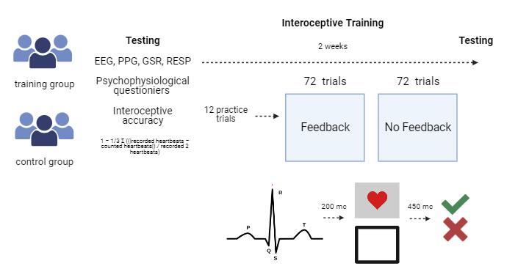
Methods

Slide 3
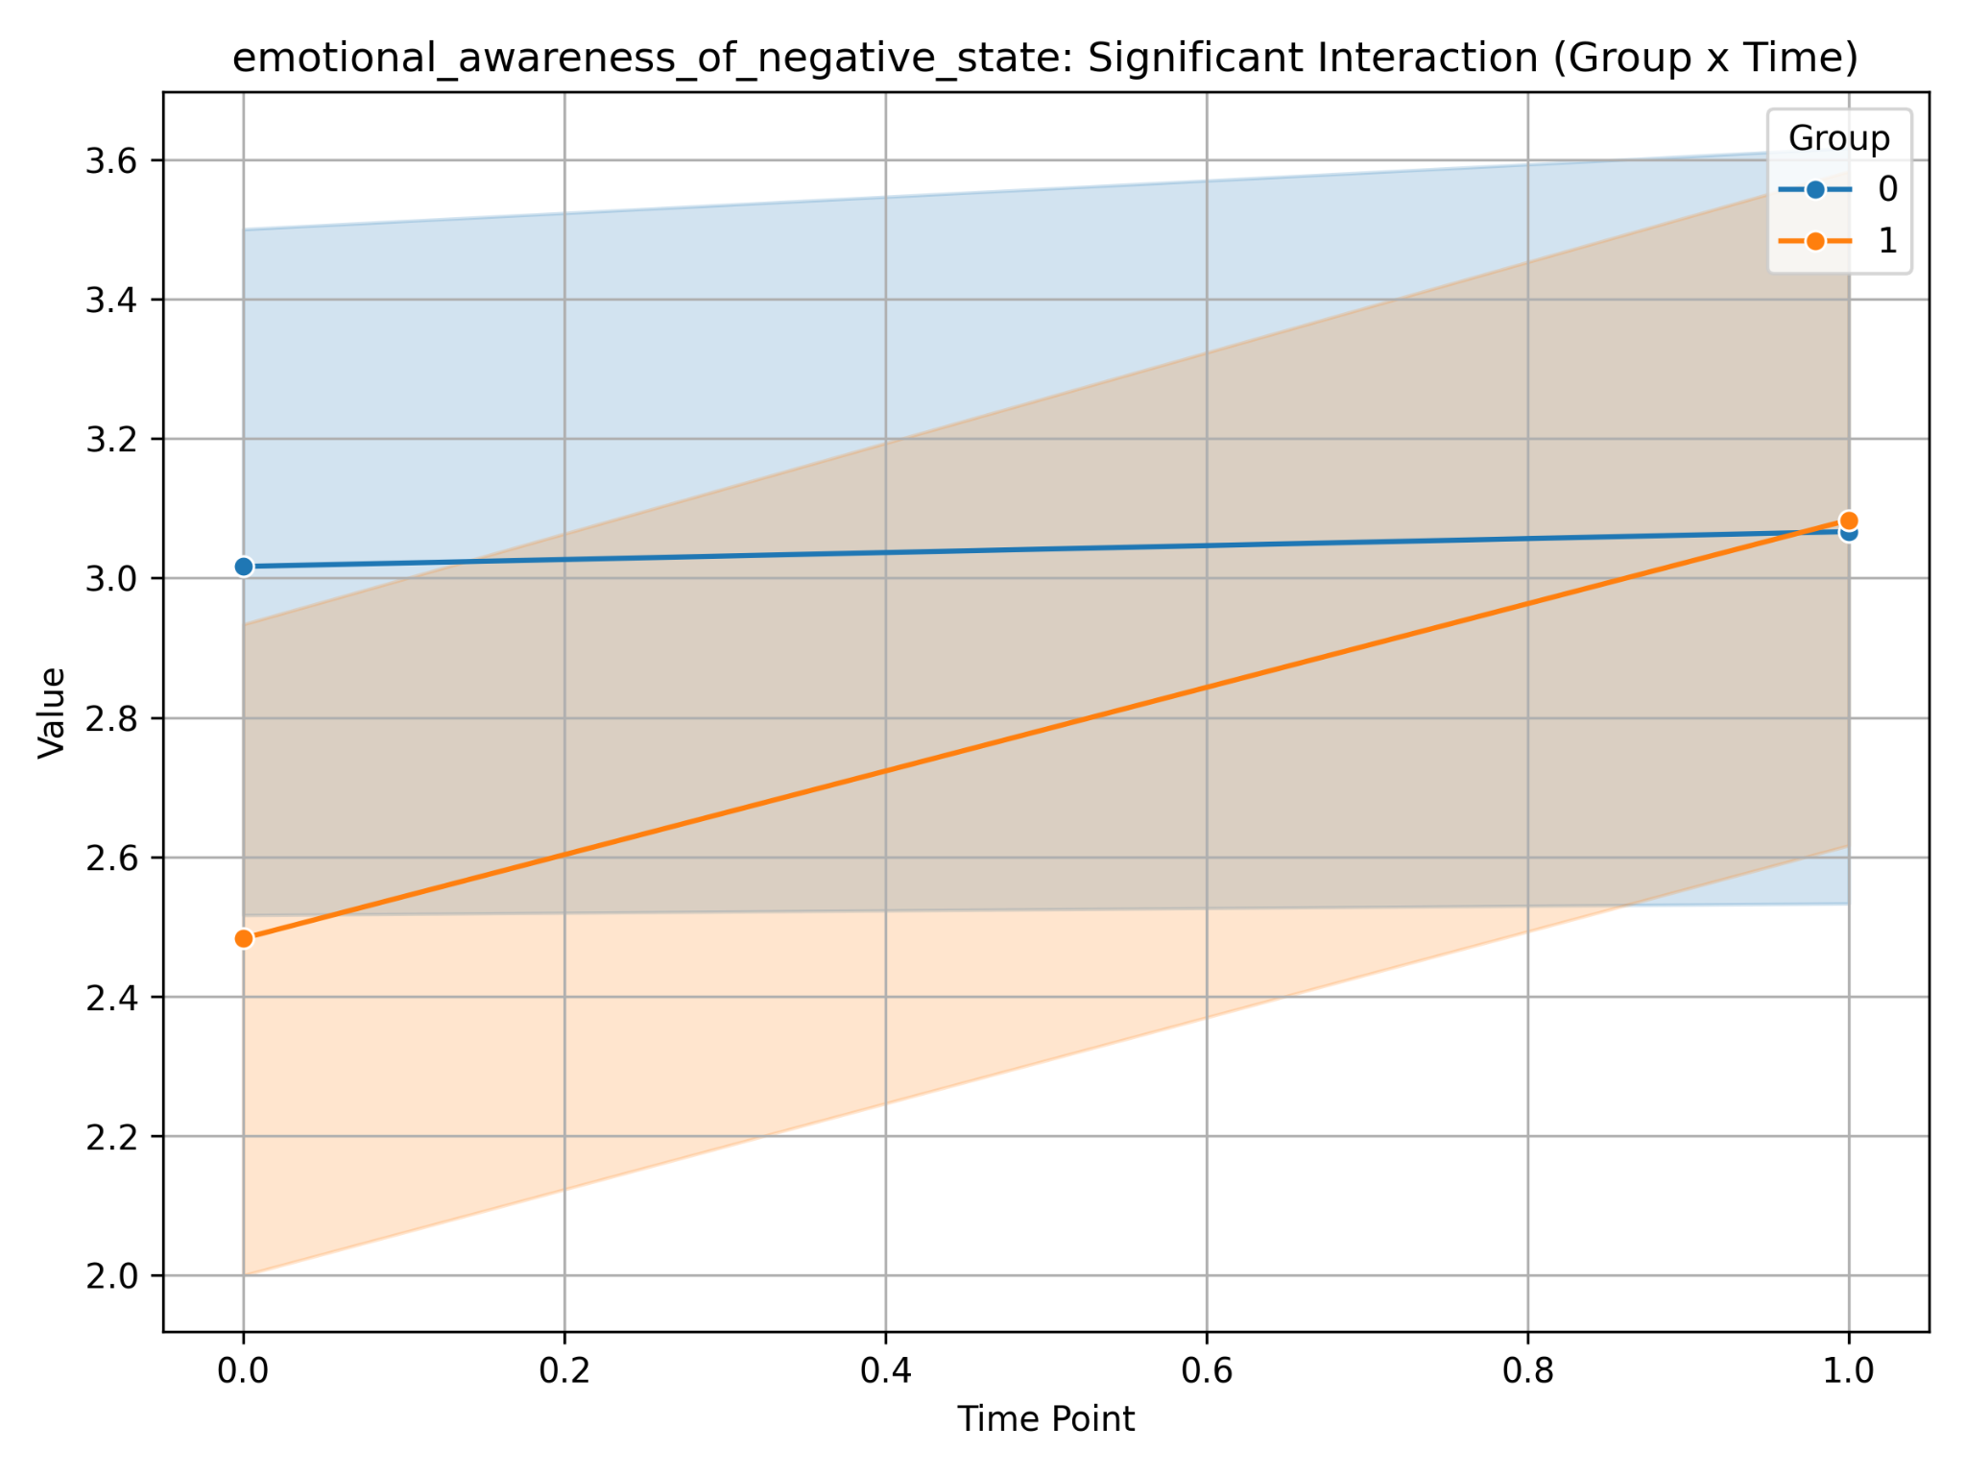
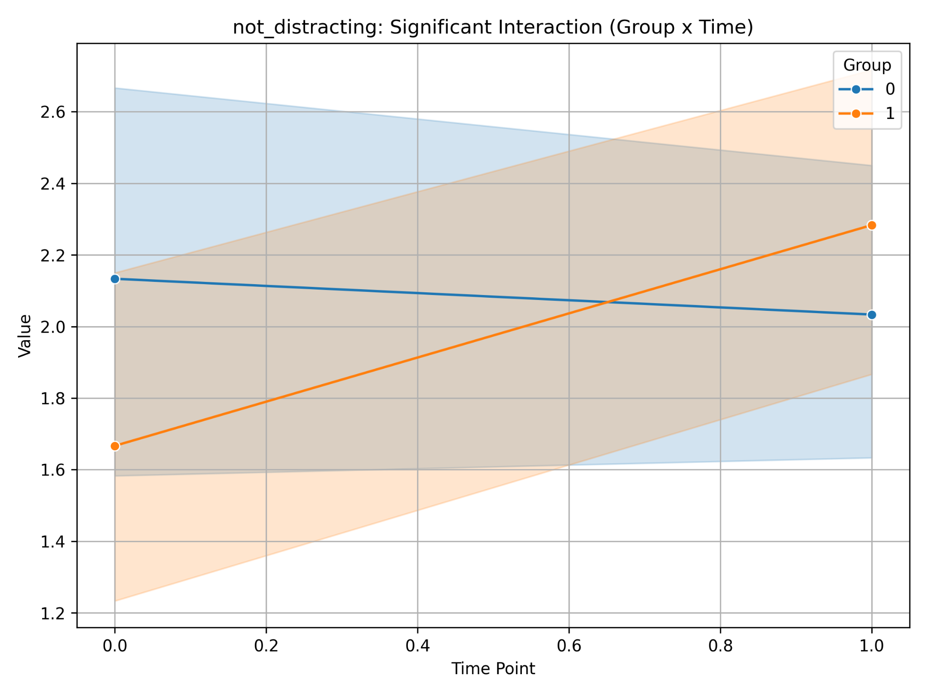
Psychological questionnaires
Participants in the training improved their results on the interoceptive Awareness Scale (MAIA), which may indicate an increase in the ability to consciously perceive body signals.

Slide 4
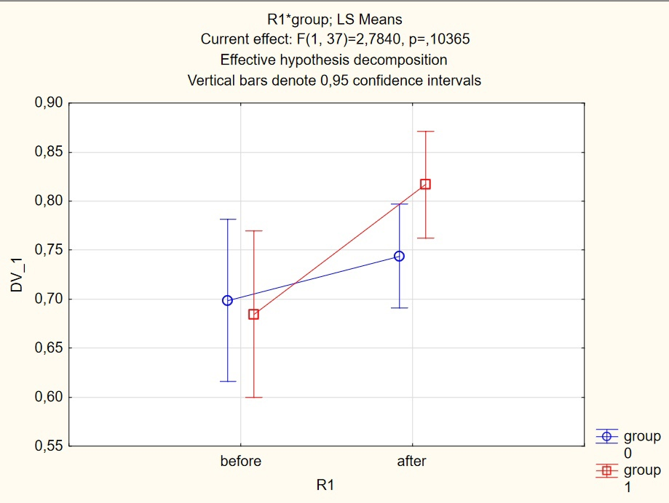
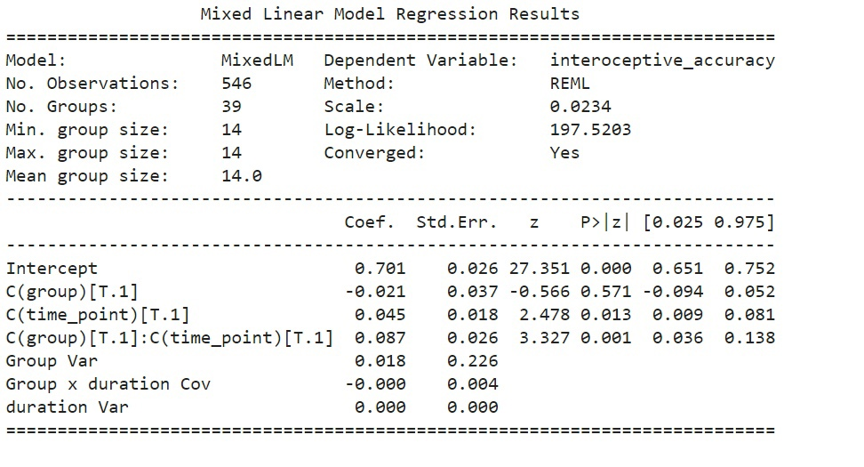
Interoceptive accuracy
After the training, significant positive dynamics in the accuracy of heart rate perception (interoceptive accuracy) was recorded in the experimental group.

Slide 5
RESTING

Slide 6
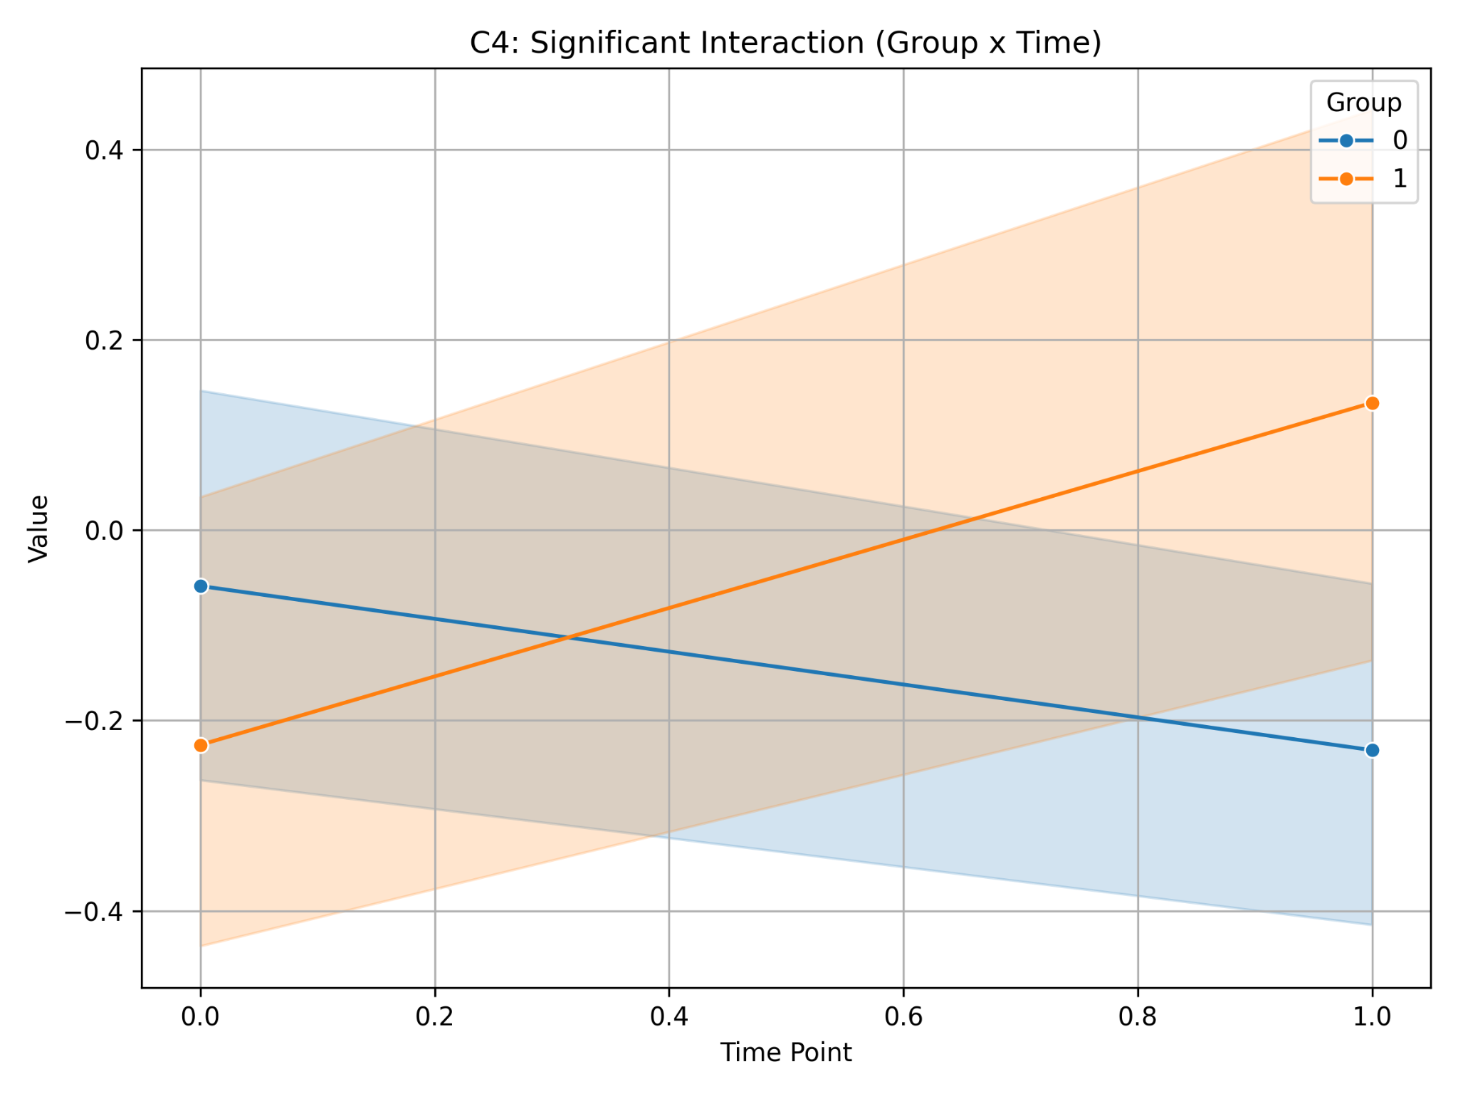
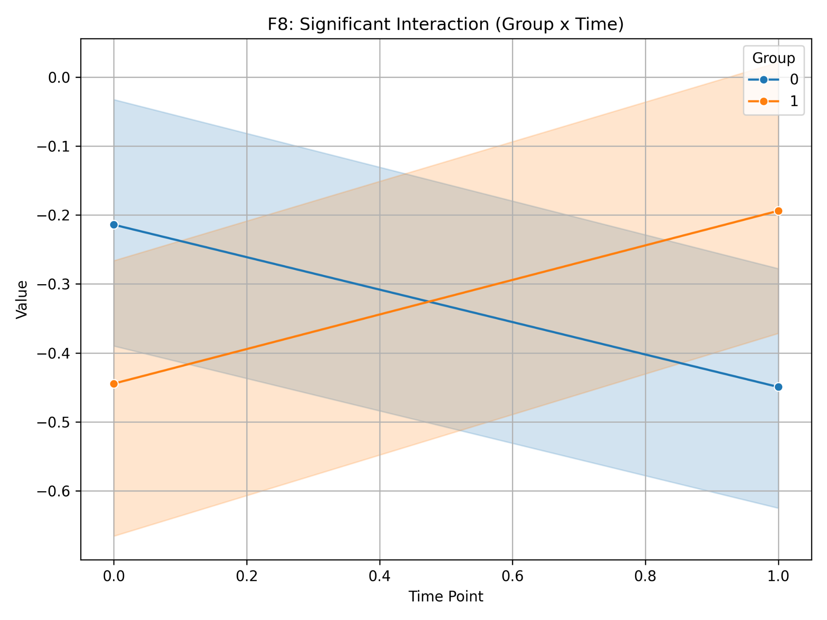
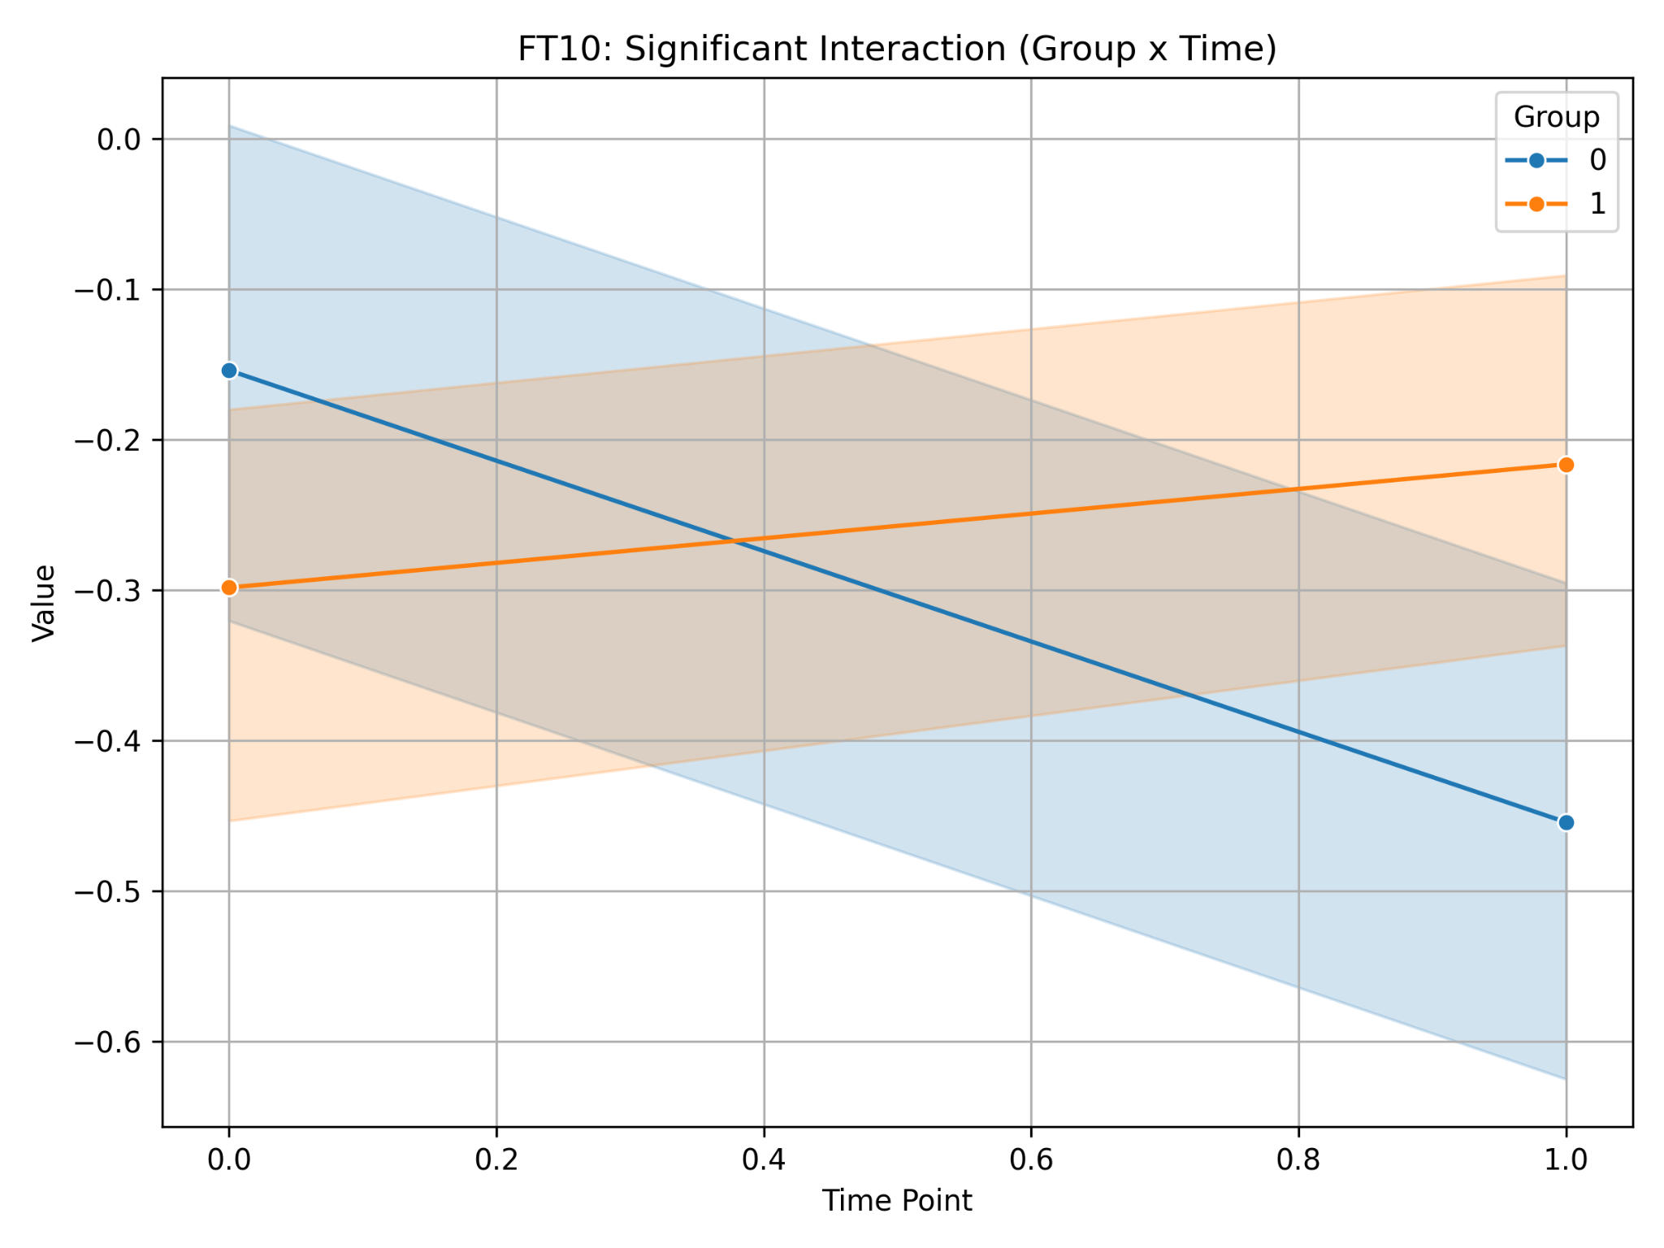
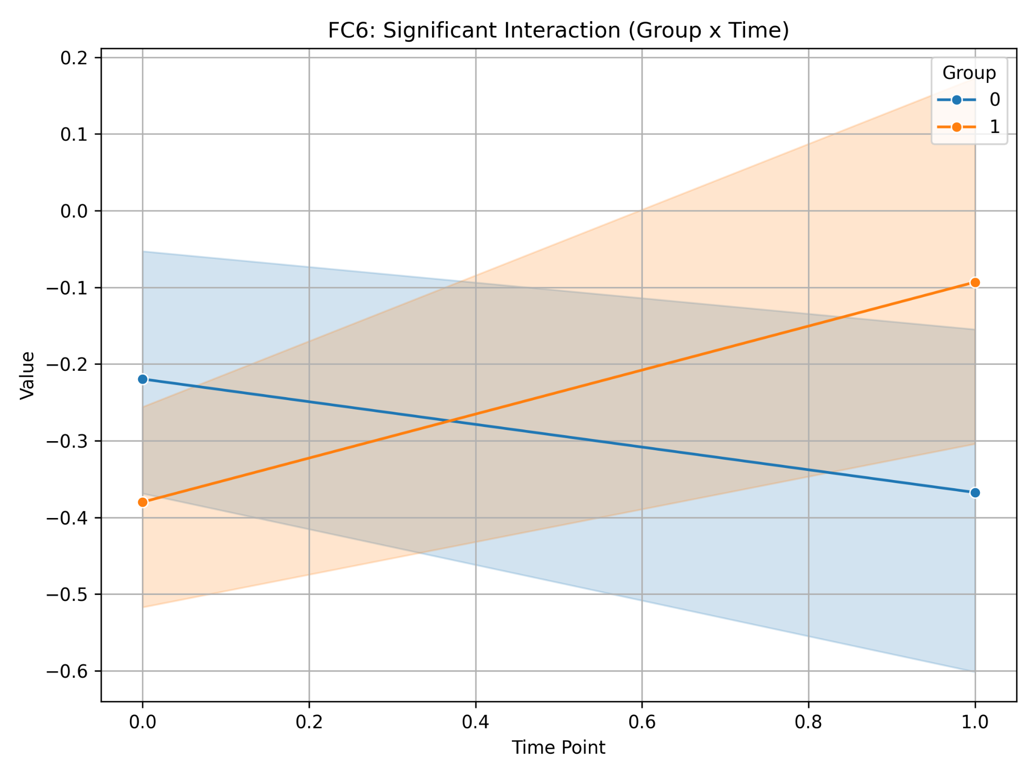
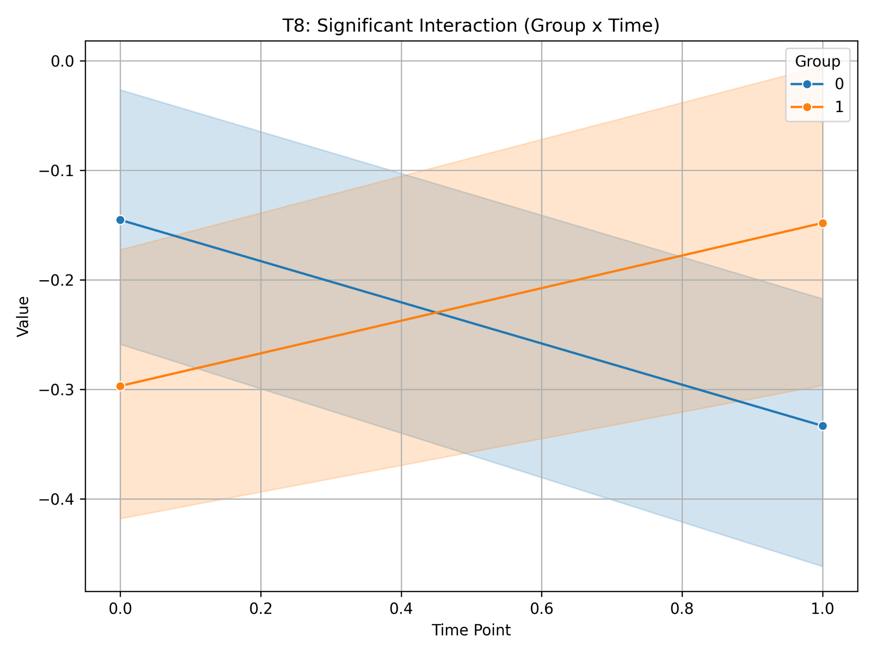
HEP RESTING
In the experimental group, an increase in the HEP amplitude was observed in the quiet state after training, which may indicate a more active processing of internal signals.

Slide 7
EEG with stimuli

Slide 8
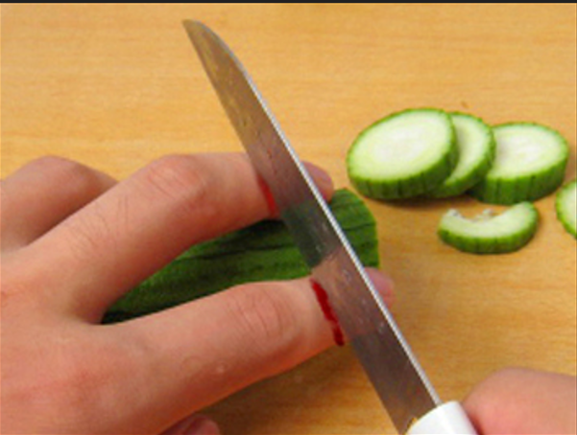
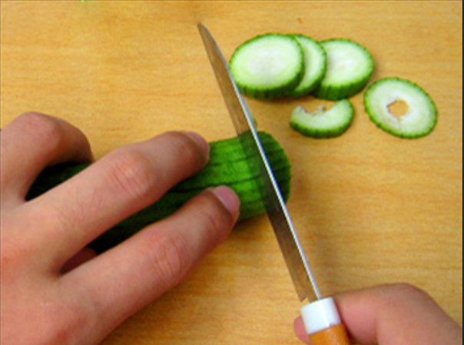
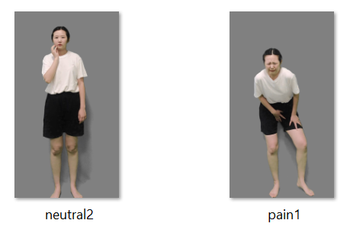
Stimuli
Faces
Digits
Videos
Videos1902

Slide 9
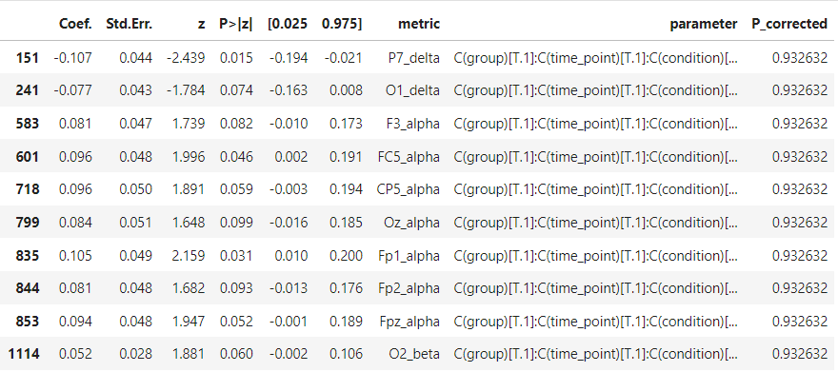
EEG FACES

Slide 10
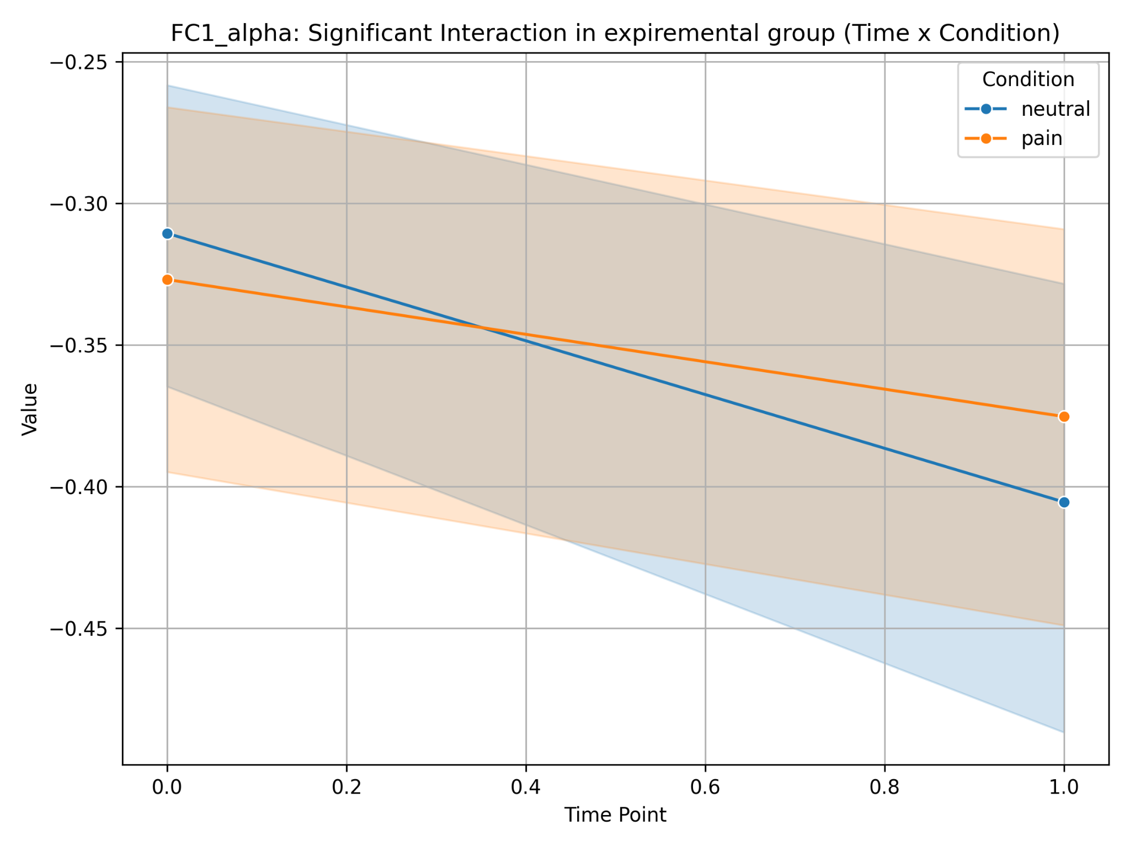
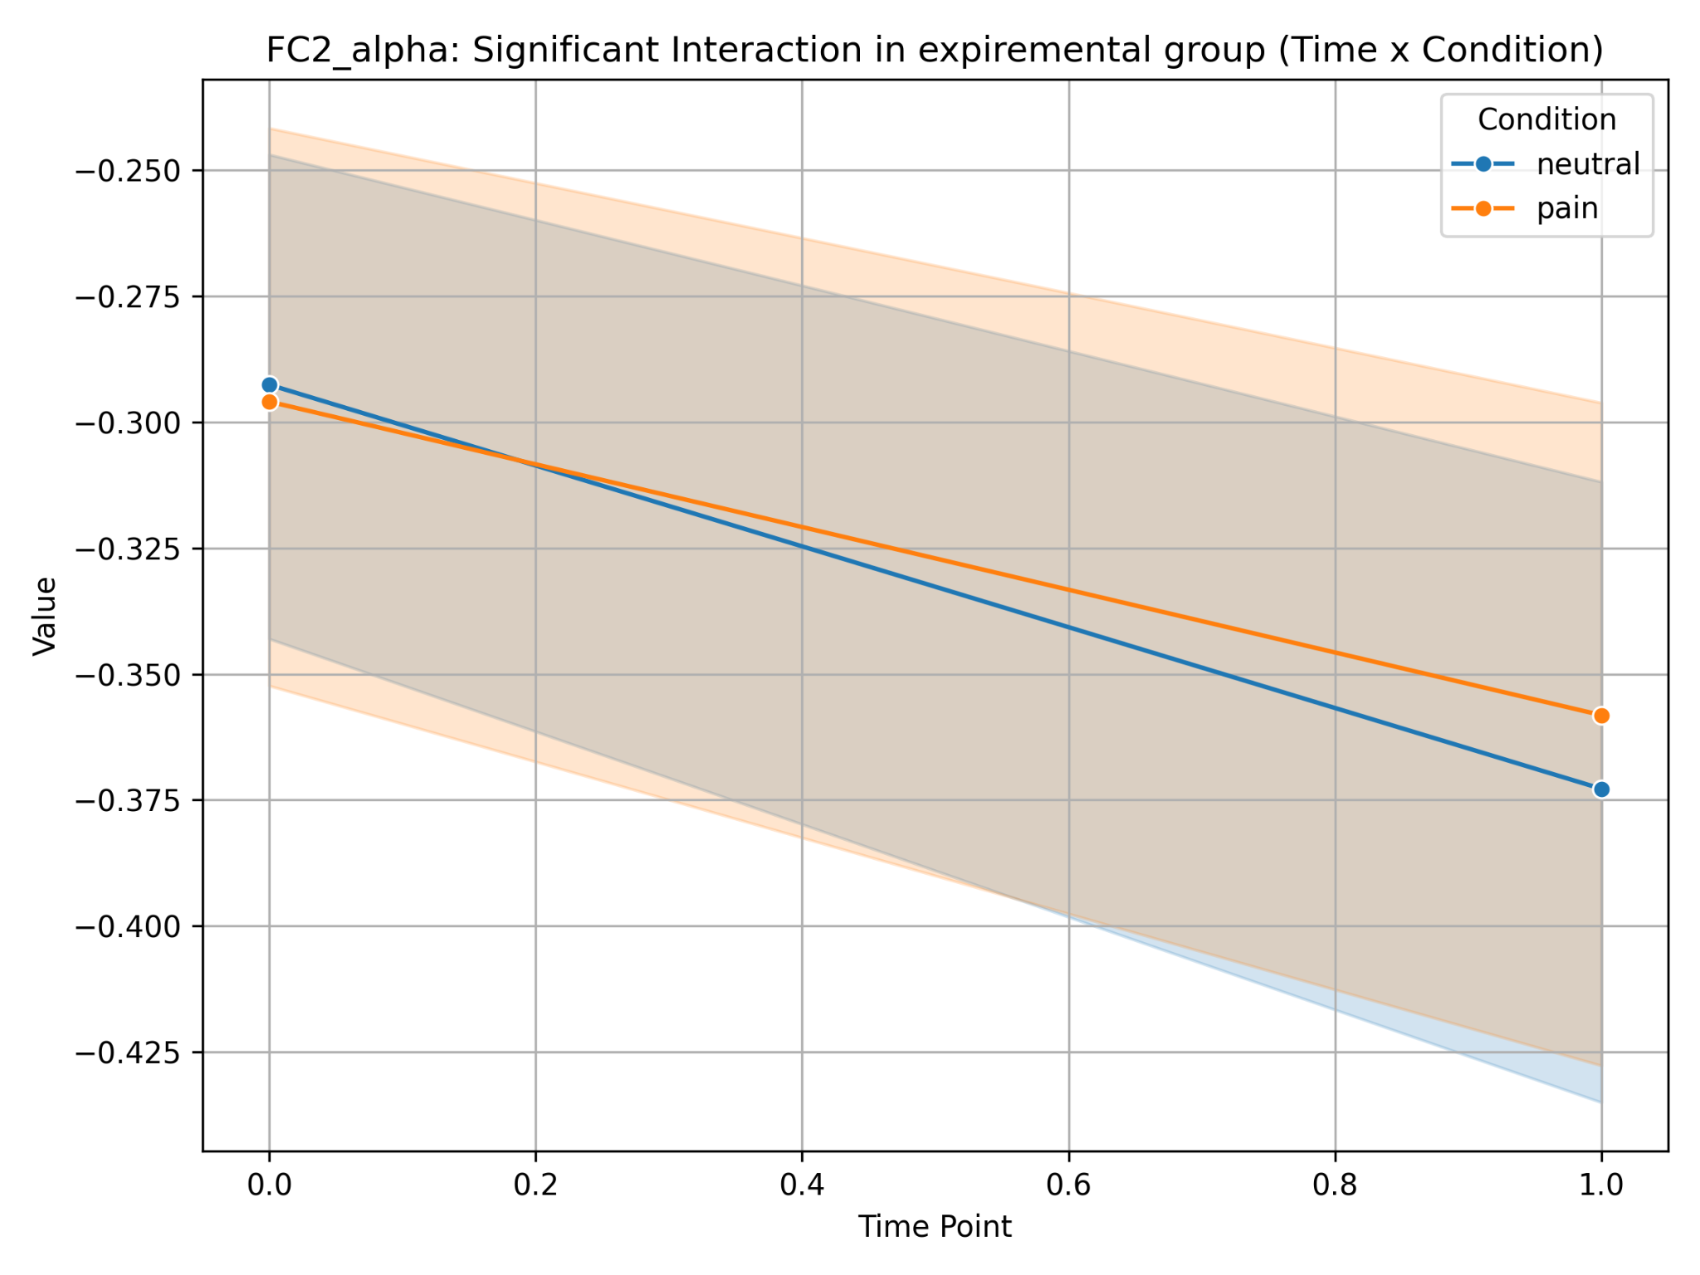
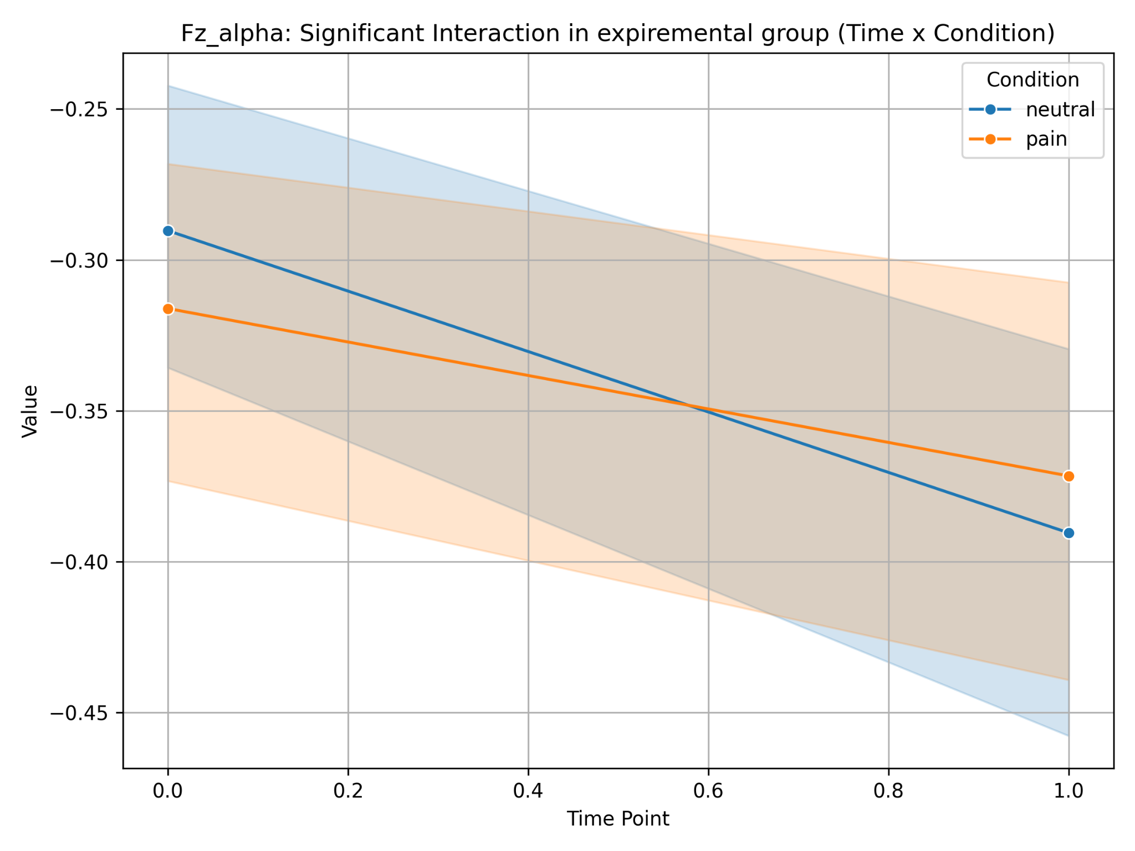
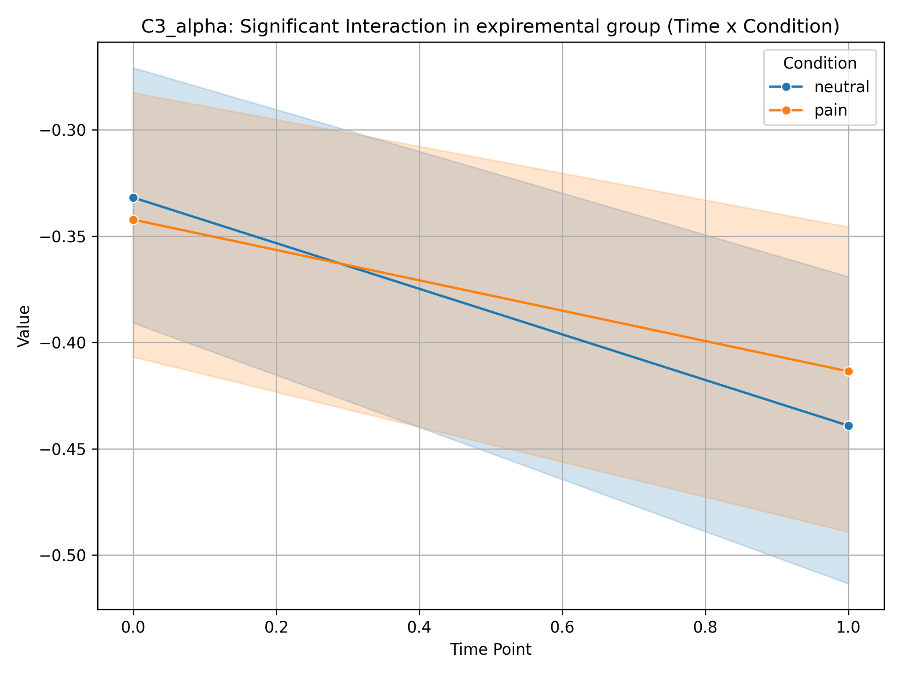
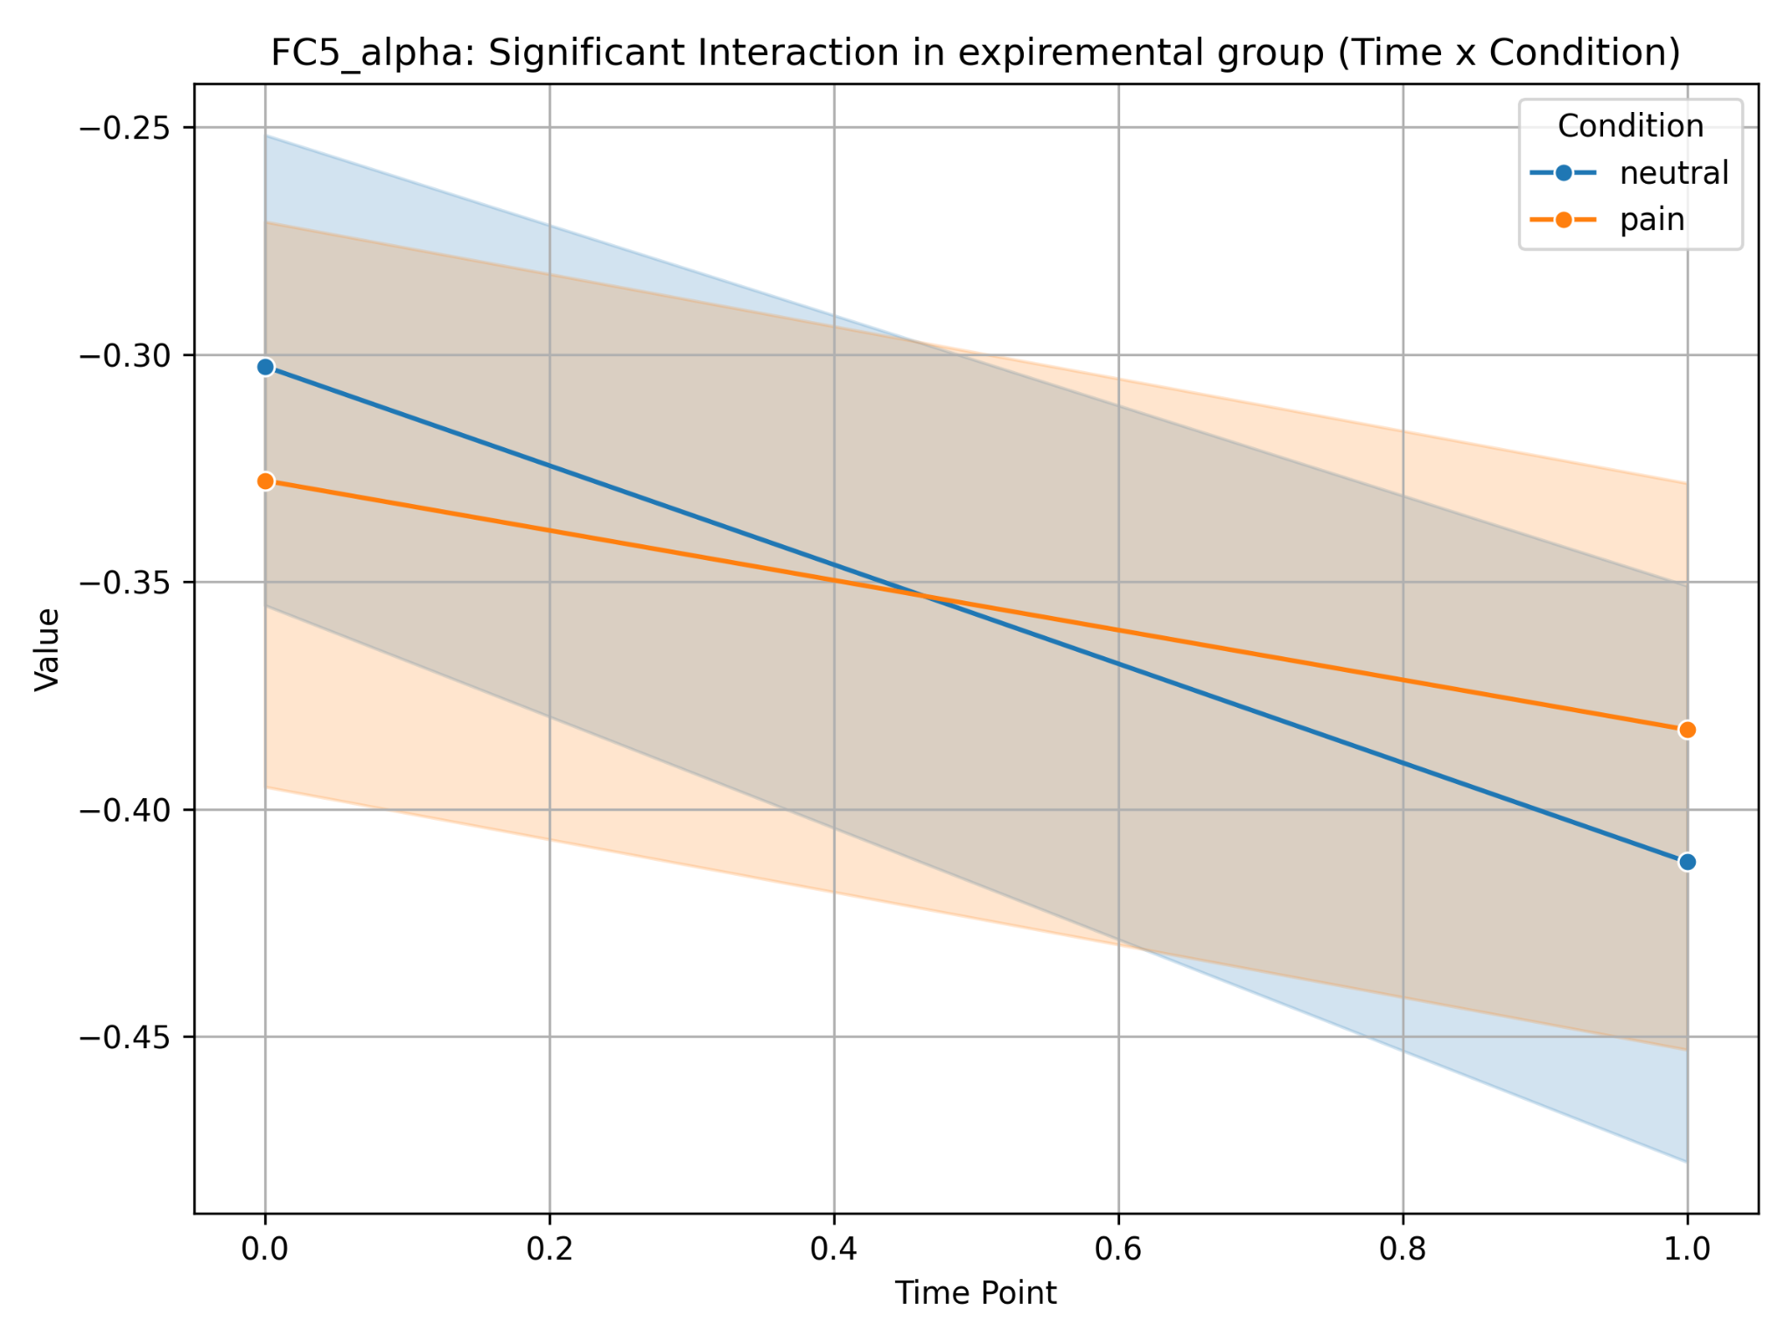
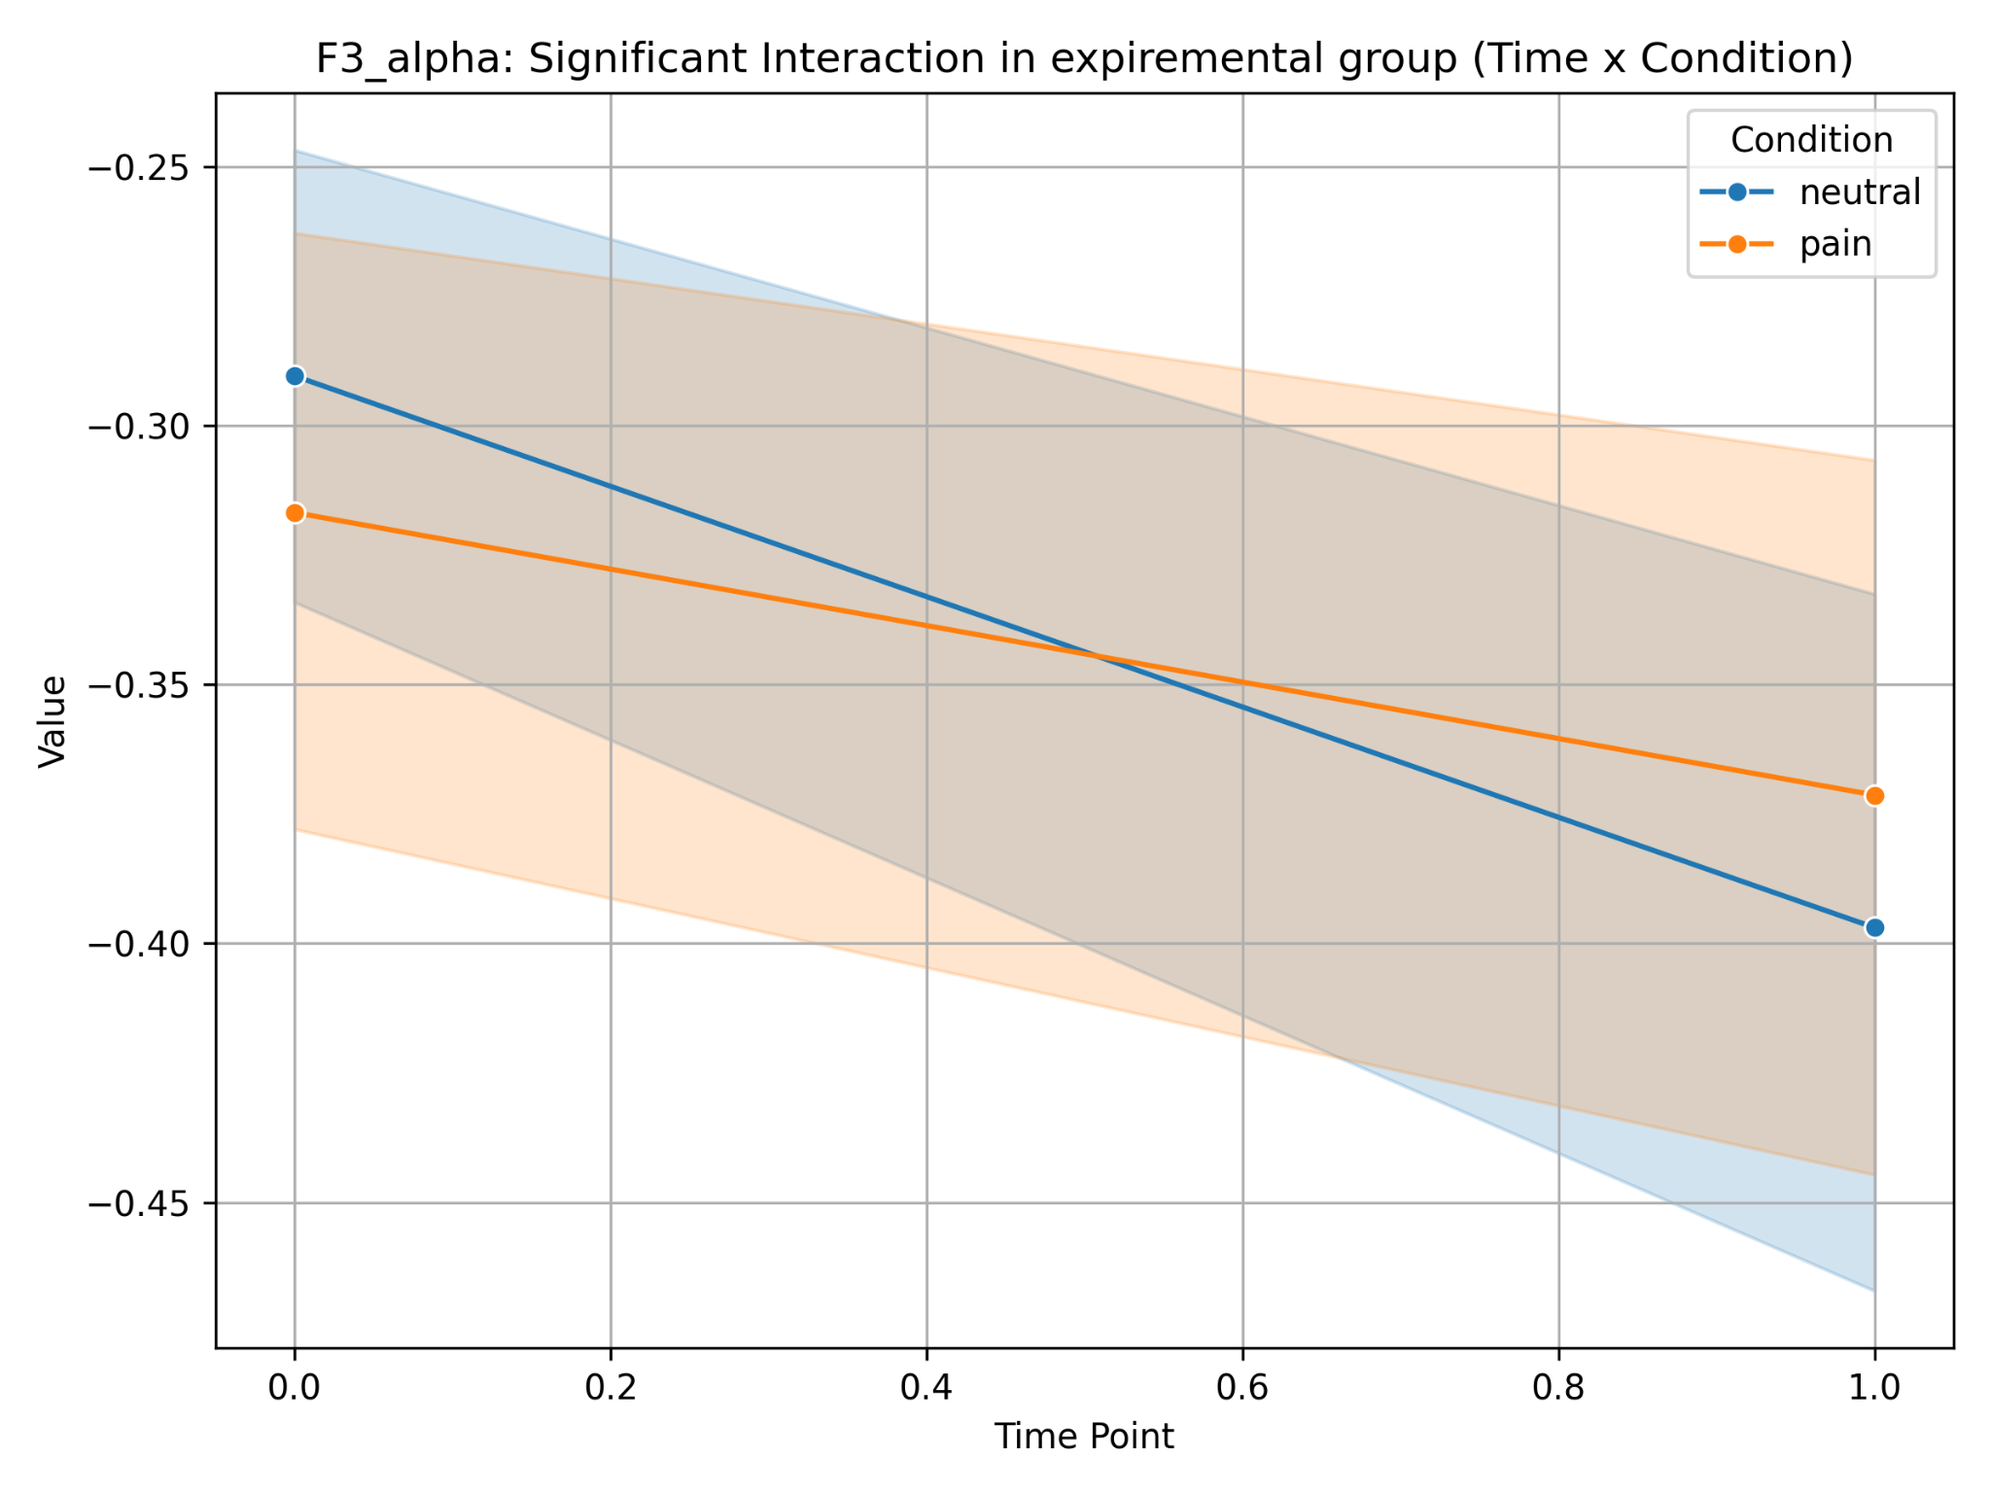
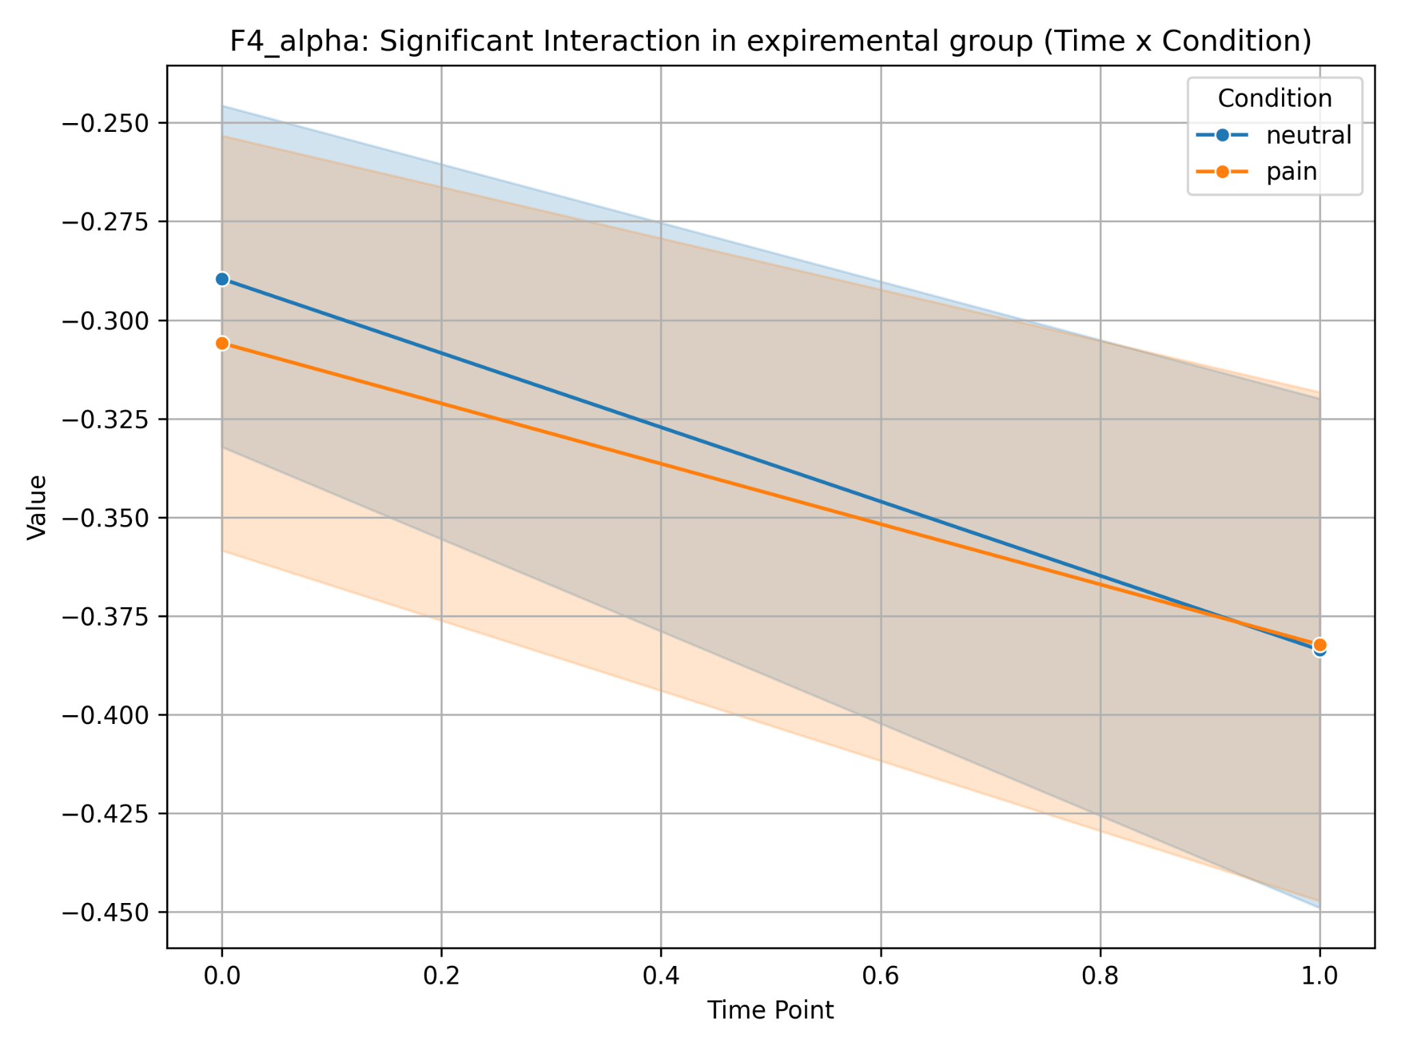
EEG FACES
Experimental
In the training participants, when viewing stimuli (faces), mu-suppression increased after the intervention.
Less mu suppression on pain stimuli may indicate more adaptive pain processing (less involvement of the mirror neural system in the empathic response).
Stronger mu suppression on neutral stimuli may mean that the training increased sensitivity to neutral sensory stimuli or improved the ability to focus on motor or interoceptive processes in the neutral state.

Slide 11
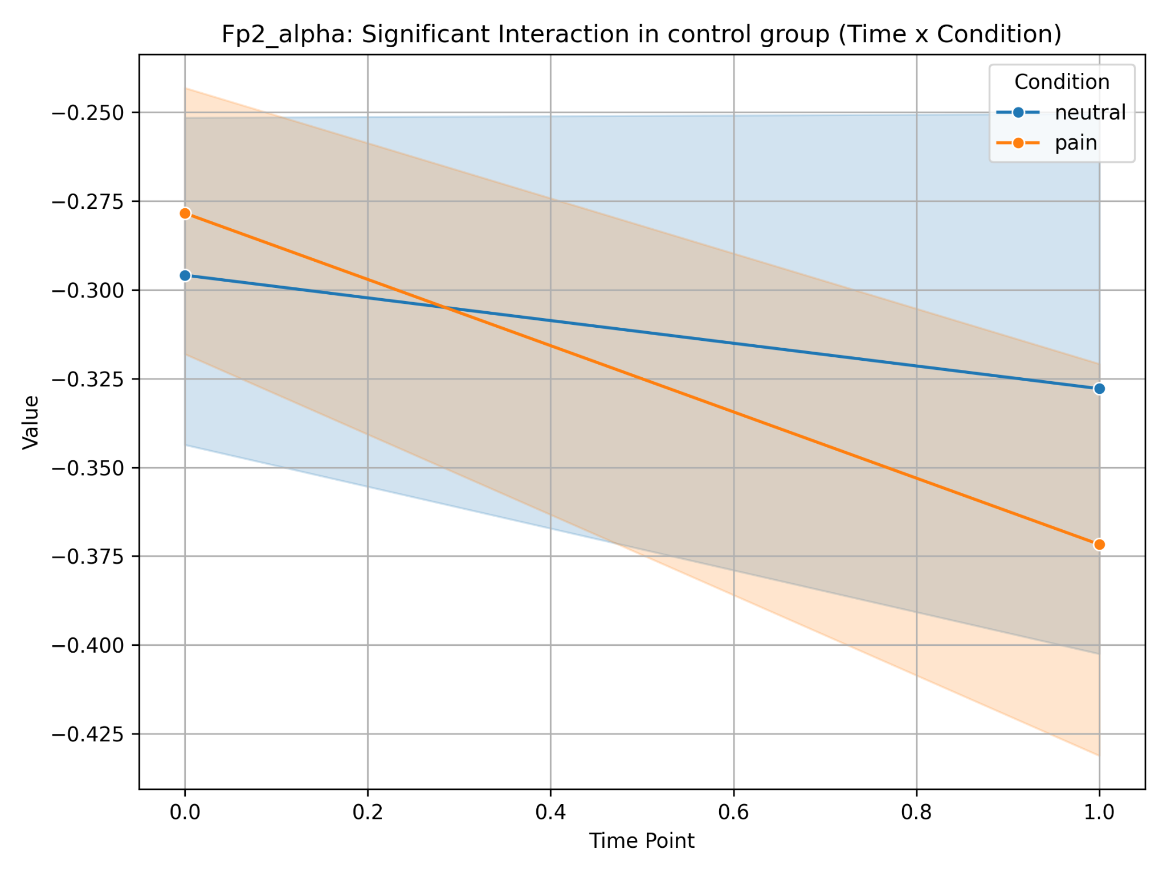
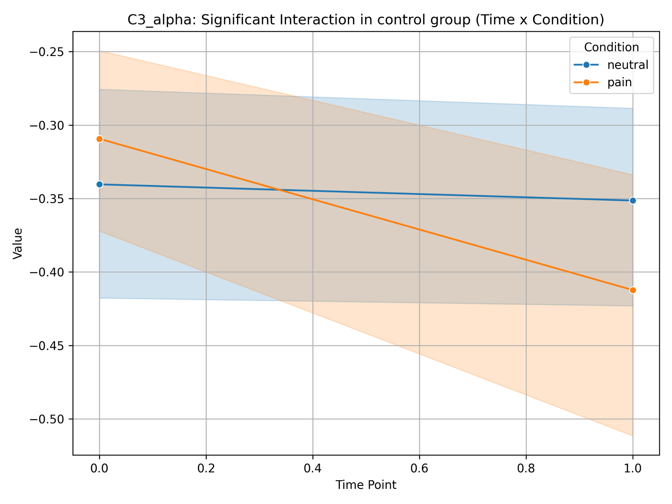
EEG FACES
Control
In the control group, after 5 days of watching videos, increased mu-suppression with pain stimuli (faces). On neutral stimuli, the changes are less pronounced, which may reflect the absence of significant changes in sensorimotor activity.

Slide 12
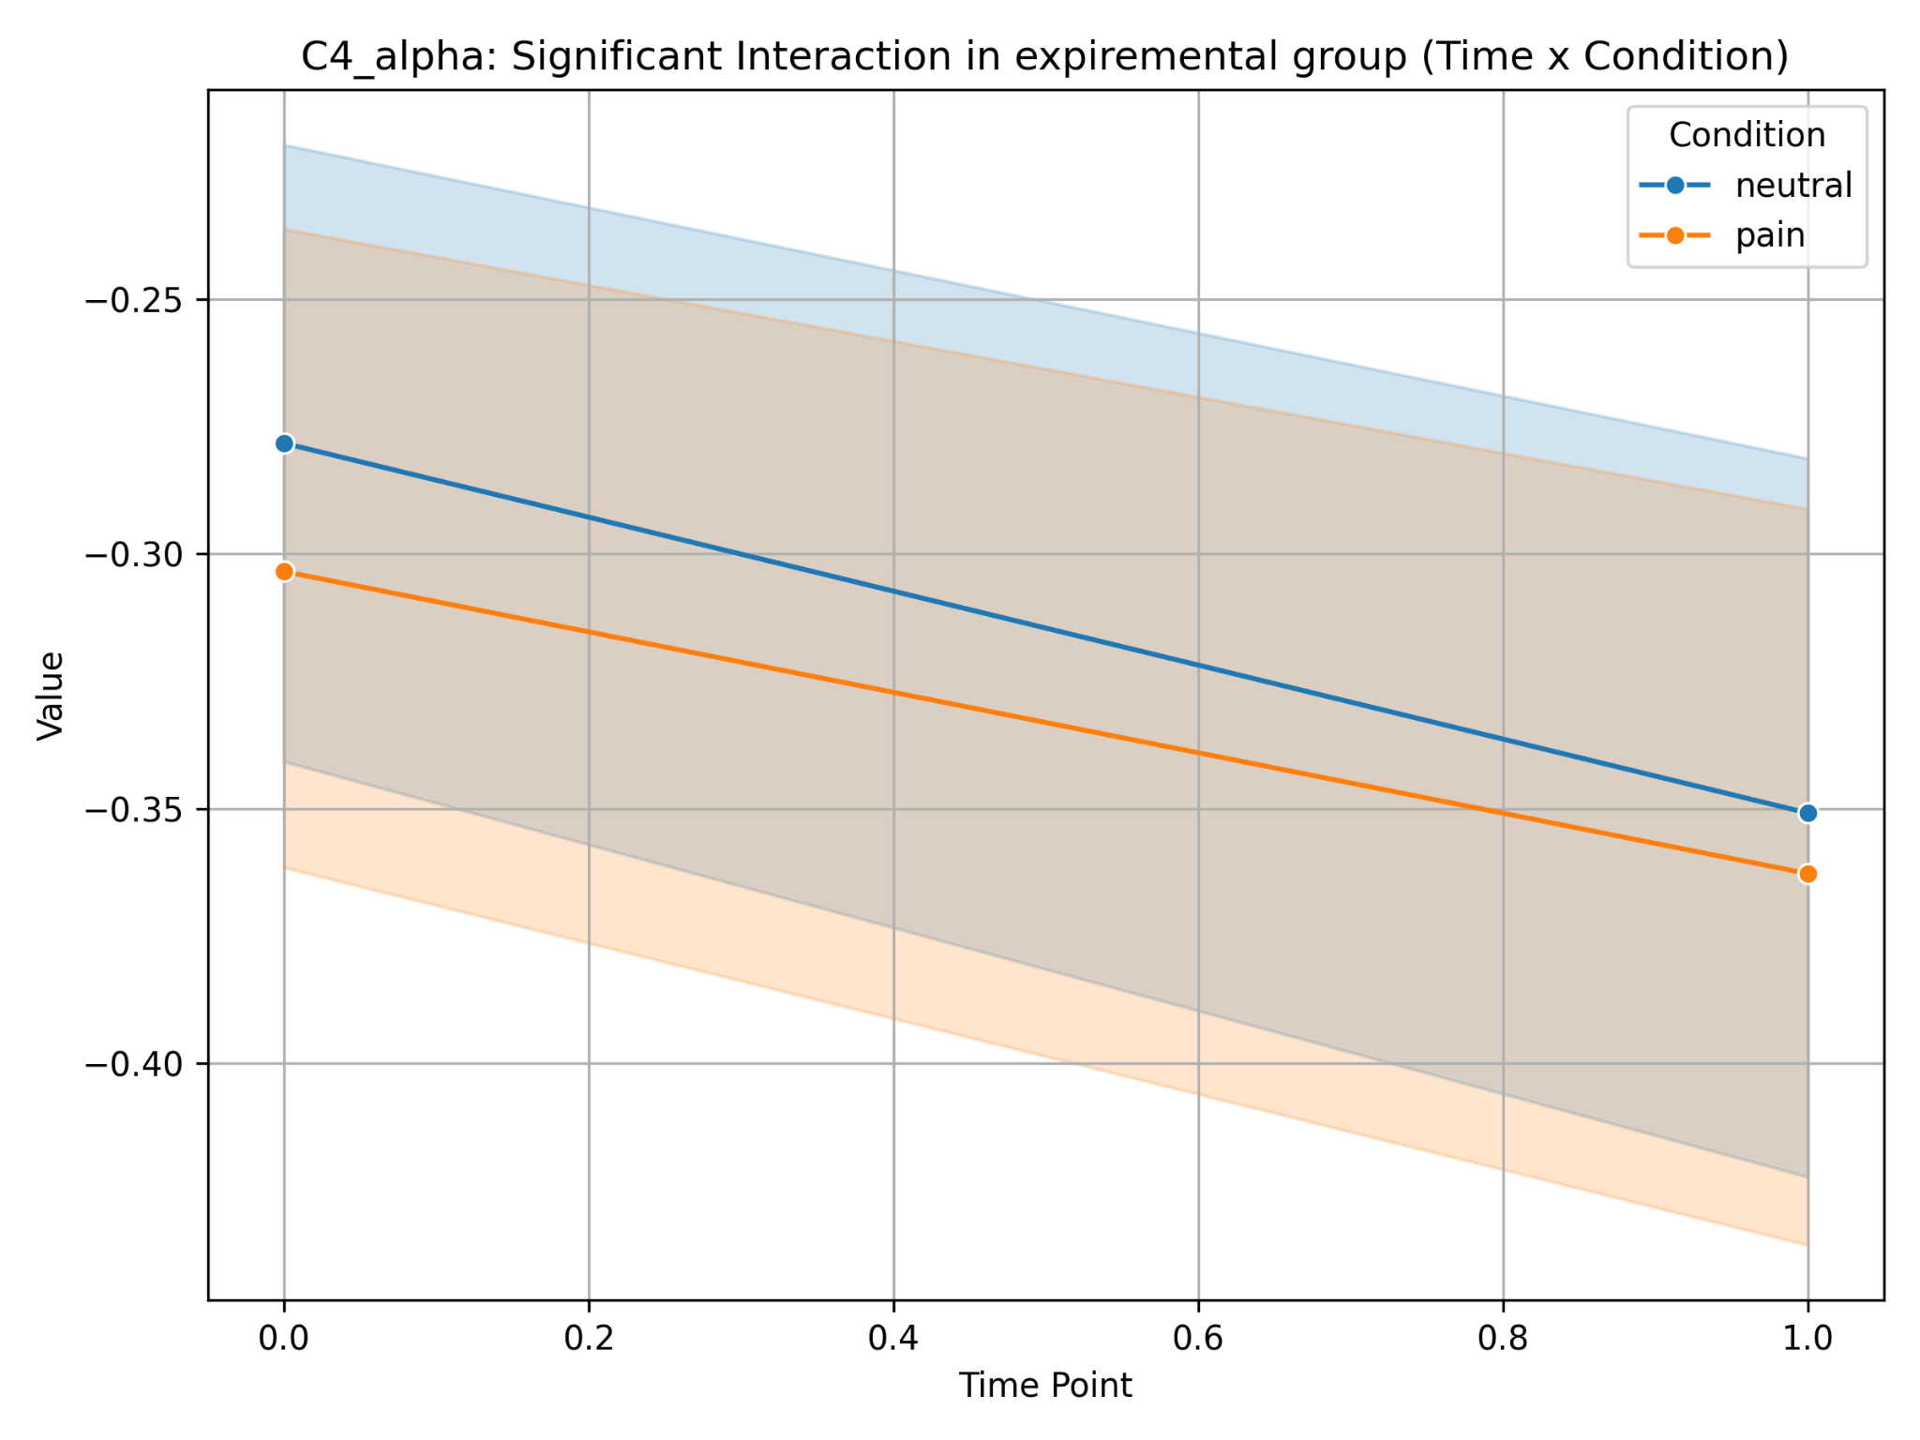
EEG DIGITS
Experimental
After interoceptive training in the experimental group, mu suppression increases on both pain and neutral stimuli (digits), which may indicate an increase in sensorimotor sensitivity or involvement.

Slide 13
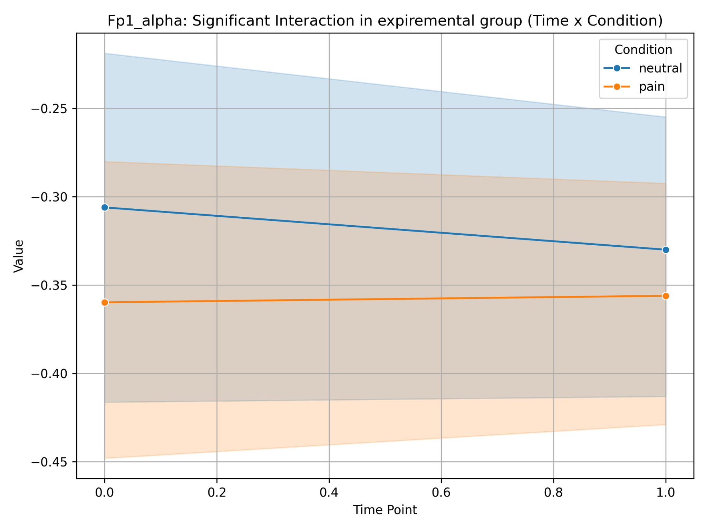
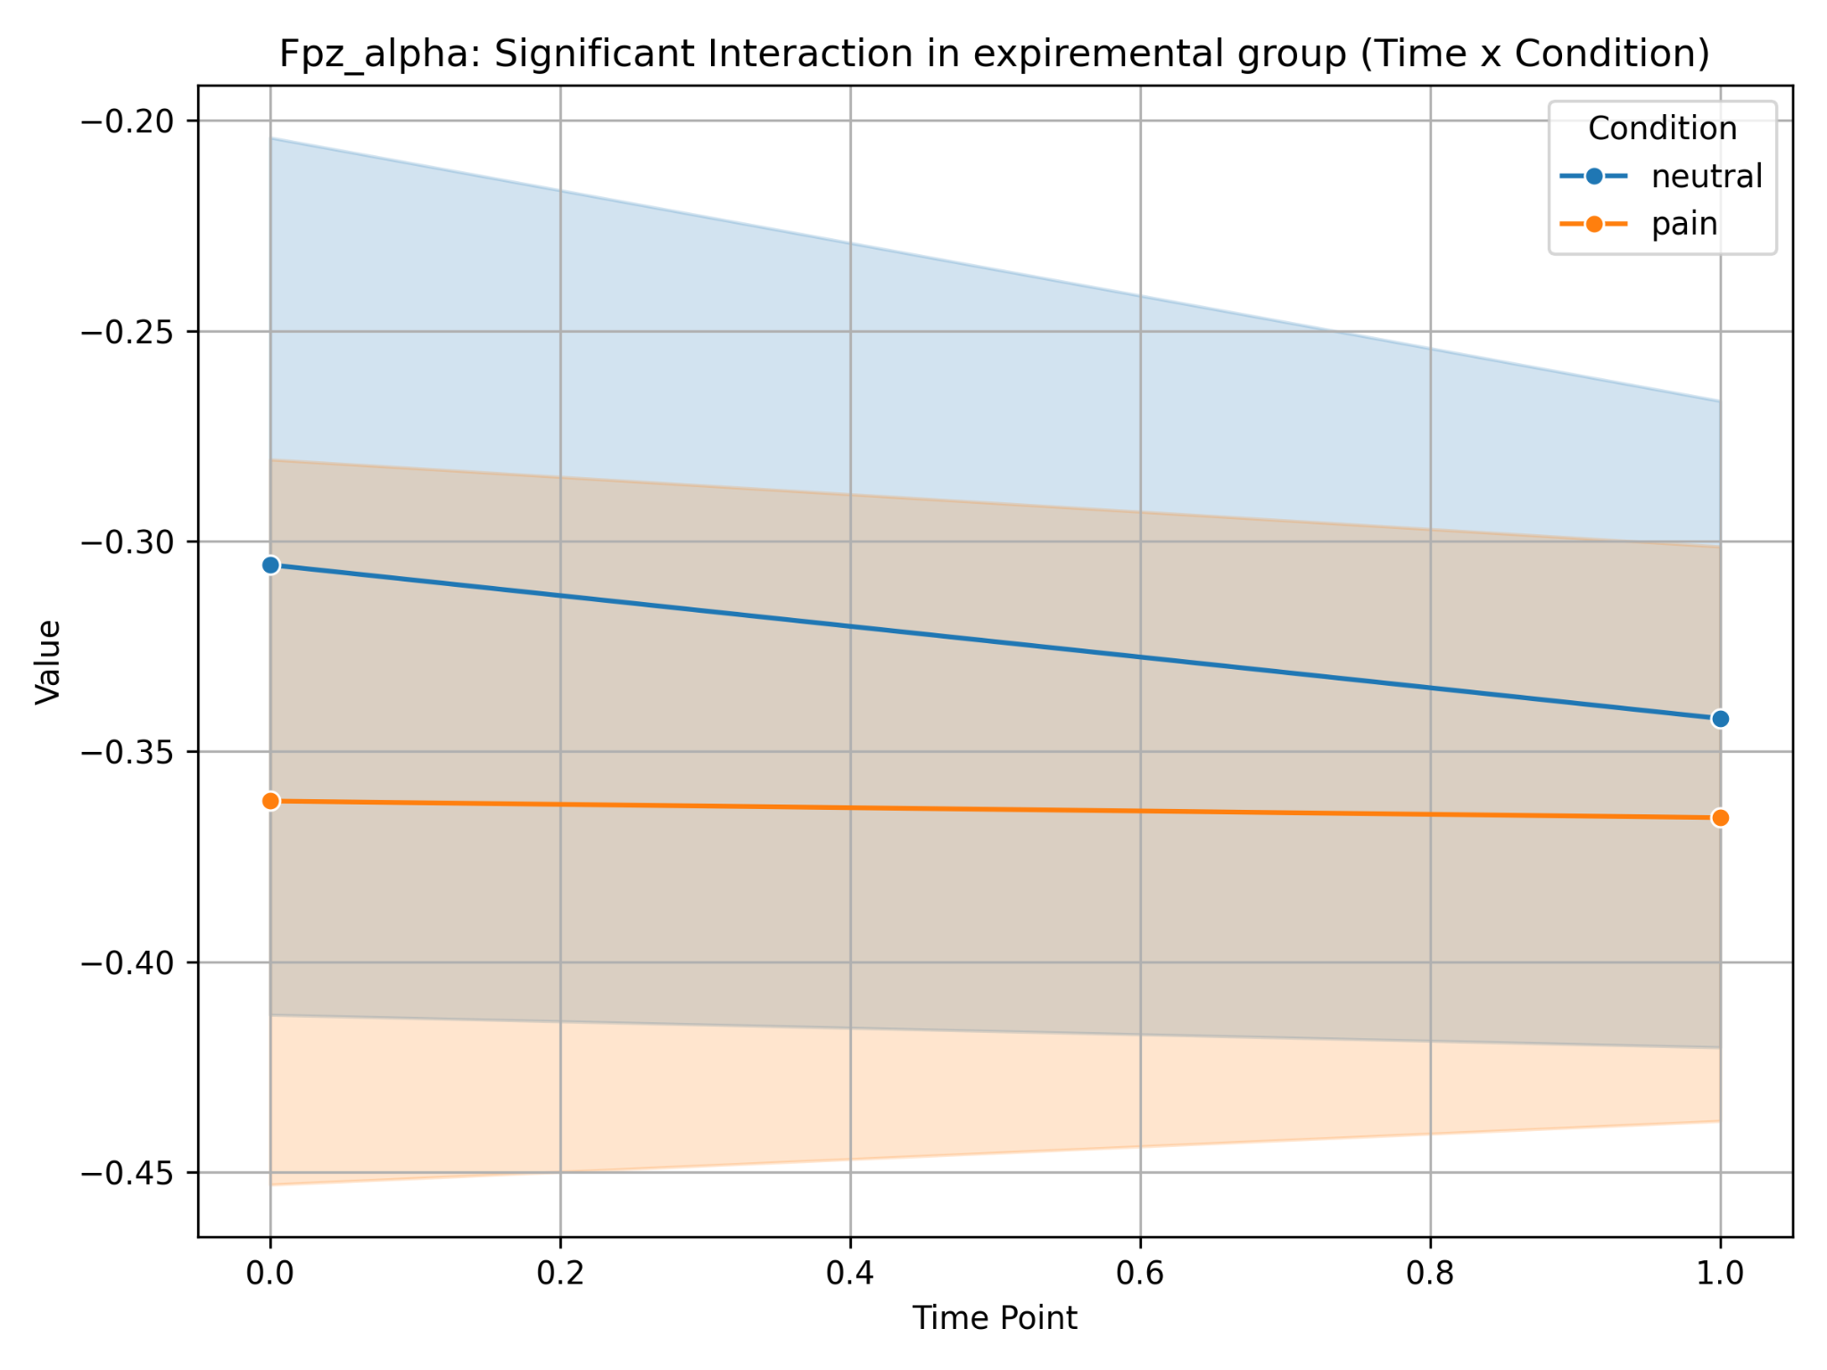
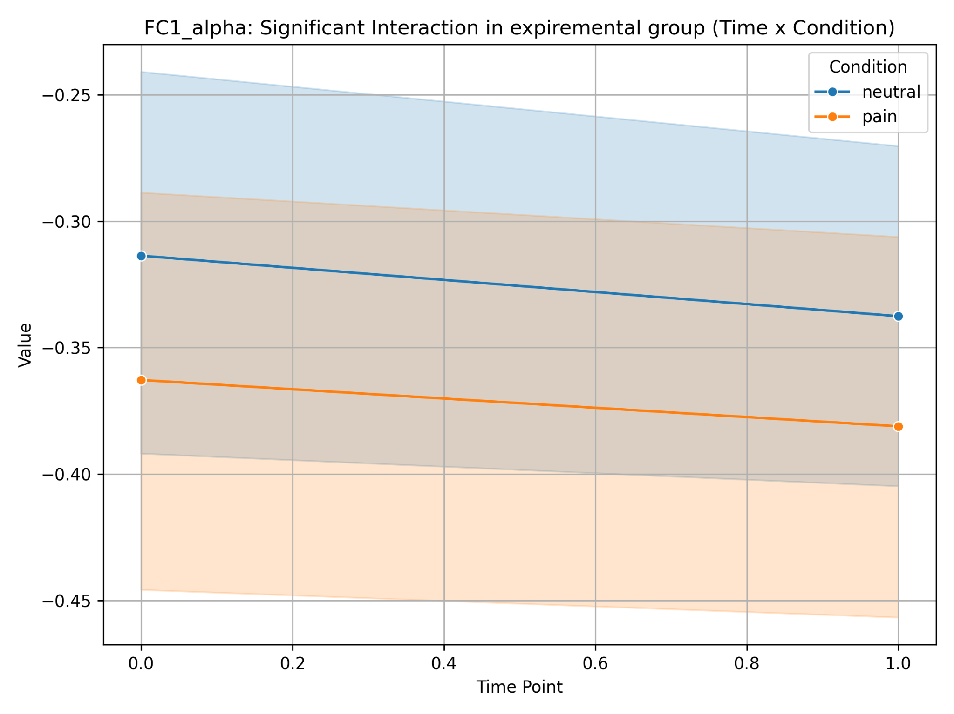
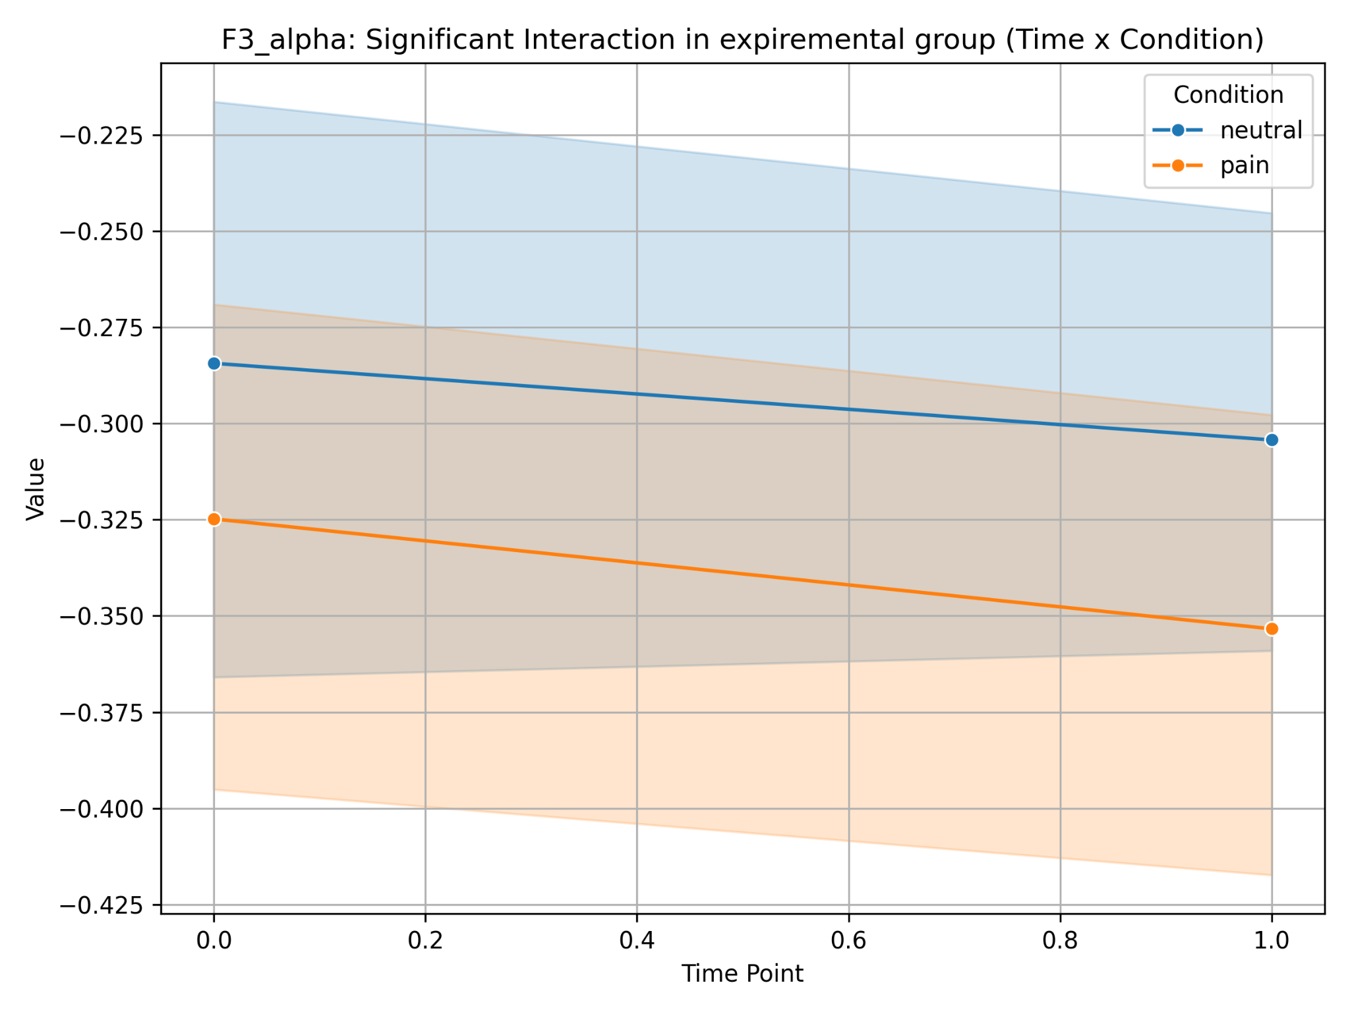
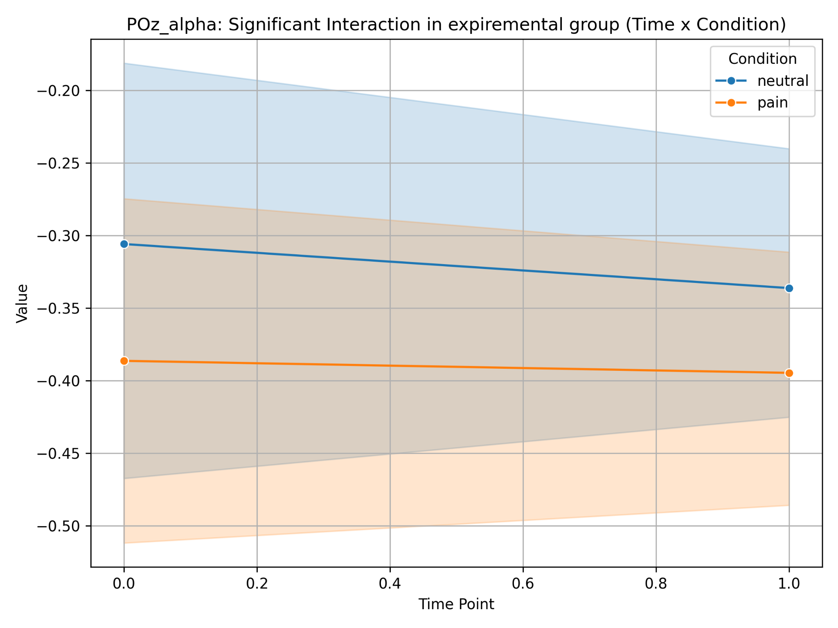
EEG VIDEOS1902
Experimental

Slide 14
HEP with stimuli

Slide 15
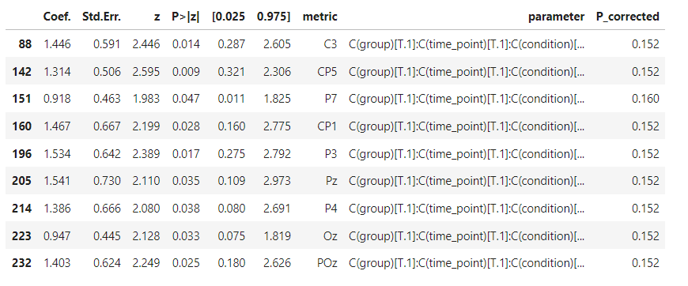
HEP FACES

Slide 16
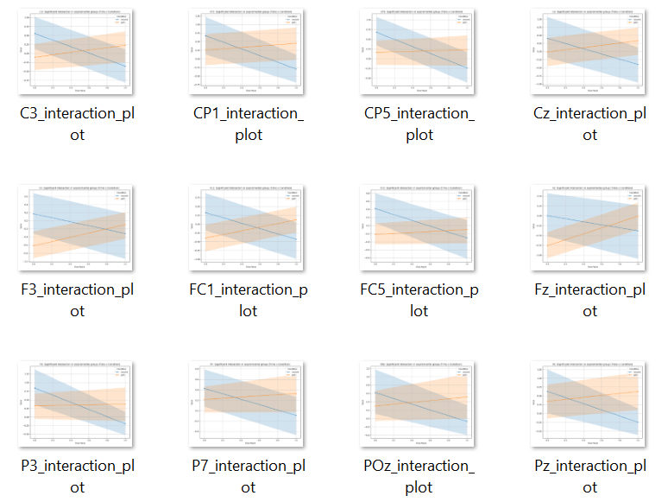
HEP FACES
Experimental
Increased HEP may indicate more active processing of pain stimuli (faces) after interoceptive training, which may be associated with increased attention or intersensory integration.
A decrease in HEP for neutral stimuli may reflect a reallocation of attention resources, which after training are directed to processing more significant stimuli, such as pain.

Slide 17
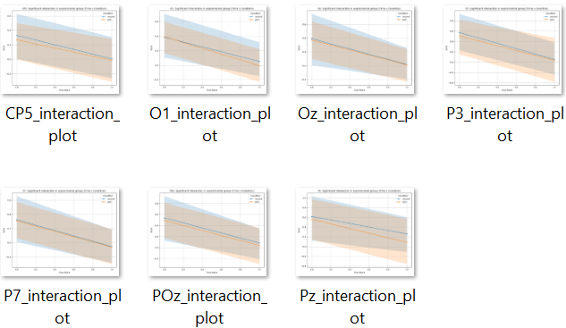
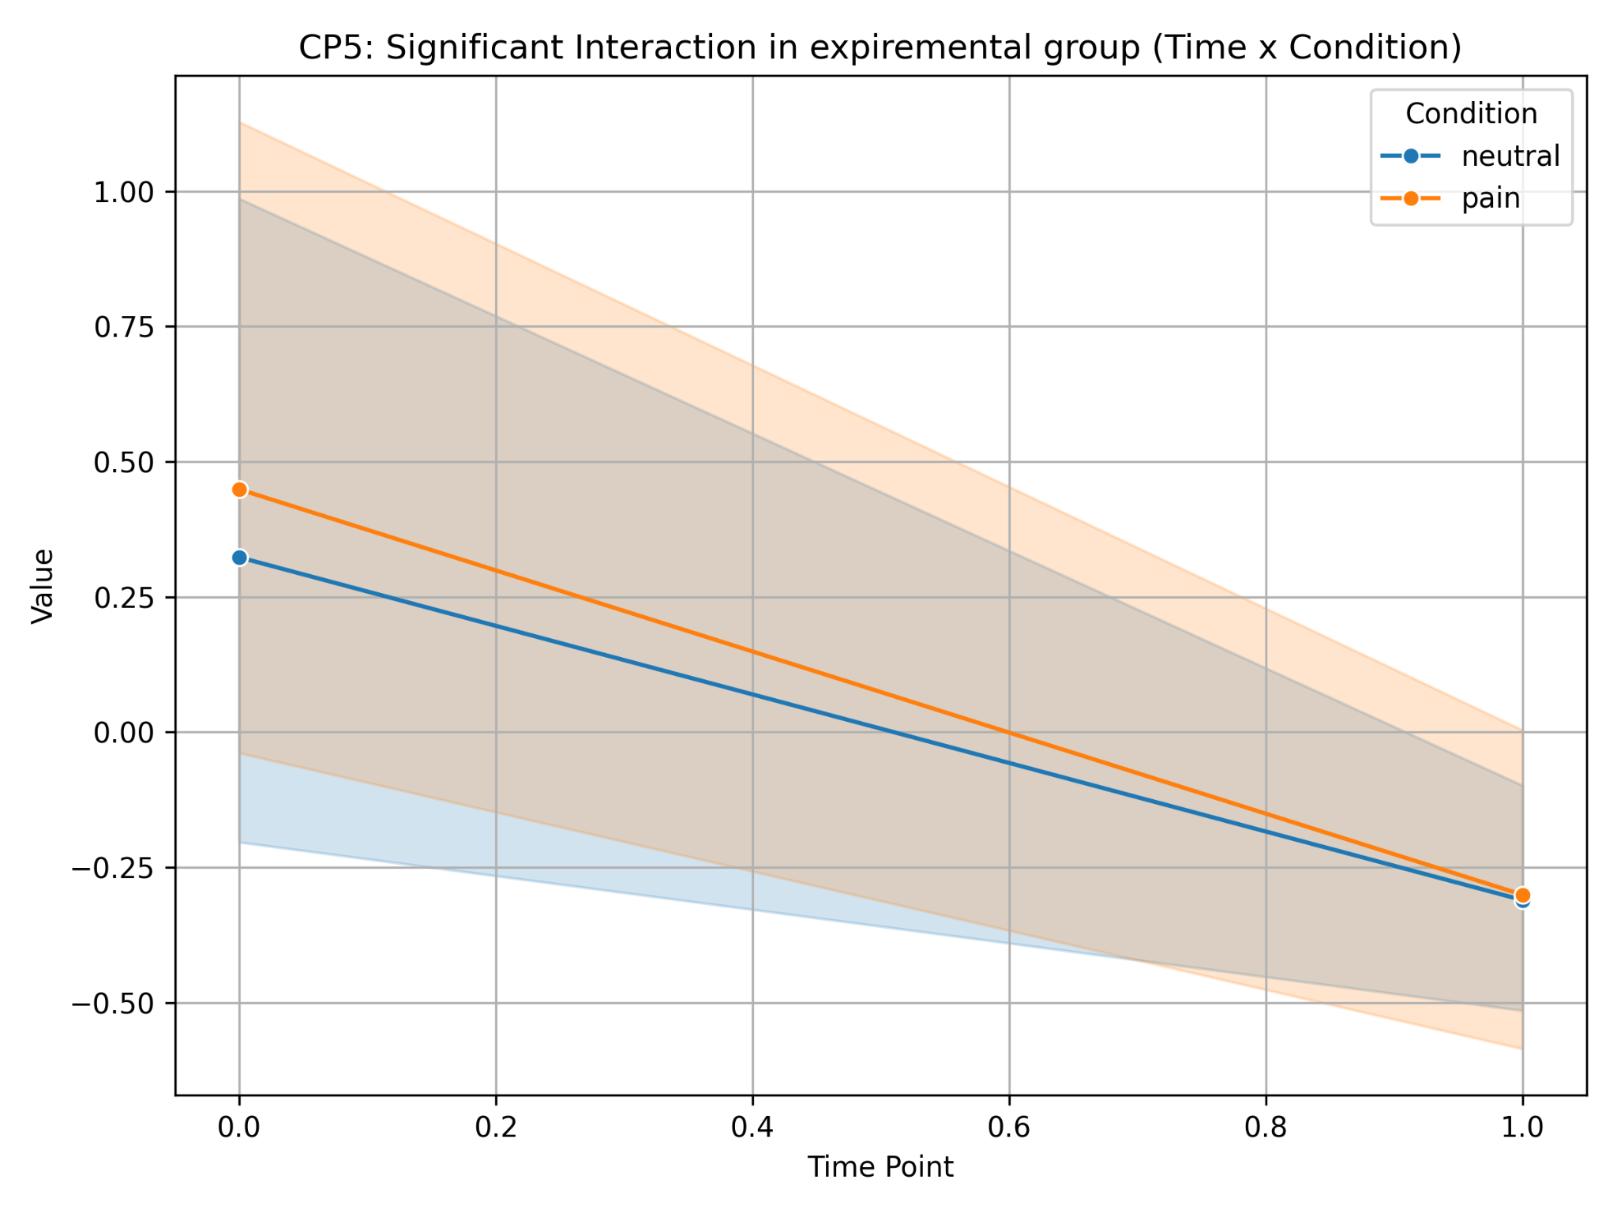
Experimental group
VIDEOS1902
VIDEOS
In the experimental group, there was a general decrease in HEP for all stimuli, with a more pronounced effect for pain stimuli. This may indicate increased processing of pain signals in the context of interoceptive training.

Slide 18
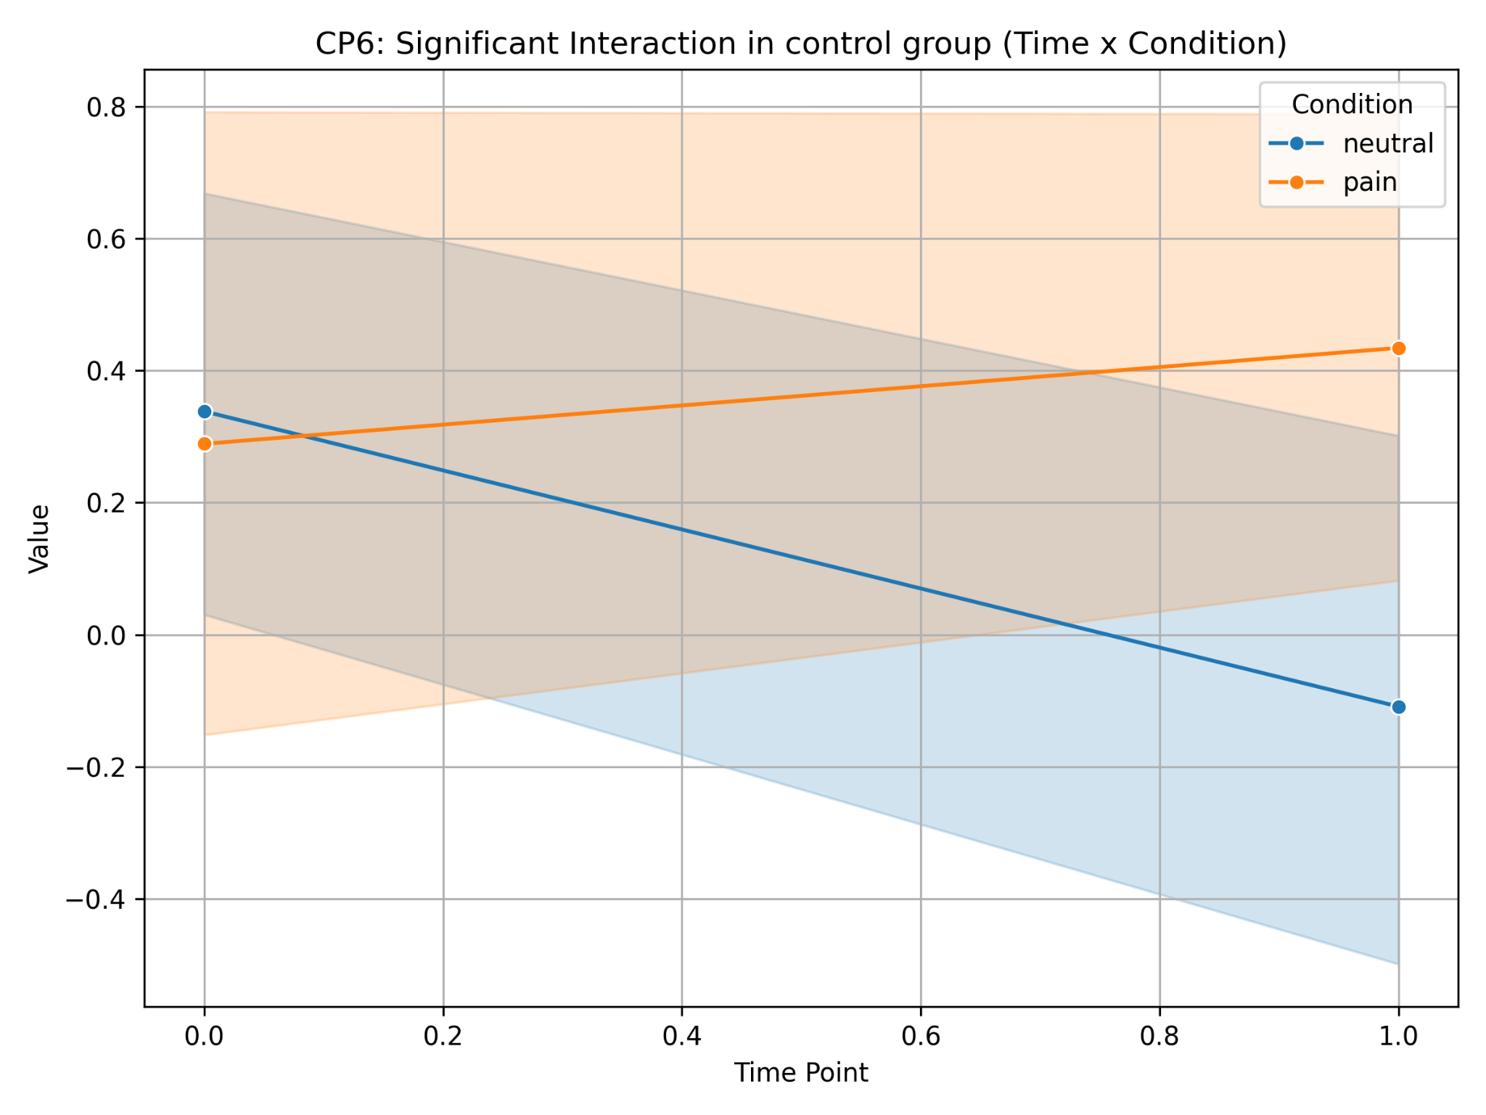
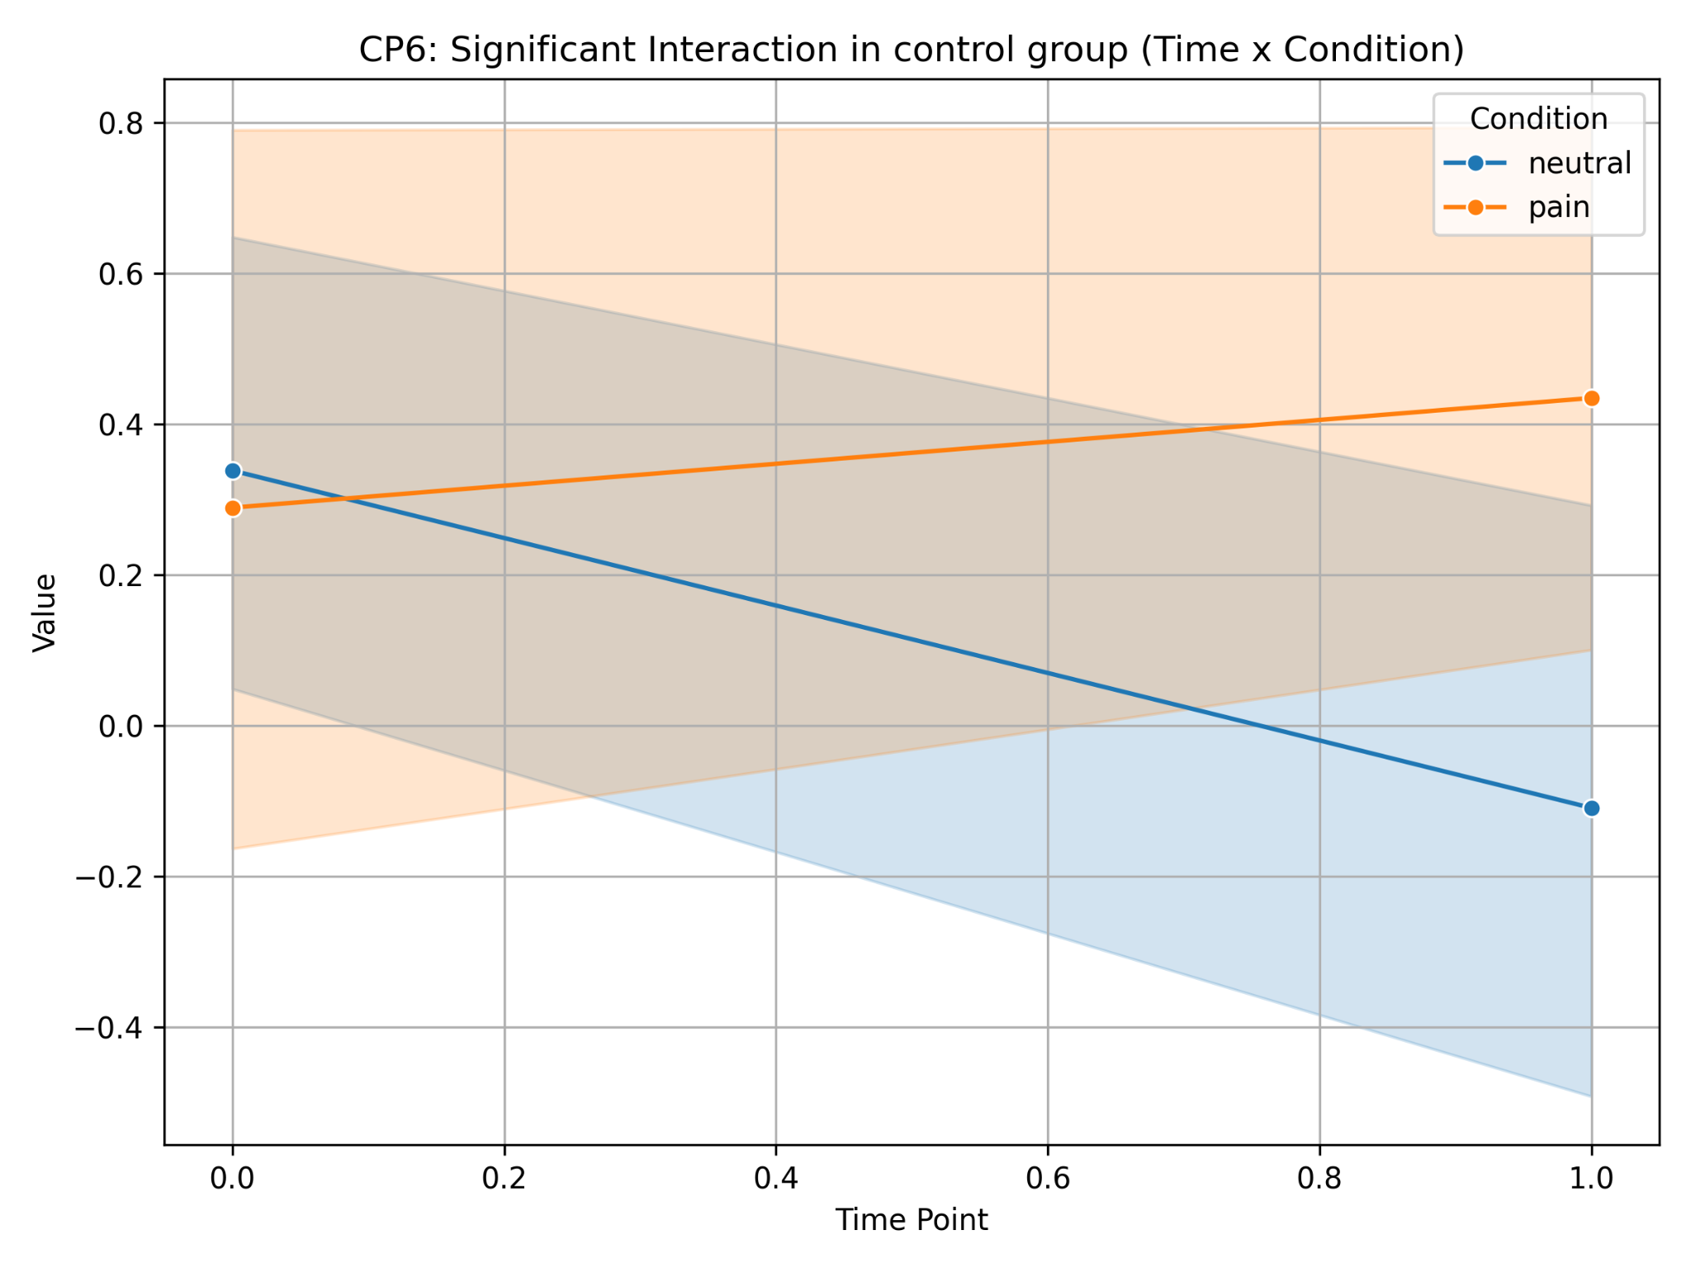
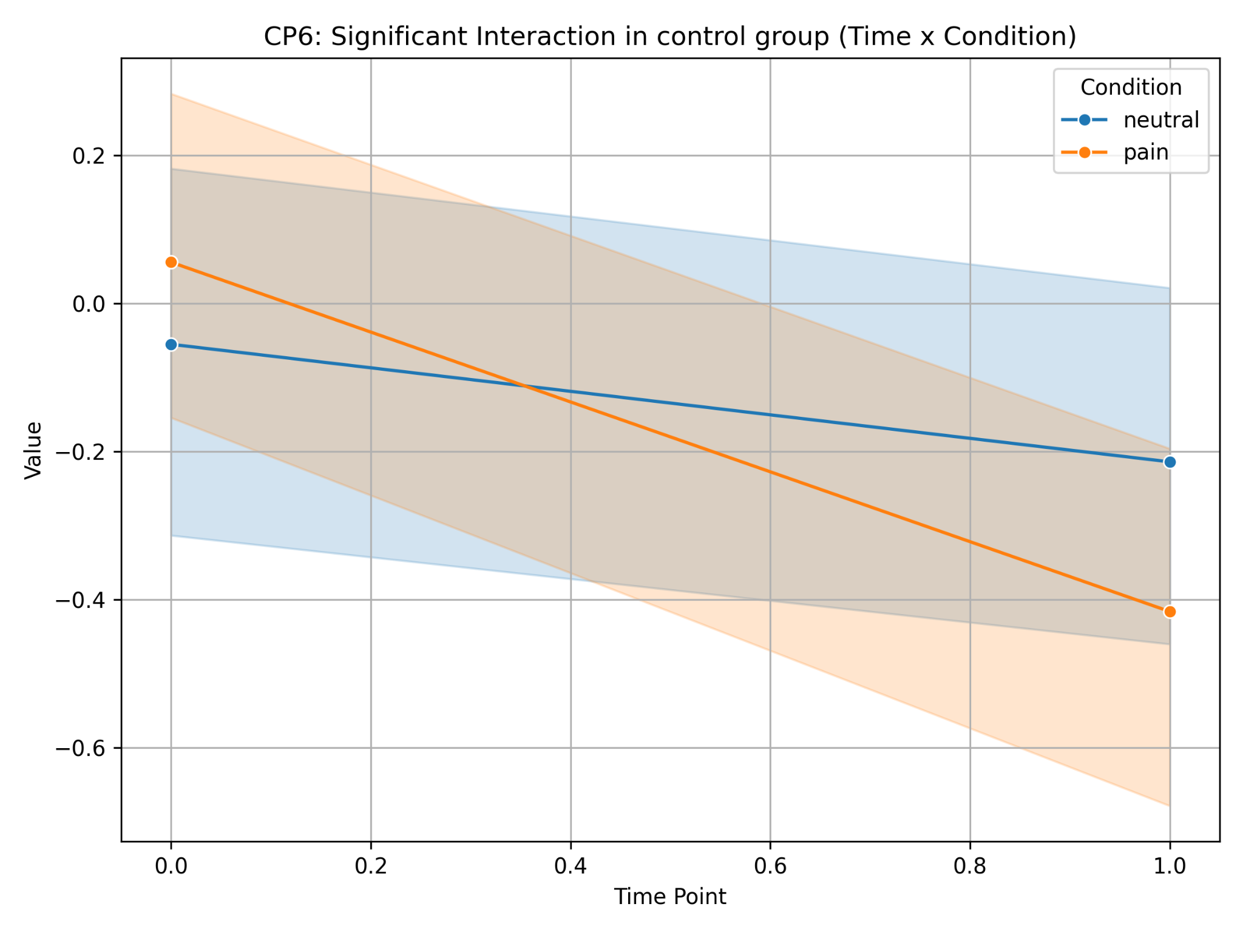
Control group
DIGITS
VIDEOS1902
VIDEOS
In the control group, there was an increase in HEP for pain stimuli (digits and video1902) and a decrease for neutral stimuli without training. This may reflect natural changes in the processing of stimuli due to repeated presentation.
Reduced HEP (video stimuli), stronger pain stimuli

